Slide 1
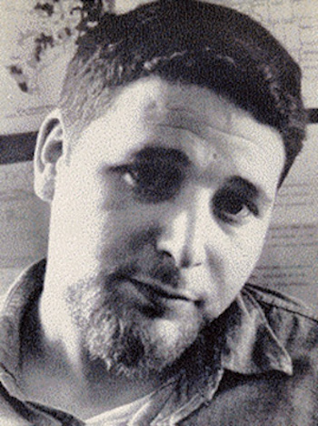
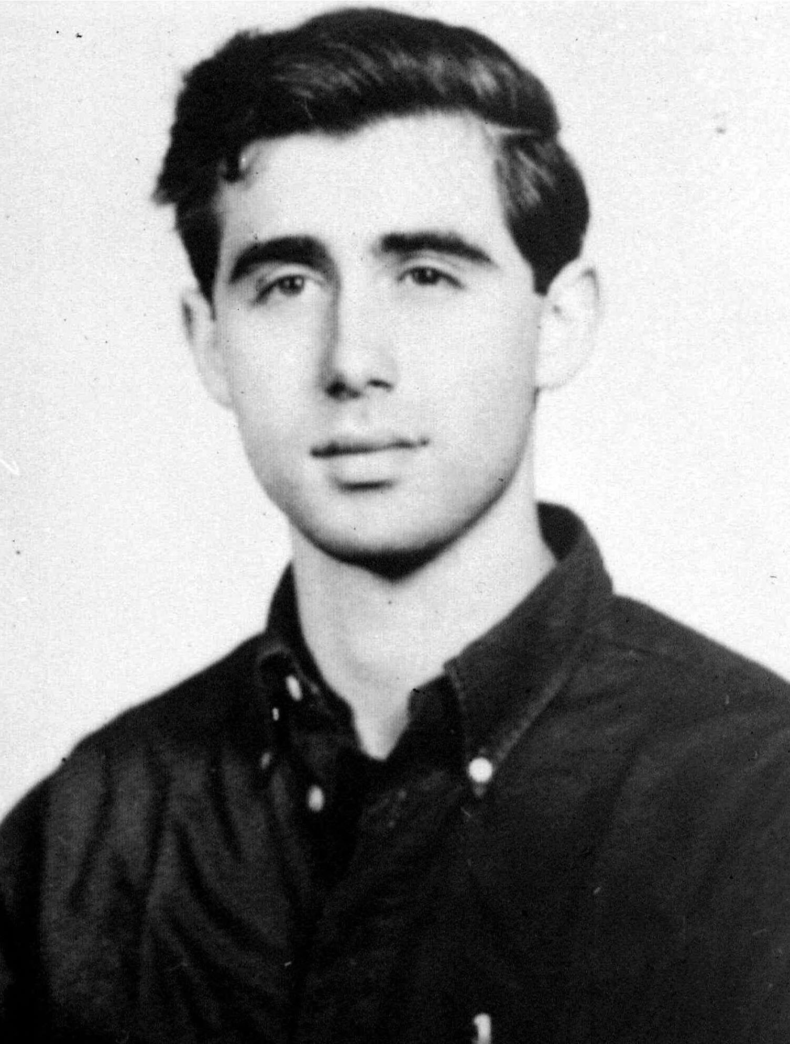
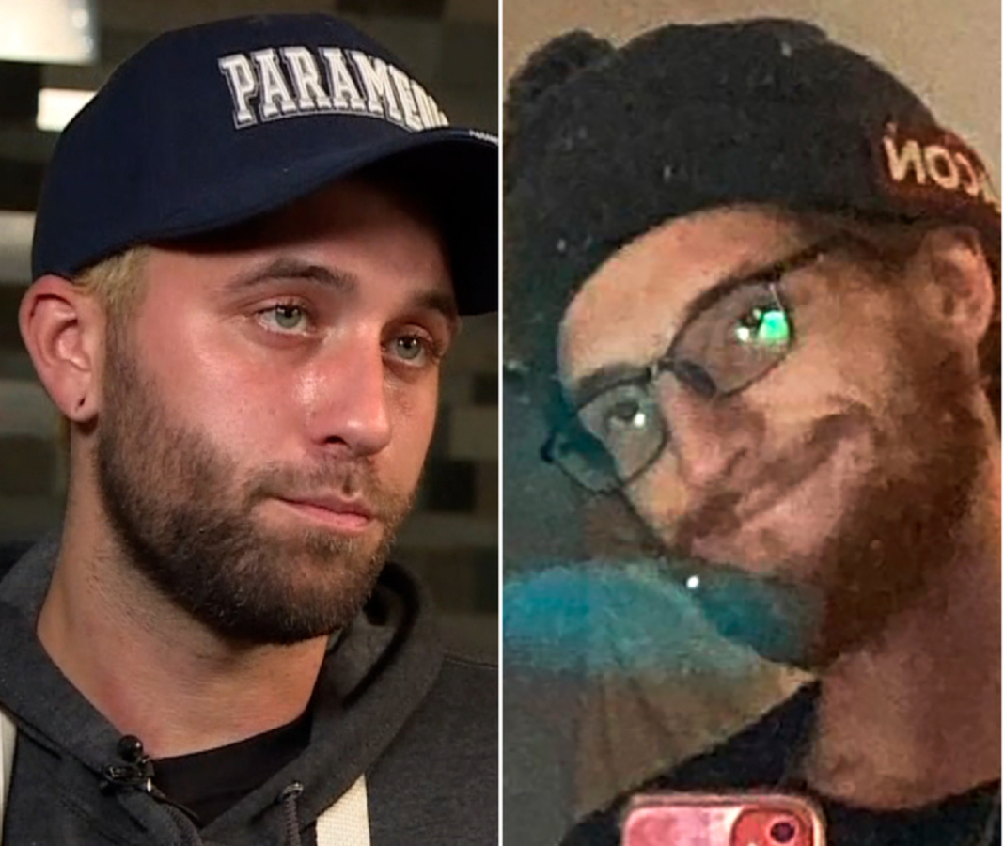
They Gave Their Lives, Standing Up For Us.
Say Their Names, Too.
Michael Schwerner
Mississippi, 1964
Andrew Goodman
Mississippi, 1964
Joseph Rosenbaum
Wisconsin, 2020
Anthony Huber
Wisconsin, 2020
Things to consider, by Ken Granderson

