Slide 1


Wakanda Technology Initiative
DRAFT – PLEASE DO NOT DISTRIBUTE WITH PERMISSION
Timbuktu Content Engine
“Content In, Knowledge Out”

Slide 3


















Timbuktu - Overview
1. Consume Content
From Any Source
2. Analyze / Categorize / Organize Content
Using Multiple AI Engines
3. Deliver Content
Based on Organization / Individual Rules
BlackFacts
Content Bots
Digital Griots
Mobile Web
Consumers
Timbuktu Content Engine
Any Site Visitor
Polls & Quizzes
Associations
Associations and Schools
Historians
Push Notification

Slide 4
The balance of slides are from other decks and left here as a ‘parking lot’ for convenience.

Slide 5
Fact Sources
Black Facts content can come from a variety of sources, including:
Existing Historical Site Urls
Online News Sites
Member Uploaded Files
Member Social Media Posts
Member Emails
Member Recorded Media
Regardless of the source, the text of the content is extracted as the ‘lowest common denominator’ required by the AI systems currently in use (image recognition etc is in the future) and analyzed by the AI systems to identify people, places, organizations, concepts, etc that can be used to link the Facts.
Fact submitters can also add additional people, places, etc into Blackfacts to augment the frequent lack of the AI systems recognizing them, as well as the AI systems linkages being limited to the submitted text (i.e. the text not mentioning well-known organization affiliations).
BlackFacts.com
BlackFacts
Content Bots
Digital Griots
Consumers
Content Creators
Associations
Historians

Slide 6
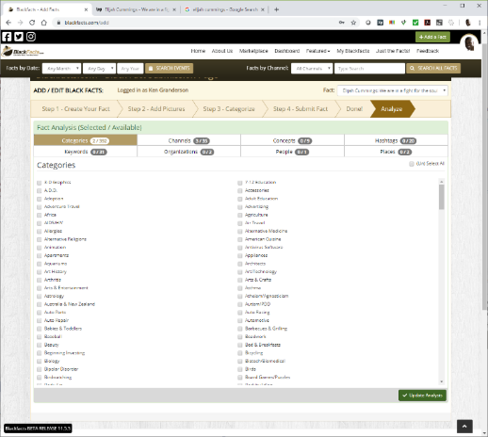
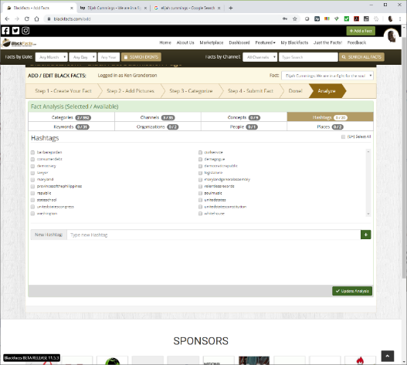
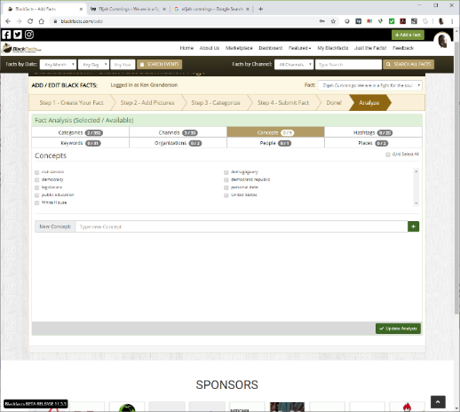

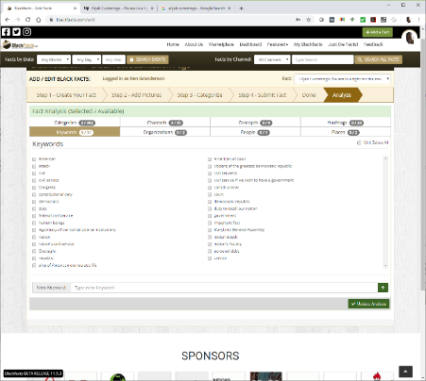
Add A Fact – AI Analysis
Blackfacts submits the entire Fact content to the ‘Natural Language Understanding’ services of Aylien and Watson, and returns their identification of the following:
Categories
Concepts
Hashtags
Keywords
Organizations
People
Places
As shown in the screen captures, the results can often be less than comprehensive or accurate ☹
To be fair, sparse results like this are also often the result of content where people are discussing things that mattered TO the subject, rather than the subject themselves.

Slide 7
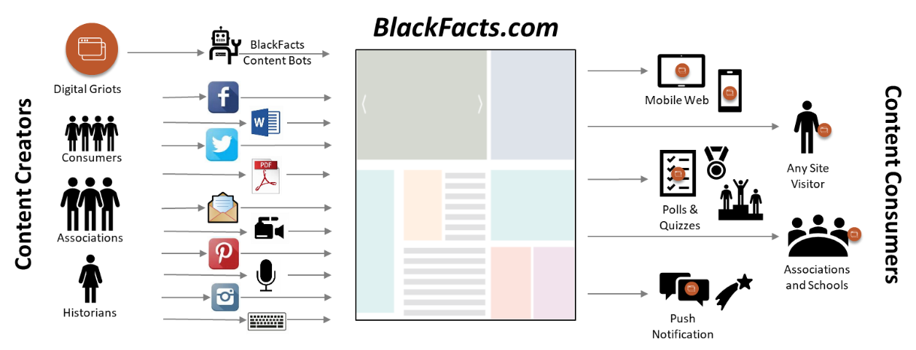
Blackfacts – Our Future is AI
Blackfacts ability to become ‘The Black Wikipedia’ and capture and preserve our stories, told by us, for all perpetuity, rests on three basic ideas:
1. Capture the Content – No matter where it is and what form it is in, get a textual representation of the information
2. Classify and Link the Content – Find common people, events, ideas, et cetera across separate content items, and create contextually appropriate linkages between them
3. Distribute the Content to People Wherever They Are – Make Blackfacts content available to the world whether they are mobile or desktop users, in school, on the train, at the gas station, in Dunkin Donuts, on their company intranet, looking at their cable TV Guide, wherever digital or printed content is found.
The Blackfacts Tech Team has the technical ability to achieve items #1 and #3 with our proprietary tech, third party tools, and #3 will require building relationships with external entities interested in our content, which is not expected to be a problem once we start marketing Blackfacts aggressively.
However, #2 requires significant investments of money and (initially) labor to arrive at the point where the AI systems will be able to operate with minimal human involvement and then become as scalable as other Blackfacts tech that has been developed without incurring significant labor costs.
Thus, we are looking to partner with academic or research institutions engaged in work that could benefit from our capabilities, who have the ability to write and win grants for research or product development in this space.

Slide 8









BlackFacts.com Core Business Model
BlackFacts.com
BlackFacts
Content Bots
Revenue Streams
Premium Membership
Premium Virtual Sites
Fact Widgets
School/Diversity Sites
BlackFacts Legacy Sites
Corporate Sponsorship
Banner/Email/Social Advertising
Marketplace Affiliate Sales
Digital Griots
Mobile Web
Consumers
Any Site Visitor
Content Creators
Content Consumers
Polls & Quizzes
Associations
Associations and Schools
Historians
Push Notification
Consumers get BlackFacts content on any platform by visiting the website or receiving push notifications via Email/Text/Social Media.
BlackFacts content is syndicated via BlackFacts Widgets hosted on affiliate sites and entire custom BlackFacts-driven partner sites.
Content is submitted by BlackFacts Users, Griots and our proprietary web crawlers (news & relevant content), from online pages, social media sharing, uploaded documents and media.
Sponsors / Advertisers / Vendors
While access is free to all, Premium Memberships, the Wakanda Marketplace, Corporate/School Sponsorships and Advertising generate BlackFacts’ Revenue

Slide 9


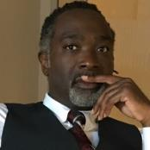
BlackFacts.com Management Team
Ken Granderson - Founder / Chief Technology Officer MIT alumnus and Tech Visionary, Creating Ethnic Technology since 1995, Creator of BlackFacts.com, Roxbury.com, Official website of the Government of St. Lucia
Dale Dowdie - Chief Executive Officer Enterprise-Level Technical Consultant / Entrepreneur Building Online Business Applications and facilitating Tech Transformation, Data Centers Buildouts and DR/BCP Strategies since the 1980s for Clients including, Harvard University, NASA, Multi-national Banks, Liberty Mutual, Staples, TJX, EDS, IBM, McCormick, MassHousing and the City of New York
Other Resources in Part-Time, Paid and Unpaid Consultant Roles:
Rick Van Rice (Business Development), James Mwihia (QA and Tech Support), Michelle Tutunjian (Operations Manager), Sandra Bone (Social Media), Beatriz Callejas (Social Media), Melanie Semedo (Social Media) and Offshore Development Resources (Pilots and Product Support)

Slide 10

Contact Information
Ken Granderson - Founder / Chief Technology Officer ken@blackfacts.com 857-222-2318
Dale Dowdie - Chief Executive Officer ddowdie@blackfacts.com 781-858-6852
Notes:
KG: Added MIT reference, NYC reference

