Slide 1
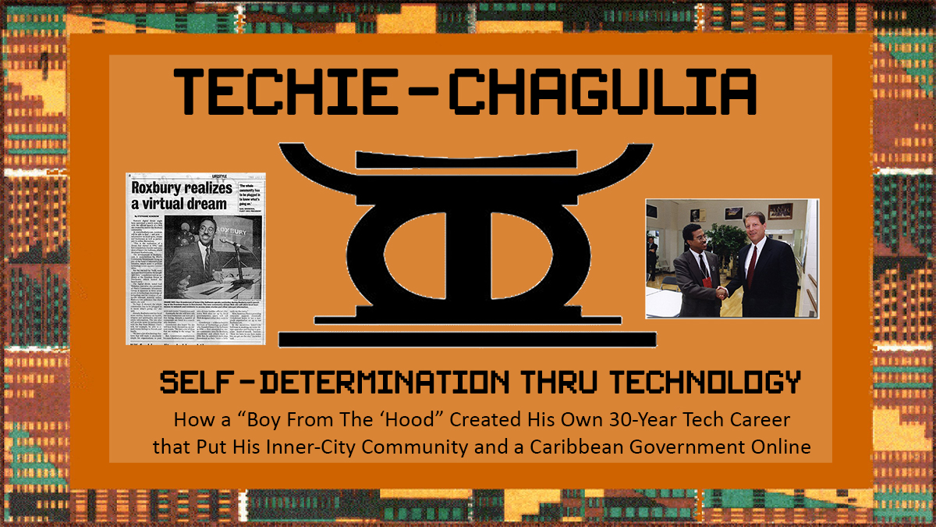

Slide 2


Agenda / Objectives
Agenda
  Introduce the Concept of Black Self-Determination thru Technology
  25 Years of Being an Unapologetically Black Technologist
  What Tech Looks Like When WE Are In Charge
  Q & A
Objectives
  Interrupt Status Quo Thinking
  Encourage You to Find Your Greatness
  Inspire You to Consider Using Your
  Tech Skills to Empower Black People
Ken Granderson
Black Technology Visionary

Slide 3
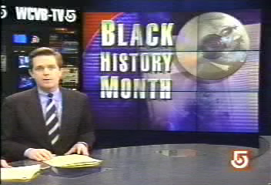
Unapologetically Black Technology
1995
Historical Images / Presentations available at https://kengranderson.com - Videos on YouTube, available at https://links.blackfacts.com/inner-city-software
Notes:
Let me share a 2 minute story about something that happened in 1995, at the dawn of the Information Age

Slide 4
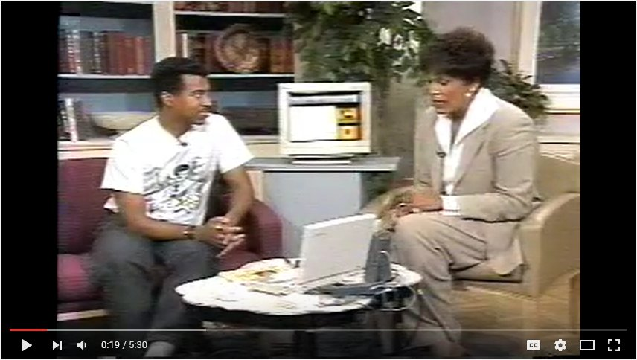
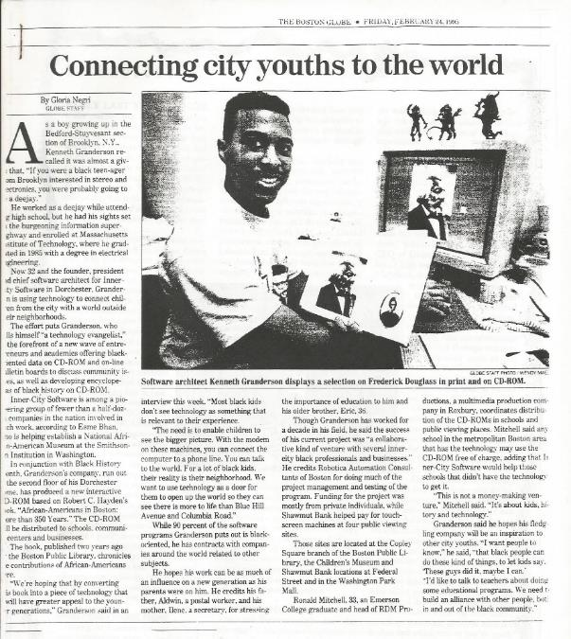
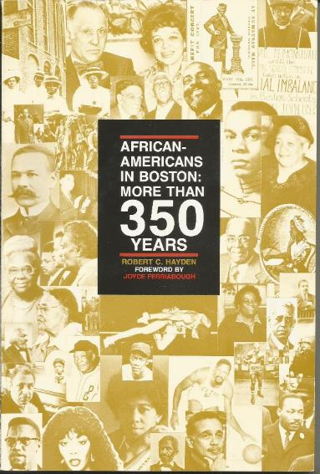
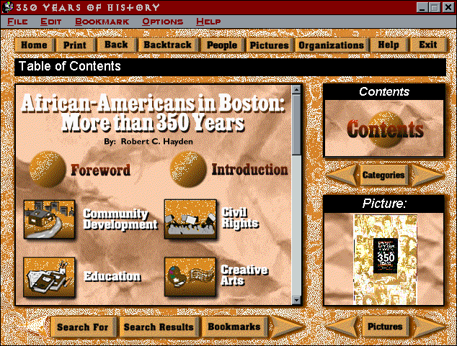
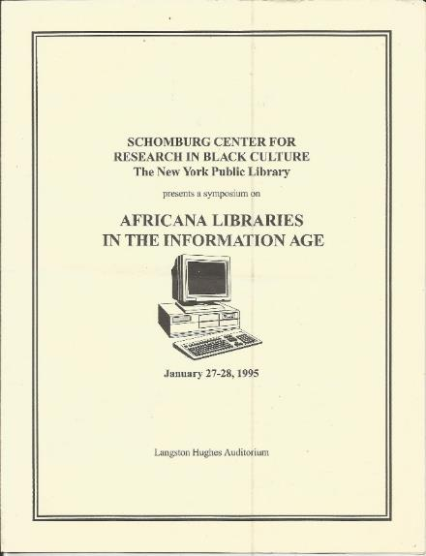
Unapologetically Black Technology
1995
Historical Images / Presentations available at https://kengranderson.com - Videos on YouTube, available at https://links.blackfacts.com/inner-city-software
Notes:
350 Years was displayed at the Boston Public Library and Children’s Museums on touch screen kiosks
It was in the news and local television, and presented at the Schomburg Center for Research in Black Culture in Harlem
However, due to politics and the none of the schools in Boston’s black communities having CD-ROM capable computers, it never got into the school system.

Slide 5
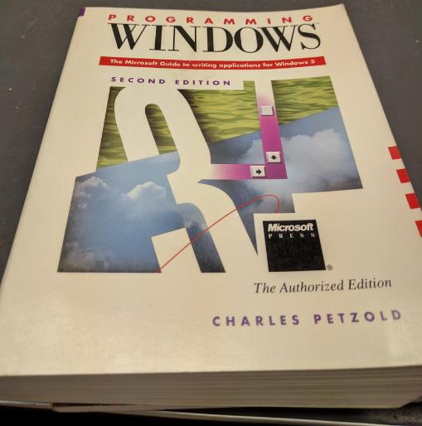

Getting Started
1989
Notes:
The story actually starts several years earlier, when I was working as a software tester at a company called Phoenix Technologies, and decided to get into programming.
I purchased two books – Programming Windows 3.0 and Windows 3 – A Developer’s Guide, and taught myself to code in C and C++.
A warning – We are about to cover a lot of activity in a very short period of time.
So I am going to just mention projects briefly. If you are interested, everything I am about to show and describe is available online in more detail.
A Side Note – I recently connected to Developer’s Guide author Jeffrey Richter on LinkedIn and thanked him for helping me get started.

Slide 6
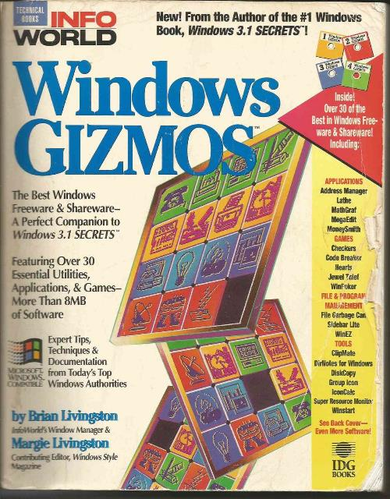
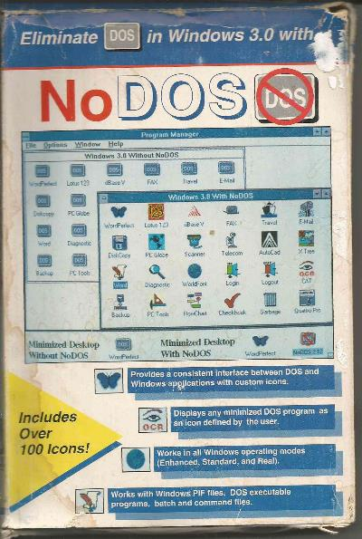
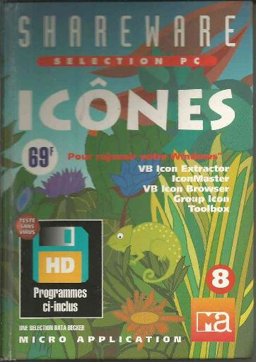
Getting Moving
1992
Historical Images / Presentations available at https://kengranderson.com - Videos on YouTube, available at https://links.blackfacts.com/inner-city-software
Notes:
I started putting out programs on the dial-up bulletin board systems that preceded the Internet, in what then was called ‘Shareware’ - try it and if you like it, buy it.
I got on the map with a desktop customization utility called ‘NoDOS’ that made Windows easier to use, and when that feature was included in Windows 3.1, I did ‘GrpIcon,’ which ended up in several books in the US and at least one in France.
GrpIcon was included in the book ‘Windows Gizmos,’ a book sold across the country, and resulted in 2000 registered users at $20 each.
As my salary then was $43,000, I quit my job at Phoenix and started doing software full-time under my company name ‘Inner-City Software,’ which was a euphemism for ‘Black Software Company.’

Slide 7
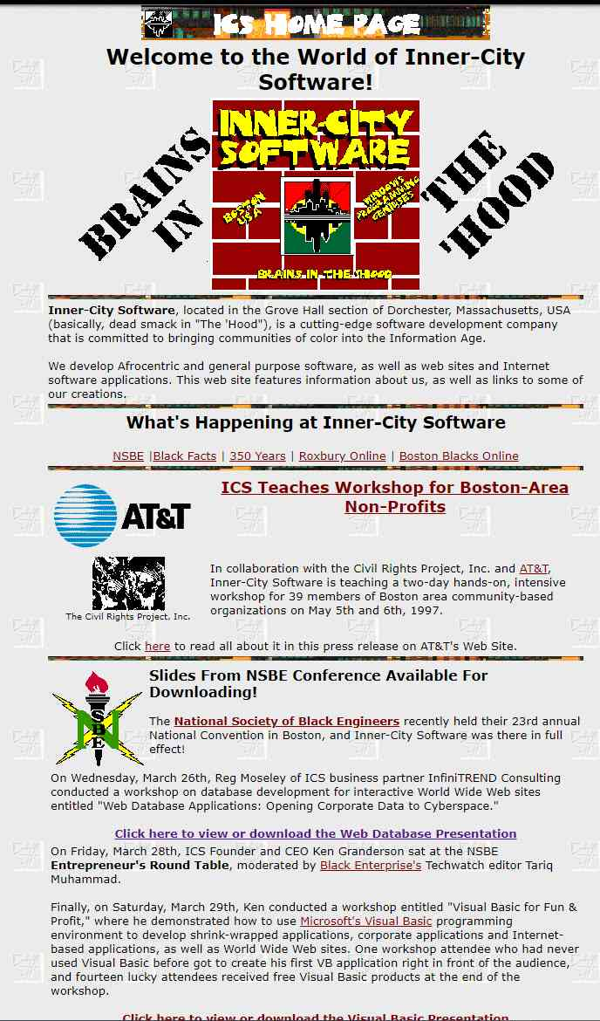

Getting Black
1992
Historical Images / Presentations available at https://kengranderson.com - Videos on YouTube, available at https://links.blackfacts.com/inner-city-software
Notes:
I realized that this Brave New World of technology had no ‘Old Boy Network’ to get in my way, nor did it require access to capital to pay for licenses, buildings and staff in order to get products out there, so I established Inner-City Software with the goal of broadcasting both inside and outside the Black community that the Computer Age represented the closest thing ever to a level playing field.

Slide 8

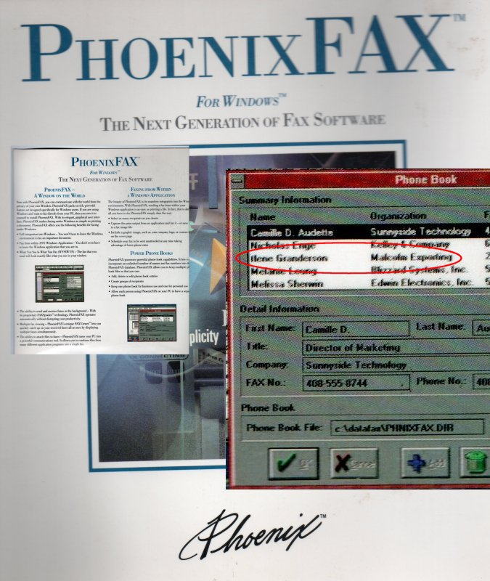
Unapologetically Black
1992
Historical Images / Presentations available at https://kengranderson.com - Videos on YouTube, available at https://links.blackfacts.com/inner-city-software

Slide 9
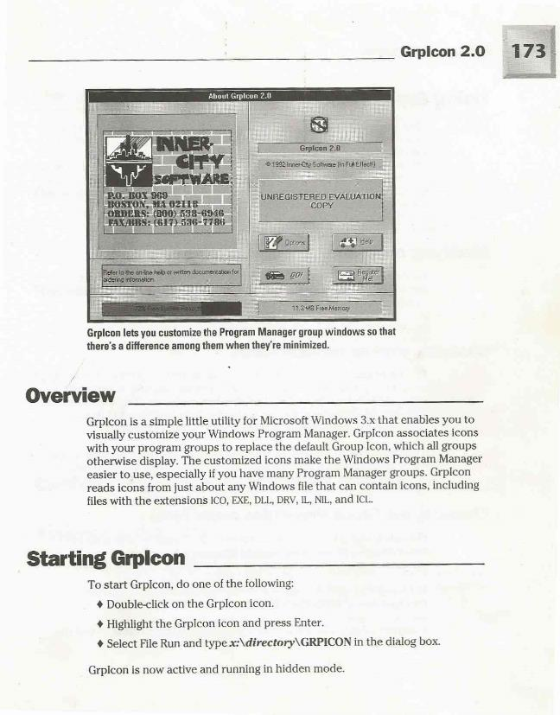
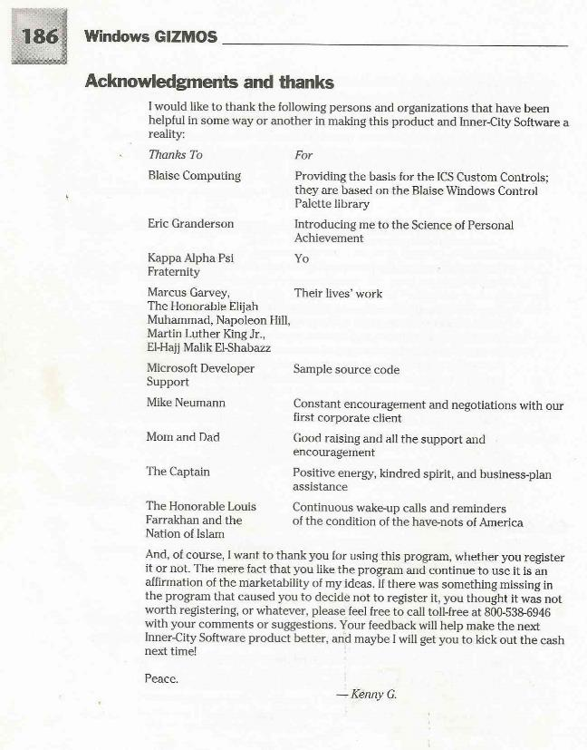
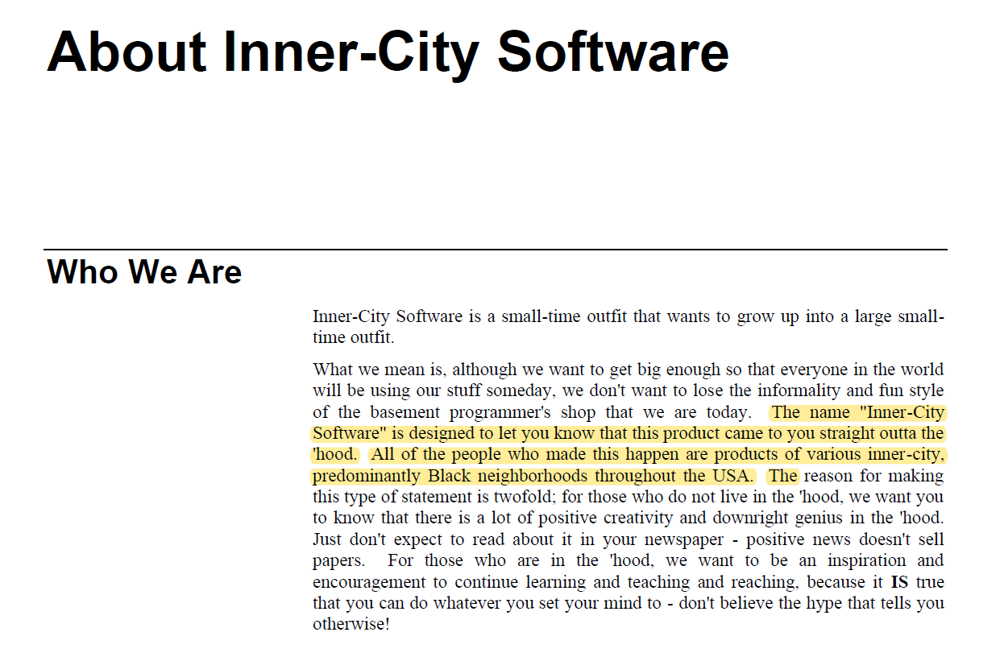
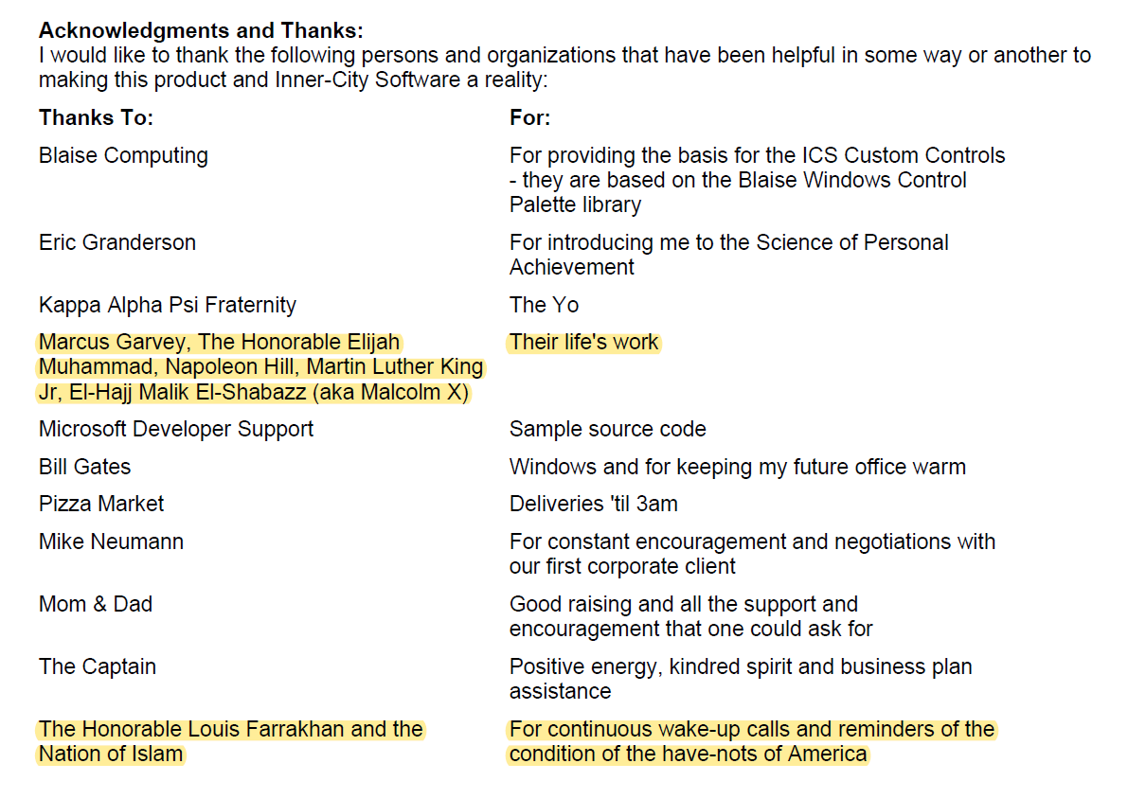
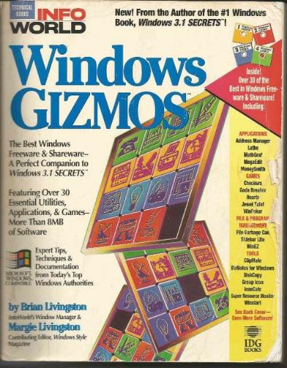
Unapologetically Black
1993
Historical Images / Presentations available at https://kengranderson.com - Videos on YouTube, available at https://links.blackfacts.com/inner-city-software
Notes:
I realized that this Brave New World of technology had no ‘Old Boy Network’ to get in my way, nor did it require access to capital to pay for licenses, buildings and staff in order to get products out there, so I established Inner-City Software with the goal of broadcasting both inside and outside the Black community that the Computer Age represented the closest thing ever to a level playing field.

Slide 10
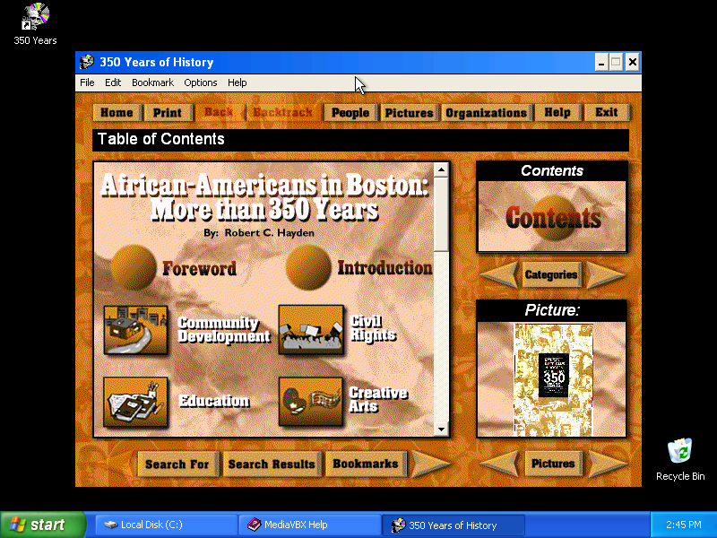
Selling Internationally
1995
Historical Images / Presentations available at https://kengranderson.com - Videos on YouTube, available at https://links.blackfacts.com/inner-city-software
Notes:
The 350 Years of History program was powered by Microsoft MediaView, a subset of the Encarta libraries that Microsoft made available for free to developers.
The API was C-based, so to simplify things for VB developers, I created a Visual Basic VBX control, which I then sold to other developers for $200 via the bulletin board systems.
One of our customers was LiveLink systems in Jerusalem, who used the VBX control for a CD-ROM version of the Encyclopedia Judaica.

Slide 11
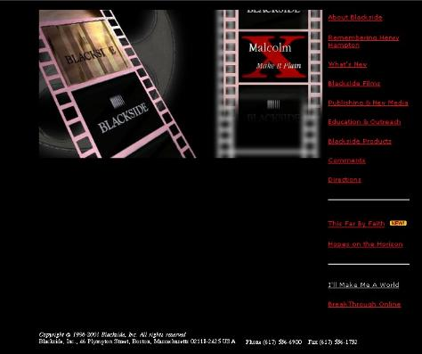
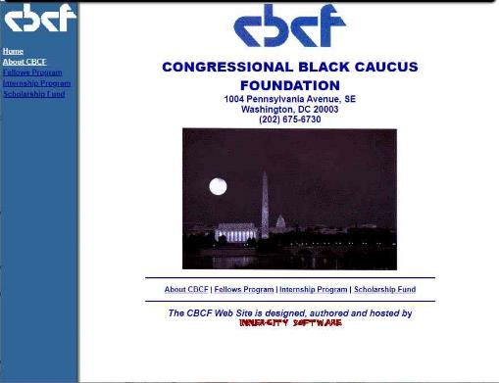
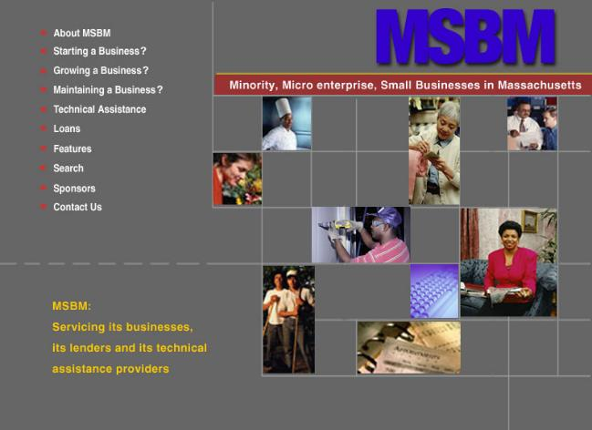
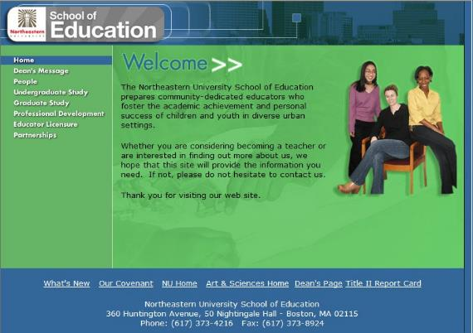
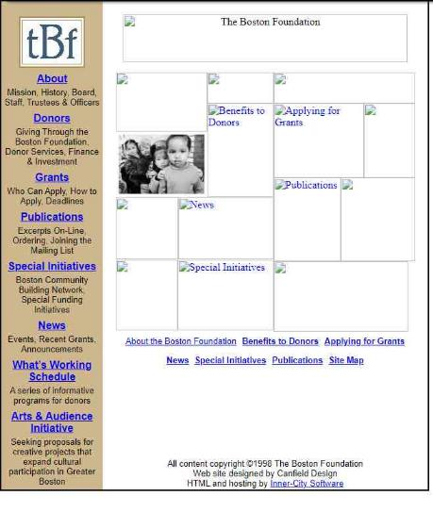
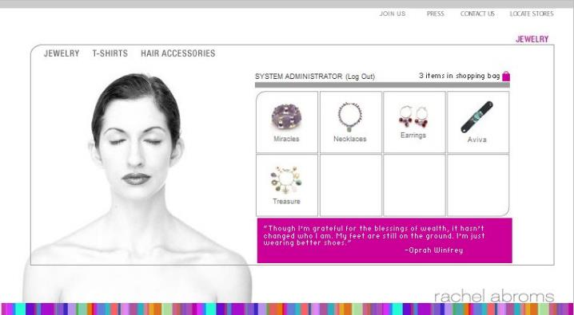
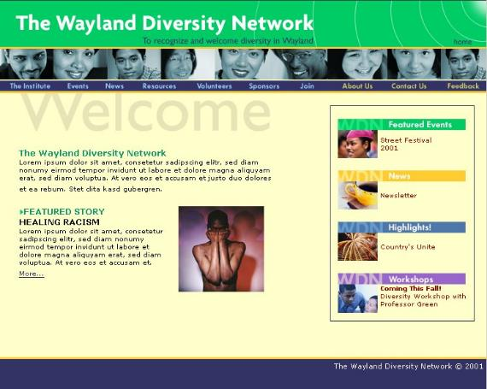
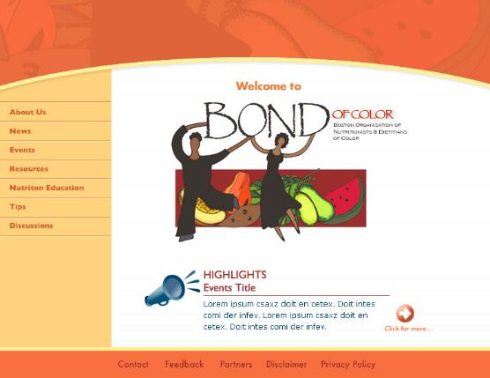
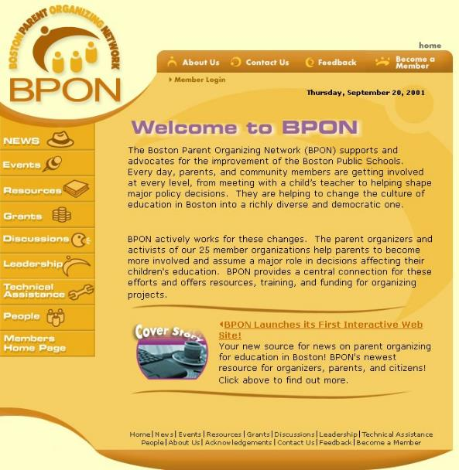
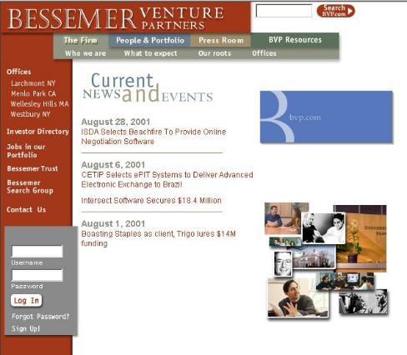
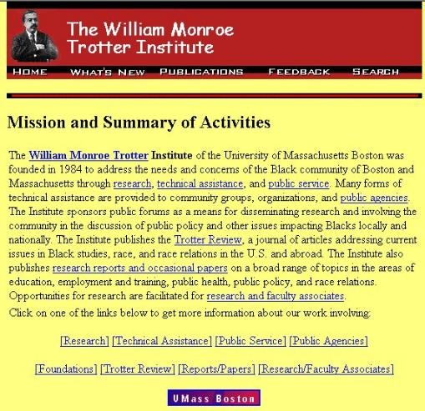
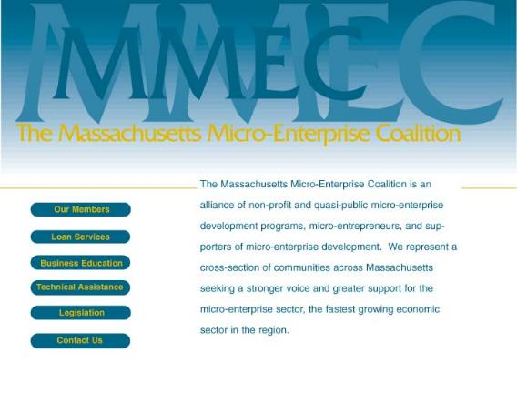
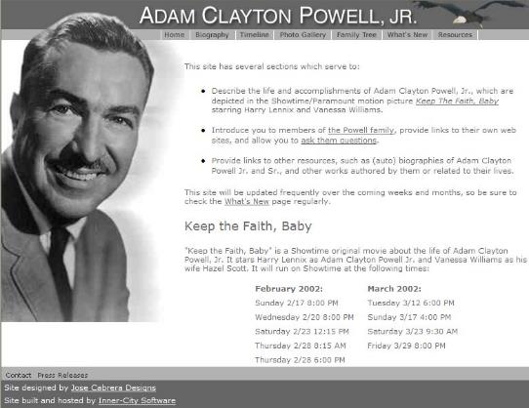
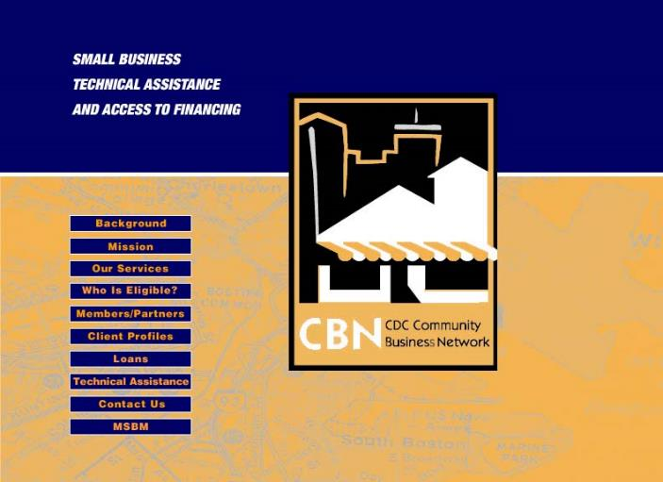
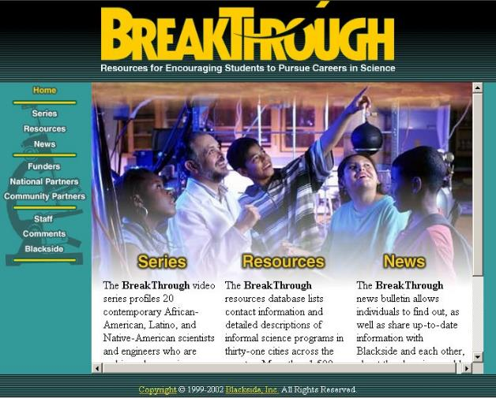
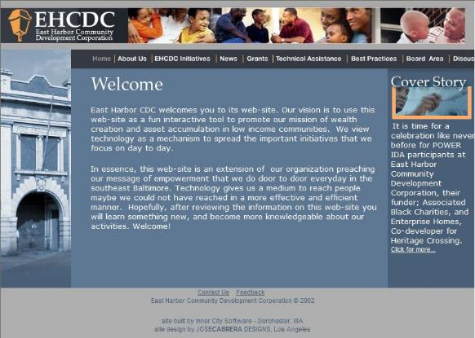

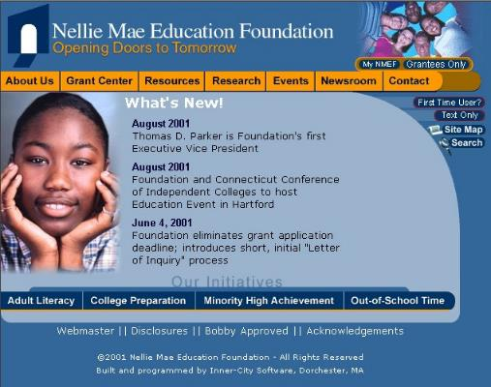
Putting Black Interests Online
Historical Images / Presentations available at https://kengranderson.com - Videos on YouTube, available at https://links.blackfacts.com/inner-city-software
Notes:
Inner-City Software became The Tech company in Boston’s communities of color, and we put dozens of local organizations and businesses online, from Black businesses like the New England Black Pages and the Black newspaper the Bay State Banner, to ally organizations like the Boston Foundation and Nellie Mae Education Foundation.
We also did the web sites for Black organizations in other areas like the Congressional Black Caucus Foundation in DC.
In the quasi-public and private sector, we did web sites and other tech work for a bunch of community economic development organizations and the VC firm Bessemer Venture Partners, but unfortunately were never able to secure external financing from any of them.

Slide 12
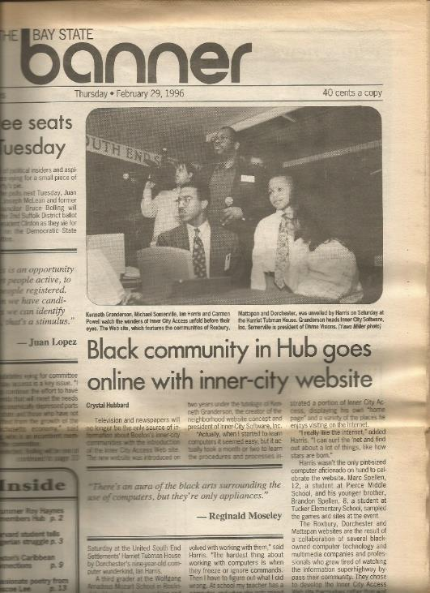
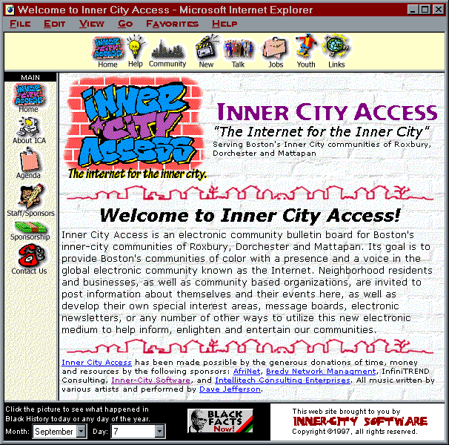

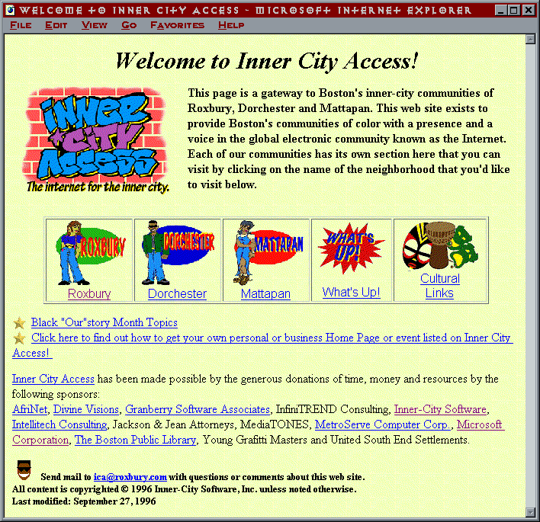
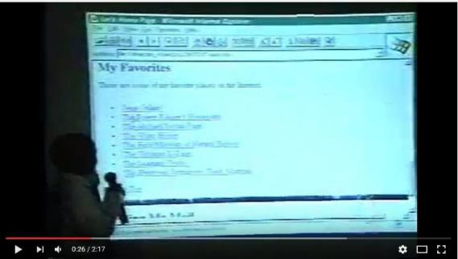
Putting Black Communities Online
1996
Historical Images / Presentations available at https://kengranderson.com - Videos on YouTube, available at https://links.blackfacts.com/inner-city-software
Notes:
In 1996, I saw that the Internet was going to be another game changer - not just for techies, but for everyone.
So I gathered up all the Black tech folks I knew to help me put together web sites for Boston’s Communities of Color, under the name ‘Inner City Access’
We gathered the information, we recruited some young folks to create some graphics, we built the HTML pages, hosted it with local Black networking company, and launched Inner City Access for Black History Month 1996.
This was the first Diversity Technology Project that Dale Dowdie, my now partner in BlackFacts, worked on together.

Slide 13
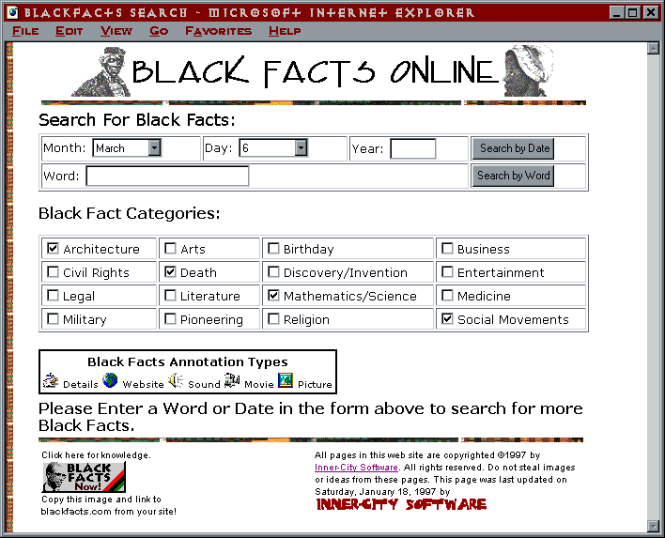
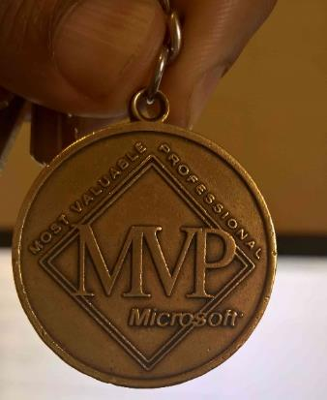
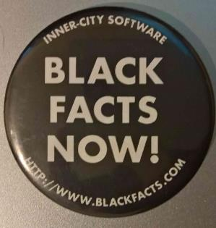
Putting Black History Online
1997
Historical Images / Presentations available at https://kengranderson.com - Videos on YouTube, available at https://links.blackfacts.com/inner-city-software
Notes:
In 1995, the Best HTML Editor was Vermeer’s FrontPage, and it was so good that Microsoft bought Vermeer.
After Microsoft bought FrontPage, I was helping so many people in the MS Developer FrontPage forums that they made me an MVP, and I have always guessed that I am probably Microsoft’s first Black MVP.
Being an MVP gave me access to all of Microsoft’s tools, including SQL Server. So I taught myself how to do database programming, and launched Black Facts Online for Black History Month 1997 on ASP Classic and SQL 6.5, with the goal of helping the Black online community see that they were fully included in this new Internet thing.

Slide 14

Encouraging Black Developers
1997
Presentation available as YouTube video at https://links.blackfacts.com/nsbe-1997 or as ppt from ken@blackfacts.com
Notes:
In 1997 I had the opportunity to do a presentation for the Annual Conference of the National Society of Black Engineers, where I demonstrated creating a simple Windows application in Visual Basic 4.
The folks at the local Microsoft office gave me three copies of VB Professional and Enterprise to give away as door prizes, which were some pretty nice door prizes!

Slide 15
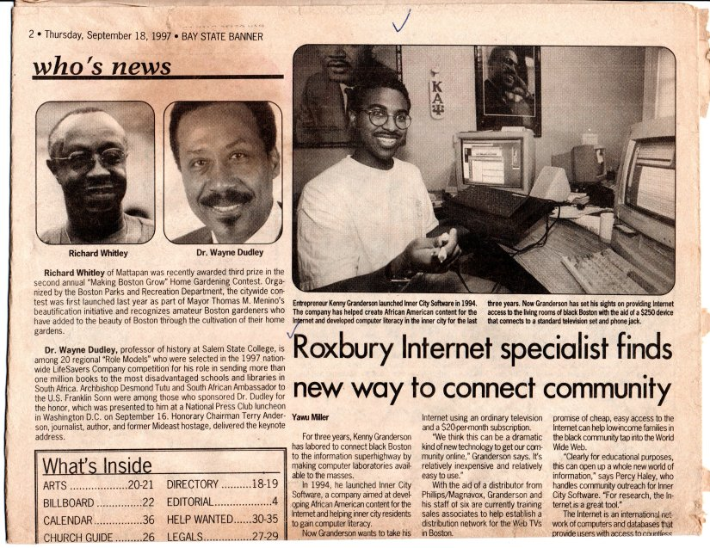
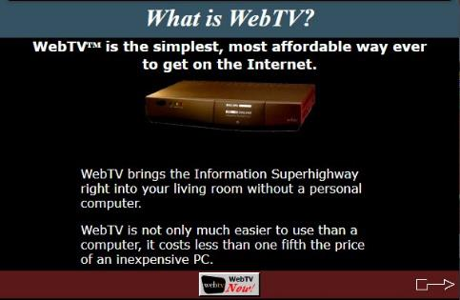
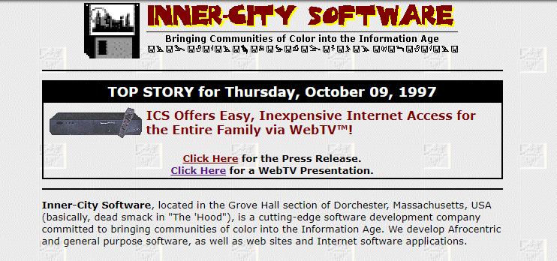
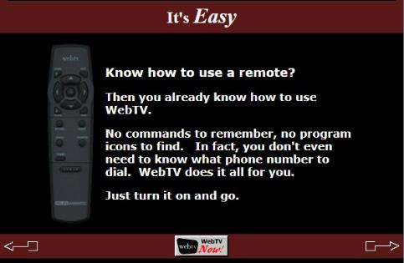

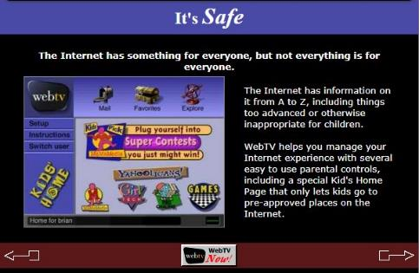
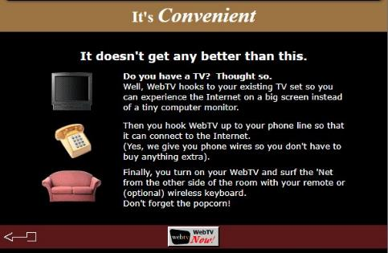
Putting Black Communities Online (for $100)
1998
Our WebTV HTML Presentation is available on the Wayback Machine at https://links.blackfacts.com/webtv
Notes:
Later that year, a low-cost Internet access set-top box called WebTV put people online by connecting to their phone and TV set.
We promoted it in the Boston area as an easy and inexpensive way for folks to get online without having to afford a computer.
And it became even more affordable when guess who bought the company? Microsoft!

Slide 16

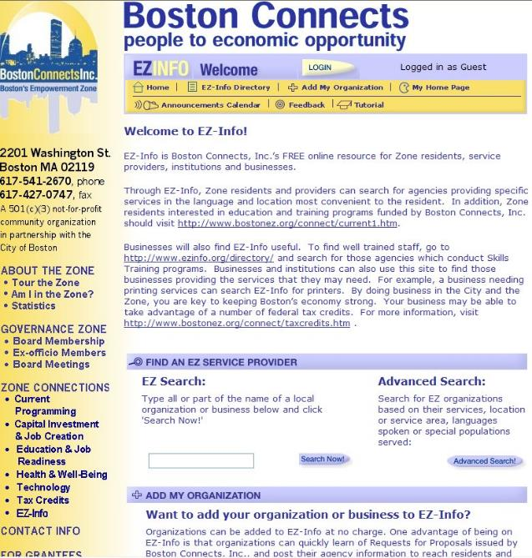


Putting Black Businesses Online
1999
Historical Images / Presentations available at https://kengranderson.com - Videos on YouTube, available at https://links.blackfacts.com/inner-city-software
Notes:
Around 1997 – 1999, I worked with Boston’s Empowerment Zone and built a Business Directory of all of the Empowerment Zone businesses.
The Empowerment Zones were a pet project of Vice President Al Gore, and I got to present it to him.

Slide 17





Roxbury.com (Boston’s Largest Black Community)
2002
Historical Images / Presentations available at https://kengranderson.com - Videos on YouTube, available at https://links.blackfacts.com/inner-city-software
Notes:
By 2000, I had a small staff, and taught them to do database web programming so that we could put our neighborhood online at Roxbury.com with local news, events, business listings, subject matter expert articles and community discussions.
Roxbury.com was the perfect solution for local Black banking executive Gail Snowden’s CommunityLink technology education and access project in Roxbury, as it gave graduates someplace relevant to go once they learned about computers and got a free family computer at graduation.
I negotiated a one-year sponsorship for Roxbury.com with Fleet Bank (now Bank Of America) for $150,000, which covered most of my payroll.
For local news, I built a custom newspaper publishing site for the Bay State Banner for free, in exchange for letting me pull news they posted into Roxbury.com

Slide 18

Roxbury.com
2002
Historical Images / Presentations available at https://kengranderson.com - Videos on YouTube, available at https://links.blackfacts.com/inner-city-software
Notes:
So here are some actual screen shots from Roxbury.com.

Slide 19








Roxbury.com
2002
Notes:
The Roxbury.com Home Page
Local News
Local Events
Event Details posted by a local organization from one of our weekly training sessions (this was 4 years before EventBrite)
Local Business Listings - 2 years before Yelp
Business Details
Community Experts - today would be called a Blog
Online Community Discussions – 2 years before Facebook, driven by my 6000 member strong email listserv Boston Blacks Online that I had been running since 1996

Slide 20




Roxbury.com
2002
Notes:
So this is what Boston’s Black community of Roxbury looked like online in 2002, powered by Windows NT, Internet Information Server 3.0 and SQL Server 2000, running straight outta the ‘hood from my office in the middle of Boston’s Dorchester neighborhood.

Slide 21

Putting a Caribbean Government Online
2013
Notes:
After Inner-City Software, I stepped back from doing my own projects for a while and worked with a smoking cessation web community, built a social network site, custom SMS text messaging platform and online recommendation engine for a longtime friend and associate who has created and purchased a few tech companies.
I also worked with Dale on several projects including a web-based scheduling and shop management system for barber shops and beauty salons, a web-based project management system for a major insurance company.
Around 2013, my former developer now in the UK, who is a native of Saint Lucia, was consulting for their government.
She (yes, I said SHE, who was one of my 3 developers in the 90s) connected me to the government, and I architected, built and stood up the official web site for the Government of Saint Lucia, which is running unchanged today.

Slide 22


Blackfacts Reboot
2017
New Look
New Platform
New Features
New Goals
Notes:
During this time, Black Facts was running on auto-pilot. Towards the end of every year, Dale and I would start thinking about next Black History Month and what would we do with it, and in 2017, we decided to reboot Blackfacts with a new look, a new platform based on SQL 2012 and .Net Framework, with .Net Core added recently, providing new functionality, and new goals far more audacious than simply making sure that Black folks saw themselves reflected on the Internet.

Slide 23






















BlackFacts.com Core Business Model
BlackFacts.com
BlackFacts
Content Bots
Content is organized via our proprietary Timbuktu™ Content Management System and external Artificial Intelligence APIs
Digital Griots
Mobile Web
Revenue Streams
Diversity Content Widgets
Corporate Sponsorships
Banner Advertising
Premium Membership
Diversity Showcase Sites
BlackFacts Legacy Sites
Marketplace Affiliate Sales
Consumers
Any Site Visitor
Content Creators
Content Consumers
Polls & Quizzes
Associations
Associations and Schools
Historians
Push Notification
Consumers get BlackFacts content on any platform by visiting BlackFacts or Affiliate websites or receiving notifications via Email/Text/Social Media.
BlackFacts content is syndicated via BlackFacts Widgets hosted on affiliate sites and entire custom BlackFacts-driven partner sites.
Content is submitted by BlackFacts Users, Griots and our proprietary web crawlers, from online pages, social media sharing, uploaded documents and (in Year 2) media.
Sponsors / Advertisers / Vendors
While access is free to all, Premium Memberships, the Wakanda Marketplace and Banner Advertising generate BlackFacts’ Revenue

Slide 24


Publishing Our Stories to Any Device
BlackFacts Today:
Internet’s First (1997) Searchable Black History Website
Blackfacts.com (Mobile / Tablet / Desktop)
#1 Google / Bing / Yahoo Search Result
E-Mail (Black Fact Of The Day™)
Third-Party Websites (Black Facts Widgets)
200K Social Media Followers
Global Black News
BlackFacts Tomorrow:
‘Black Facts Minute™’ on HBCU TV
K-12 and College History Project Sites
Corporate Diversity Sites
Marketplace Affiliate Sites
Professional / Fraternal History Sites
Third-Party Video Ad Widgets
Store Displays
…etc.
24
Notes:
Once content is in the Blackfacts system, we can deliver it through a variety of channels, including:
The Blackfacts web site
Mobile devices
Widgets on Third-Party web sites
Via Email like our daily mailing called Black Facts of the Day

Slide 25



BlackFacts.com Offers:
Black History
Black News
Black History Videos
On Both the BlackFacts Site AND on our School and Corporate Client Sites
Notes:
At a high level, BlackFacts delivers 3 things – More and Better than anyone else:
Black History
Black News
Black History Videos

Slide 26
BlackFacts.com: By The Numbers
26
Notes:
And we deliver Black History to a lot of folks, so if you get concerned about kids not being taught Black History in schools, or states being concerned about teaching ‘Critical Race Theory,’ don’t worry, we got this.
We are the Solution, because We are in Complete Control of Our Platform.

Slide 27


The Wakanda Technology Initiative™
Technology Services Offering for Minority Entrepreneurs, Businesses and Students
Low Cost. Easy to Use. Business/Startup-in-a-Box! Ecosystem
Core Content Management Services (CMS)
Other Features
Structured Website
Branded Page(s)
(CSS)
Carousel Widgets
Templates
Cloud Services Integration
Select your
Widgets
Existing website
Embedded
Components
HTML Widgets
Video Widgets
Calendars
Social Media Integration
Embed in
Your
Site
Businesses & Start-Ups
Data
Tables
Admin
Tools
List Widgets
Gallery Widgets
Feedback
Survey Widgets
eCommerce (Shopping Cart)
Integrated Community
Target Demographics
No Website
No Problem
Event Widgets
Professional
Associations
Shared Services
Discounts on Products/Services
Reports/
Activity Logs
Ads
Manager
Mail/ Chat Services
Jobs/ Internship Postings
Affiliate Programs
Entrepreneurs
& Students
Freemium Subscription
Shared Reward Programs
Integrated sales of products/services
Get complete
Website
Data
Model
Security
Shared Content Widgets
News Feed
Diversity Showcase
Target Demographic: Entities with sub-par or non-existent technology presences - offer a low-cost solution that brings them to a higher quality of functionality
Pricing Structure (NOT YET FINAL):
FREE for the Introductory Offering
$19.99/month for BASIC package
$49.99/month for STANDARD package
$79.99/month for PREMIUM package
Other services a la Carte billing
Outcomes: Organizations with credible online presences, digital marketing campaigns, e-commerce for membership and ticket sales, etc.
Businesses with online ordering, specials, marketing, loyalty clubs, accounting, human resources, inventory management, etc.
Notes:
And BlackFacts is just the start of a larger set of software services code named the Wakanda Technology Initiative

Slide 28

Blackfacts.com: The Big Picture
Technology Benefits for Everyone
All Platforms. Consumer / Community / Commercial. Globally Available.
Blackfacts.com
Wakanda Technology Initiative
Blackfacts.com is just the initial offering in what will be an entire platform of technology services created to help ‘uplift the race’ by connecting individuals and communities of color with today’s advanced software capabilities.
The platform is called the Wakanda Technology Initiative™ and is based on a ‘Black Paper’ by Blackfacts’ founder Ken Granderson titled Lessons From Wakanda: Embrace Technology To Protect Your Culture.
The Wakanda Technology Initiative™ aims to finally connect communities and organizations of color with today’s powerful software capabilities towards the goal of enabling us to be more competitive in every aspect of our lives and fields of endeavor.
Diverse Demographics
Universal Platform
Consumers
Associa-tions
Historians
Businesses & Start-Ups
Professional
Associations
Entrepreneurs
& Students
Content Services
Engage / Inspire / Educate
Individuals / Educators
Promote Organization Diversity
Create / Expand Awareness
Create / Expand Affiliations
Organization / Business Services
World-Class Online Presence
Automation of Key Operations
Automation of Marketing / Outreach
Automation of Fund-Raising / Commerce
Notes:
And Ultimately, our objective is nothing less than powering hundreds of thousands of organizations and business across the Diaspora on technologies that WE Created, Control, Own and Profit From.

Slide 29









Creating Technologies for Black People
Notes:
At the start of this presentation, I said that I would end this with a ‘Challenge for You to Create Technologies for Black People.’ Well, here we are.
I don’t know you, but I think that I know something about you.
What I think I know about you is that you do not realize the potential you have to positively impact the Black community with the technical knowledge you already possess. And I think that way because if more of us did realize our potential, if we realized our POWER, then more of us would use it.
And if more of us used the power our technical knowledge gives us, here’s how it might look:
We would see more of our schools, both K-12 and our HBCUs leveraging today’s technologies to help ensure that they operate more competitively with mainstream schools.
We would see more of our community-based organizations and local businesses using freely available technologies for operations, business and organizational planning, having access to lower-cost services, getting their messages out better and increasing their constituencies and customer bases.
We would see more of our local elected officials able to connect directly and better serve their constituents.
We would see more of our brothers, sisters and cousins who are not in the tech industry using the computers and devices they already have or have access to, to put themselves on tracks more likely to lead to better work opportunities.
(Click) 25 years ago, when I quit my tech job because I sold enough copies of a program I wrote to replace my salary, I used my technical knowledge to put many organizations and businesses in my community, then the local Black newspaper, and my entire inner-city community of Roxbury, Massachusetts online, and I did this without connections or investors. And this was before freely available software, frameworks, high-speed internet or everyone having a mobile device.
Today, at least from what I see, it seems like everyone is trying to get into or better position themselves in the industry, which is important, but not enough.
What I mean is that while you getting a good tech job means that your grandkids will go to good schools, history suggests that’s not likely to have much impact outside of you and your immediate family.
Creating positive impact on a larger, community level requires conscious thought and effort at that level. While I cannot say exactly how that might play out, and would never be so presumptuous as to suggest to anyone what they ‘should’ do, I encourage you to consider ways that you - based on who you are, what you know today, and what you can learn tomorrow, might be able to use your technological knowledge to make sure that the doors of opportunity that were opened for you remain open, and maybe, just maybe, you can open up some new doors for those who will come after you and I.
If we had not been aware before, the last several
years has shown us that we cannot afford to take any of the victories of the past for granted, and as we find ourselves in the most influential industry on the planet, if anyone has the potential to help improve opportunities for the Black community locally to nationally, it’s us.
I’m going to close with another video - a segment from the video from our crowdfunding campaign we are doing with FundBlackFounders.com

Slide 30


