Slide 1
CommunityLink
Web Portal
by Inner-City Software

Slide 2
What is a Portal?
A Web site or service that offers a broad array of resources and services, such as e-mail, forums, search engines, and on-line shopping malls.
The first Web portals were online services, such as AOL, that provided access to the Web, but by now most of the traditional search engines have transformed themselves into Web portals to attract and keep a larger audience.
http://webopedia.internet.com/Internet_and_Online_Services/Internet/Web_portal.html

Slide 3
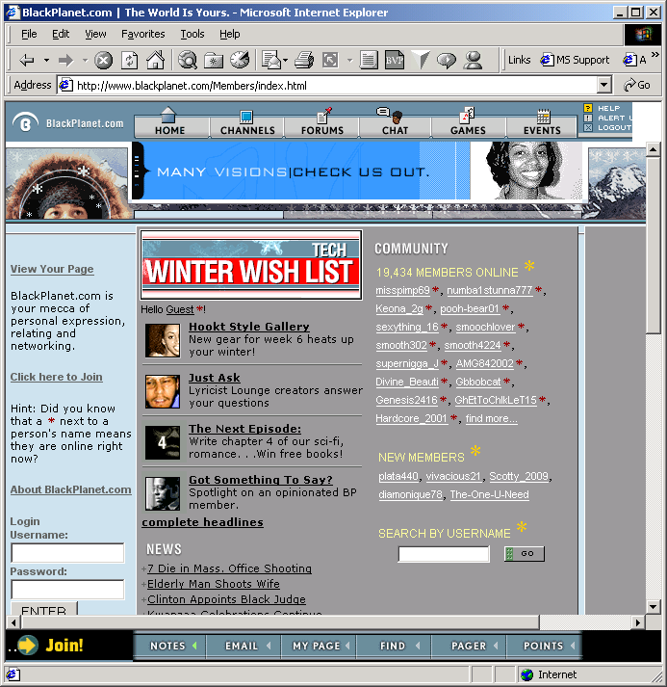
Portal Examples (1 of 4)

Slide 4
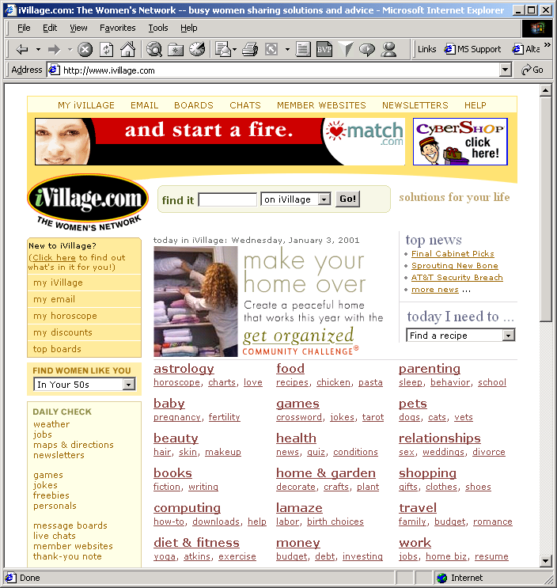
Portal Examples (2 of 4)

Slide 5
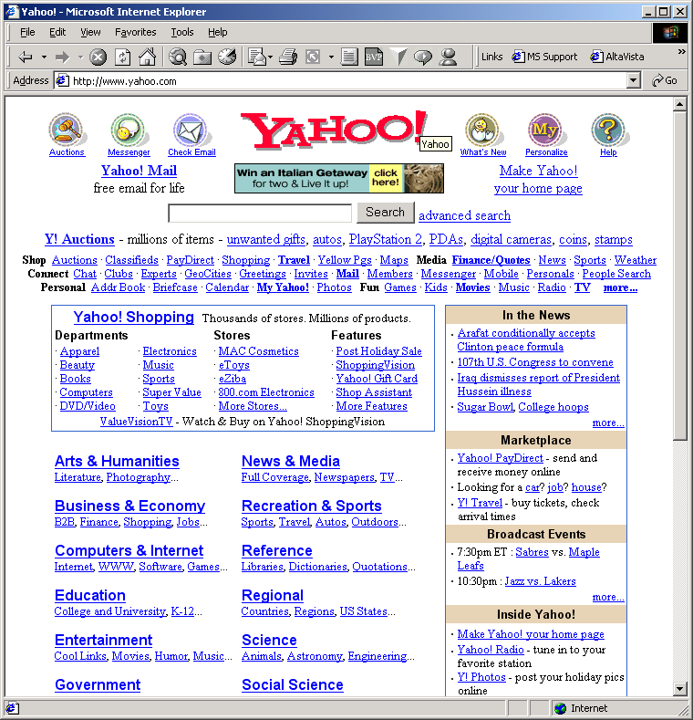
Portal Examples (3 of 4)

Slide 6
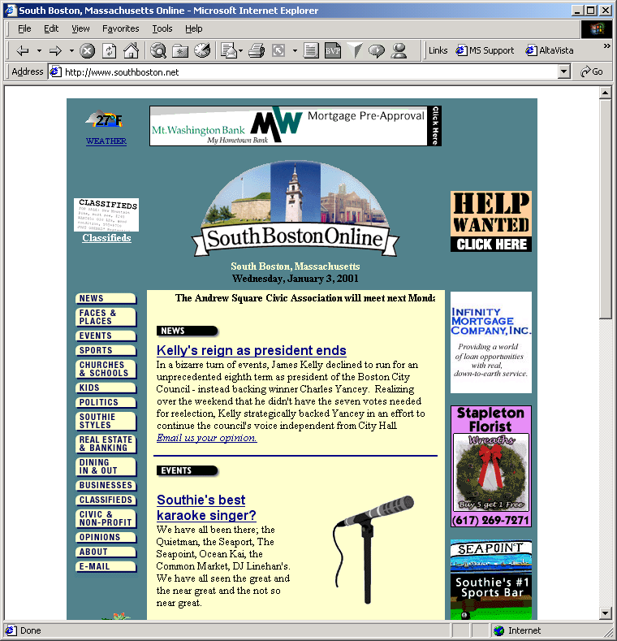
Portal Examples (4 of 4)

Slide 7
Portal Benefits
Convenience of one-stop “shopping”
Content relevant to affinity group
Connection to people with similar interests
Information quality control

Slide 8
Portal Features
News Stories
Editorials
Discussion Forums
Events
Live/Scheduled Chats
Surveys and Questionnaires
Links, Documents and Media of interest
Restaurant, Film and Music Reviews

Slide 9
Portal Features
Web-Based E-Mail
Favorite Areas
Online Content Subscription
Personal Profiles
Electronic Event Invitations
Online Directories
Classified Ads
Shopping
Auctions
Online Banking

Slide 10



Portal Styles (Interactivity)
Café
Shrine
Theater

Slide 11



Portal Styles (Focus)
Shop
Bazaar
Mall

Slide 12

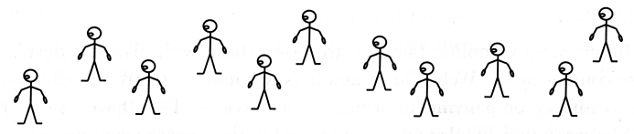

Portal Styles (Cohesion)
Family
Loners
Associates

Slide 13
Community Tools Unlimited™
Chat
News
Forums
Jobs
Classifieds
Banking
Events
E-Mail

Slide 14
CTU Strategy
Generic community portal components
Mix ‘n match to build portal foundation
Customize capabilities for specific implementation
Apply design for specific implementation
Built on Internet standards
Scale to large numbers of users
Scale to large numbers of communities

Slide 15
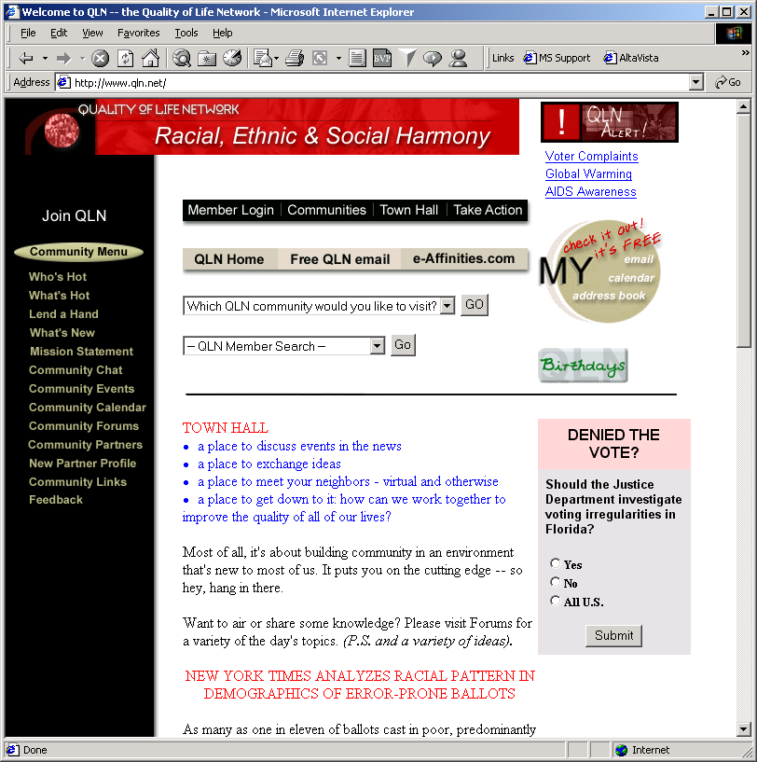
CTU Examples

Slide 16
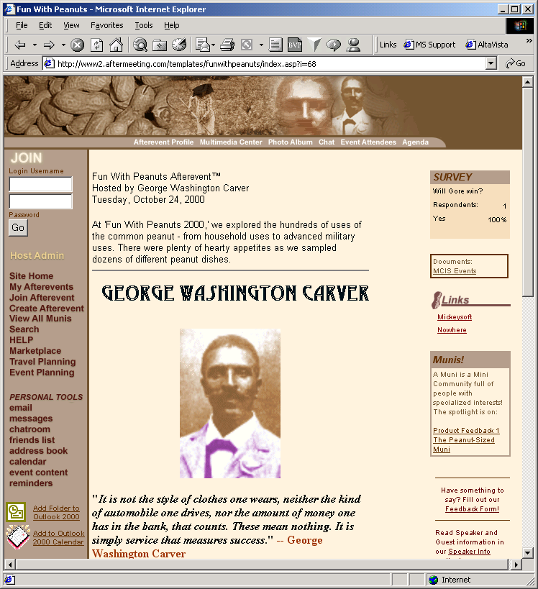
CTU Examples

Slide 17
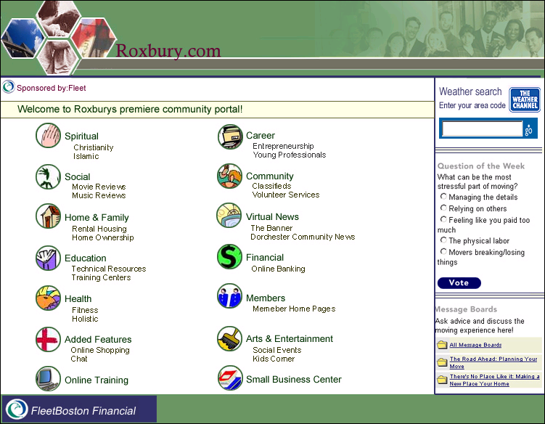
Proposed CommunityLink Portal Strategy

Slide 18
Proposed CommunityLink Portal Strategy
Proposal
Discovery Process
Project Scope Document
Platform Functional Design
Functional Specification
Platform Development
Platform Testing
Platform Rollout/Launch

Slide 19
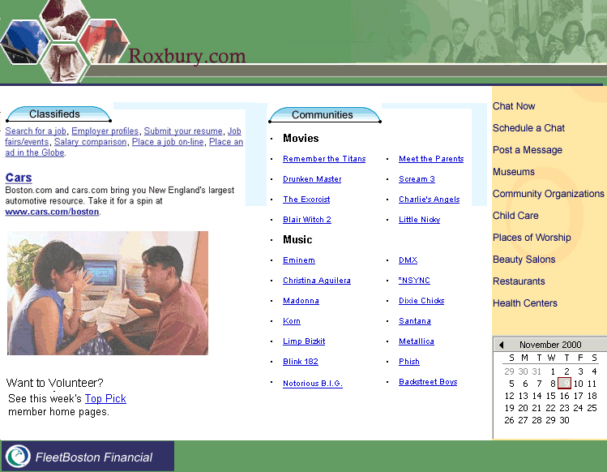
Questions

