Slide 1



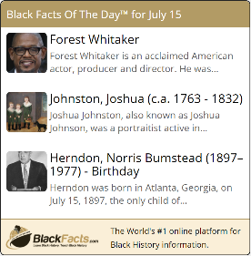


The Internet’s First Black History Encyclopedia, Launched in 1997
100% Black Conceived, Created, Controlled and Owned
Black History
Black News
Black History
Videos
Putting Black Communities In Control of Our Narratives
We EMPOWER BLACK PEOPLE THROUGH TECHNOLOGY
Notes:
Good Evening, My Name is Ken Granderson and I am the Chief Technology Officer of BlackFacts.com, the World’s 1st Online Black History Encyclopedia
And I’m Dale Dowdie, BlackFacts’ CEO.
BlackFacts Delivers Three Types of Content:
Black History
Black News
Black History Videos

Slide 2

What is the Problem?
1
Corporations are challenged to implement and quantify the effectiveness of their DEI initiatives.
2
Schools and the communities they serve are grappling with the impact of Historical Erasure in increasing levels.
3
Organizations, Academics and Governments are facing questions around Critical Race Theory and its impact.
2
Notes:
Since the George Floyd Video and the Cultural Awaken that took place as a result … the Ideas like INCLUSION, IMPLICIT BIAS and a general Awareness of the role of race in education and corporate decision making has taken hold around the globe.

Slide 3






The Solution – BlackFacts Diversity Widgets
We deliver CONTENT to help EDUCATE, INSPIRE and ENGAGE Employees, Clients and Schools about Black History and Culture, as well as other Diverse Communities.
KEY BENEFITS:
Simple to Use
Lots of Variety
Subscription Based
Trusted Resource
Metrics Reporting
Custom Branding
3
Notes:
SIMPLE to USE – Plug-and-Play. One line of code on any Webpage and it’s Done! Content is updated automatically each day.
LOTS of VARIETY – Over 600 Videos and 500,000 Historical Facts and News Articles – with more added each day
SUBSCRIPTION BASED – Manageable Costs, get as little or as much content as you desire – based on topic and campaign.
TRUSTED RESOURCE – BlackFacts.com is the World’s First and longest-running digital encyclopedia of Black History since 1997 and is #1 for “Black Facts” in all 3 major search engines.
METRICS REPORTING – Anonymous Tracking of User Activity and Clicks allows you to understand the effectiveness of your campaigns and which items draw the most interest
CUSTOM BRANDING – Our Widgets can be customized with your Colors and Logo to solidify your brand as being on the leading edge of approaching diversity with 21st Century techniques

Slide 4
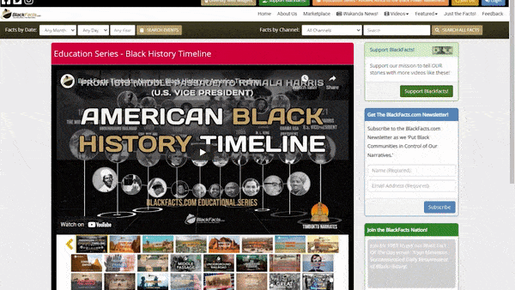
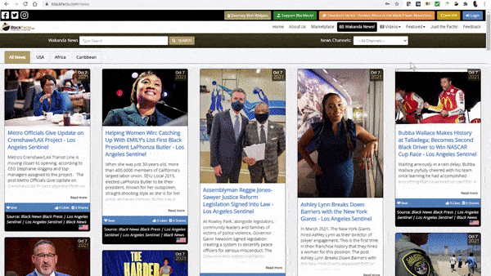

BlackFacts.com Offers:
Black History
Black News
Black History Videos

Slide 5
BlackFacts.com: By The Numbers
5

Slide 6






BlackFacts: ‘Creating the Future of Black History’ by:
1
Collecting Our Black History Stories and News Digitally via Our Proprietary Platform
2
Organizing Our Stories using Artificial Intelligence
3
Publishing Our Stories to Any Site or Device
4
Saving Our Stories Forever for Future Generations
on a Platform We Own and Control

Slide 7






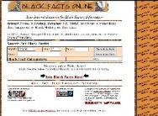
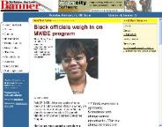




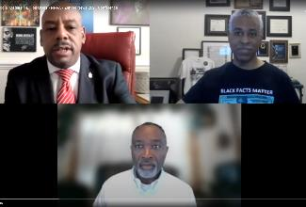

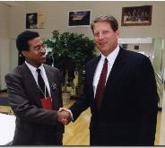
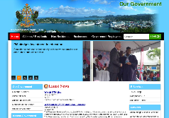
Our Unique Foundation / Qualifications
Technical Wizardry
We Are World-Class Technologists First
We Are Platform Architects
We Create Our Own Platforms and IP
Diversity Technology Pioneers
1st Online Urban Communities – 1996
1st Online Black History Encyclopedia - 1997
1st Self-Published Online Black Newspaper – 2001
Diversity History / News Web Widgets - Today
25-Year Track Record
Building Online Tech Since BBS Days
Always Stayed True to the Community
Creating New Solutions Every Month
We Have Global Reach
Built USA Community and Regional Solutions in the 90s
Put Government of Saint Lucia Online, 2014
Wakanda News - 200 Black News Sources from 35 Countries

Slide 8




















BlackFacts.com Core Business Model
BlackFacts.com
BlackFacts
Content Bots
Content is organized via our proprietary Timbuktu™ Content Management System and external Artificial Intelligence APIs
Digital Griots
Mobile Web
Revenue Streams
Diversity Content Widgets
Corporate Sponsorships
Banner Advertising
Premium Membership
Diversity Showcase Sites
BlackFacts Legacy Sites
Marketplace Affiliate Sales
Consumers
Any Site Visitor
Content Creators
Content Consumers
Polls & Quizzes
Associations
Associations and Schools
Historians
Push Notification
Consumers get BlackFacts content on any platform by visiting BlackFacts or Affiliate websites or receiving notifications via Email/Text/Social Media.
BlackFacts content is syndicated via BlackFacts Widgets hosted on affiliate sites and entire custom BlackFacts-driven partner sites.
Content is submitted by BlackFacts Users, Griots and our proprietary web crawlers, from online pages, social media sharing, uploaded documents and (in Year 2) media.
Sponsors / Advertisers / Vendors
While access is free to all, Premium Memberships, the Wakanda Marketplace and Banner Advertising generate BlackFacts’ Revenue

Slide 9

Commercialization and Growth Plan
3 Year Strategic Objectives
To grow our existing platform from being a ‘Popular’ Black History reference website with a #1 Google/Bing/Yahoo Search position, 1.6MM average monthly impressions and 200K Social Media Following to THE #1 online source for Black History and Black Cultural Impact, Contributions and News and Resources. Thus becoming, the de facto BLACK WIKIPEDIA.
Then, leveraging our Technology Platform to digitally empower businesses, organizations, schools and communities of color!
3 Year Tactical Objectives
Year 1: 2021 Portfolio (Grow It!)
Expand Content, Features and Products
Outreach and Awareness Campaign
Year 2: Brand (Establish It!)
Engage: Affiliates, Partners & Sponsors
Black News Syndicate & Diversity Content Distribution
Year 3: Scale (Leverage It!)
Open Sales Funnel, Leverage Social Media and Automation
Monitor Audience Engagement
Wash / Rinse / Repeat
30 Million Unique Visitors/Month
1 Million Premium Members
Content and Demographic Tracking
Outreach and Membership Services
Technology Solutions for the Black Community
New Products and Revenue Streams
Targeted solutions for Schools and Students
1 Million Black History Facts
150,000 Black Vendors
9

Slide 10

Sponsors/ Partners / Advertisers
$$
Marketplace/ Products
Diversity Widgets
Premium Membership
GROWTH PROJECTIONS
2021 - Focusing on Diversity Content Widgets
Growth Strategy:
Leveraging our Diversity Widgets for Corporate and School Subscribers
YTD Earnings: $59,220
$25k – from 2 Corp Sponsors
$20k – Consulting Services
$12k – Diversity widget Corp Client
$2,220 – 25 x Silver + 43 x Gold Members
Notes:
Our Projections are VERY conservative. And our pricing in more “Introductory” Pricing – we believe the market will bare much more – especially schools. But we think that at the current pricing it becomes a no brainer for most organizations to subscribe without any concerns of cost… Minimal Friction.
Also you may note that the target for Schools (which we believe will be our biggest revenue source, even though they have the most inexpensive costs) is only 1000 Schools.
We expect that number to be closer to 10,000 even as we initially target primarily Urban School Districts. For perspective – NY has over 1200 public schools, and we recently resumed talks with one of the principles of the schools, with whom we had discussions prior to the pandemic. He was so impressed by what we had to offer that not only did he agree to subscribe but he wanted to introduce us to his History and Social Studies teachers to see if they could make use of the content in their courses AND he wants to introduce us to the Chancellor of all Public Schools. He believe there is a good chance for us to become providers for many if not all NY public schools.. And that is just public schools not private or parochial schools.

Slide 11







BlackFacts.com – The Ask!: Angel
Expand core team of developers and DBA resources to speed up buildout of key features and support expanded membership and ads/sponsor requirements
Ken G. Sr Developer – FT ($150k)
$500K
(Seed Investment)
Technology
Services
($336k)
Outreach
&
Sales
($72k)
Content Growth
($24k)
Operations & Marketing
($68k)
Full Stack Developer – FT ($100k)
Dale D. Management – PT ($50k)
Increased budget for business developments resources and Sales teams to reach out to Urban Schools and Sponsors
DBA – PT ($36k)
Graphics Designer – PT ($24k)
2 x Sales/Bus. Dev – PT ($12k x 2)
Social Media/ Marketing – PT ($24k)
Continue to grow our Site Content with News, Diversity Jobs, Black Business Directory. expand partnership opportunities and invite GRIOTS and content creators
Content Mgr/Historian – PT ($24k)
Operations/Marketing cost ($68k)
Operational costs for hosting infrastructure and Marketing costs in awareness campaigns on social media with added press releases and targeted news stories

Slide 12



BlackFacts.com Management Team / Staff
Ken Granderson - Founder / Chief Technology Officer MIT alumnus and Tech Visionary, Creating Ethnic Technology since 1995, Creator of BlackFacts.com, Roxbury.com, Official Website of the Government of St. Lucia (https://kengranderson.com)
Dale Dowdie - Chief Executive Officer Enterprise-Level Technical Consultant / Entrepreneur Building Online Business Applications and facilitating Tech Transformation, Data Centers Buildouts and DR/BCP Strategies since the 1980s for Clients including Harvard University, NASA, Multi-national Banks, Liberty Mutual, Staples, TJX, EDS, IBM, McCormick, MassHousing and the City of New York
ken@blackfacts.com 857-222-2318
ddowdie@blackfacts.com 781-858-6852
Other Resources in Part-Time, Paid and Unpaid Consultant Roles:
Michelle Tutunjian (Business Analyst), Cardwell Washington (Database Management), Gina Milton (Executive Assistant), Sandra Bone (Social Media), Beatriz Callejas (Social Media), Offshore Development Resources in India (Pilots and Product Support)
12

Slide 13

Notes:
Black Facts Matter.

