Slide 1

The Internet’s First Black History Encyclopedia, Launched in 1997
100% Black Conceived, Created, Controlled and Owned
Putting Black Communities In Control of Our Narratives
We create technologIES THAT
uplift the race

Slide 2

Putting Black Communities In Control of Our Narratives
1
Blackfacts Is Creating Tools for
Journalists
Educators
Media Companies
Activists
Historians
Thought Leaders
Individuals
Web Site Owners
Civic Leaders
Faith Leaders
Business Leaders
3
To Any Electronic Devices / Feeds, including
Web Browsers
Mobile Devices
Tablets
Email
Jumbotrons
RSS Feeds
Other Digital Displays
4
On Intellectual Property and Technology Infrastructure that
We Created
We Own
We Manage
We Control
We Protect
2
To Publish Online Content to be
Categorized
Cross-Indexed
Syndicated
So that Never Again Will Others be able to Ignore, Overlook or Destroy the Record of our Achievements, Successes and Triumphs
2
Notes:
PC: Big Picture: Does the word "Stories" leave out any other major effort of the business? Or do Stories incorporate Black Schools, Black marketplace, etc...? Is there a better, grander, more-encompassing word to use than "Stories"?
KG: The term ‘stories’ came to mind because I have seen it used in many places recently in regard to historical ‘stories.’ The intended message is that we are managing the building blocks of what ultimately comprises what we call ‘history’ at a ‘molecular’ level, i.e. can organize them at will to create anything we need.
PC: Instead of Word, Twitter, etc... Icons, could we use words that the describe the types of things that one finds in BlackFacts like "Historical Events", "People", "Products for Sale", "Schools", "Oral History", etc...?
KG: The intended message was that no matter where the historical information comes from, we can incorporate it into BlackFacts.
PC:
- I like the visual icons for #1
- The icons for #2 are unfamiliar accept for our logo and the cloud
- There might be too many icons for #3 (e.g. redundancy of handheld devices)
- I am unfamiliar with the icon for #4 (looks like a Star Trek communicator?)
KG: All the graphics are conceptual – seeking to convey an idea, with the same or different graphics.
The AI graphic is using logos of AI engines - Watson/Aylien/Azure Cognitive Services to show info flowing through them
The Devices image is trying to communicate the idea of posting once, and it showing up anywhere
Yes, that IS an Original Trek Communicator – Along with the Federation and Klingon symbols, Blackfacts is right there! The message to convey is that Blackfacts is forever

Slide 3



Our Unique Foundation / Qualifications
Technical Wizardry
Blackfacts is a Black Tech Company founded by Black Tech Wizards, with a combined half-century of professional tech industry experience running their own tech consultancies, as well as writing code for technology leaders including NASA, Phoenix Technologies, IBM and Hewlett-Packard.
One Blackfacts Founder has managed technology projects for billion-dollar organizations, and the other is an MIT alumnus who, as the #1 DJ in the Black College market in the Northeast US in the 80s, literally ‘partied through MIT.’ So we do Tech better than most in the industry.
Unmatched Vision
In addition to launching Blackfacts in 1997 as the Internet’s First Black History Encyclopedia, the Blackfacts Leadership Team created precursors to Facebook, Yelp and Yahoo Groups for the Black community several years before those well-known sites, put Boston’s communities of color online in the 90s, and built a newspaper site management system that put Boston’s Black Newspaper online in 2001.
We have always been WAY ahead of the curve, and still are today.
Track Record
While in 2020, many are just starting to talk about Diversity in Technology, since 1995, the Blackfacts Leadership Team has been Living Tech Diversity by creating tech products and online services that ‘Bring Communities of Color into the Information Age’ and have created and delivered solutions to small and large businesses, as well as to communities at local to international levels.
While in 1997, Blackfacts was conceived as a ‘Community Technology Awareness Project’ intended to help the Black community see itself as a participant in the then-new brave new world of the Internet, in 2018, the Blackfacts Team decided to evolve it into a social venture that would leverage our technical expertise and commitment to community to create a unique platform to put Us in control of telling and disseminating our stories via the Internet.
So here we are.
3
Notes:
PC: Big Picture: Does the word "Stories" leave out any other major effort of the business? Or do Stories incorporate Black Schools, Black marketplace, etc...? Is there a better, grander, more-encompassing word to use than "Stories"?
KG: The term ‘stories’ came to mind because I have seen it used in many places recently in regard to historical ‘stories.’ The intended message is that we are managing the building blocks of what ultimately comprises what we call ‘history’ at a ‘molecular’ level, i.e. can organize them at will to create anything we need.
PC: Instead of Word, Twitter, etc... Icons, could we use words that the describe the types of things that one finds in BlackFacts like "Historical Events", "People", "Products for Sale", "Schools", "Oral History", etc...?
KG: The intended message was that no matter where the historical information comes from, we can incorporate it into BlackFacts.
PC:
- I like the visual icons for #1
- The icons for #2 are unfamiliar accept for our logo and the cloud
- There might be too many icons for #3 (e.g. redundancy of handheld devices)
- I am unfamiliar with the icon for #4 (looks like a Star Trek communicator?)
KG: All the graphics are conceptual – seeking to convey an idea, with the same or different graphics.
The AI graphic is using logos of AI engines - Watson/Aylien/Azure Cognitive Services to show info flowing through them
The Devices image is trying to communicate the idea of posting once, and it showing up anywhere
Yes, that IS an Original Trek Communicator – Along with the Federation and Klingon symbols, Blackfacts is right there! The message to convey is that Blackfacts is forever

Slide 4



BlackFacts Today: ‘Creating the Future of Black History’ by:
1
Collecting Our Black History Stories and News Digitally via Our Proprietary Platform
2
Organizing Our Stories using Artificial Intelligence
3
Publishing Our Stories to Any Site or Device
4
Saving Our Stories Forever for Future Generations
on a Platform We Own and Control
4
Notes:
PC: Big Picture: Does the word "Stories" leave out any other major effort of the business? Or do Stories incorporate Black Schools, Black marketplace, etc...? Is there a better, grander, more-encompassing word to use than "Stories"?
KG: The term ‘stories’ came to mind because I have seen it used in many places recently in regard to historical ‘stories.’ The intended message is that we are managing the building blocks of what ultimately comprises what we call ‘history’ at a ‘molecular’ level, i.e. can organize them at will to create anything we need.
PC: Instead of Word, Twitter, etc... Icons, could we use words that the describe the types of things that one finds in BlackFacts like "Historical Events", "People", "Products for Sale", "Schools", "Oral History", etc...?
KG: The intended message was that no matter where the historical information comes from, we can incorporate it into BlackFacts.
PC:
- I like the visual icons for #1
- The icons for #2 are unfamiliar accept for our logo and the cloud
- There might be too many icons for #3 (e.g. redundancy of handheld devices)
- I am unfamiliar with the icon for #4 (looks like a Star Trek communicator?)
KG: All the graphics are conceptual – seeking to convey an idea, with the same or different graphics.
The AI graphic is using logos of AI engines - Watson/Aylien/Azure Cognitive Services to show info flowing through them
The Devices image is trying to communicate the idea of posting once, and it showing up anywhere
Yes, that IS an Original Trek Communicator – Along with the Federation and Klingon symbols, Blackfacts is right there! The message to convey is that Blackfacts is forever

Slide 5
Collecting Our Black History Stories and News
Crawling the Web (BlackFacts Bots)
Social Media
Academics / Griots
BlackFacts Members
BlackFacts Legacy™
BlackFacts Griot™
Just get the Story to an electronic device, we’ll take it from there!
5
Notes:
PC: Could we add a page before this page that describes what "Types" of stories we collect? (see comment 2 for Page 2)
KG: Was trying to reduce the verbiage as much as possible and try and communicate major ideas, but maybe using concrete content types might be better.

Slide 6
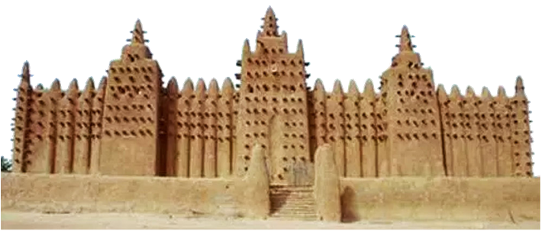
Organizing Our Stories using Artificial Intelligence
BlackFacts Uses our proprietary AI-aware Engine (code-named Timbuktu™) to Link Stories Based On:
People
Events
Places
Concepts
Keywords
Hashtags
Driving Features Like:
‘You May Also Like’
‘Also About Malcolm X’
‘The Black Church Throughout History’
‘Other Female Inventors’
‘Other Black LGBT Pioneers’
…etc.
Timbuktu™
6
Notes:
PC: Again, I am unfamiliar with the blue spherical, the capital "A" (AI?) and the sun with eye icons
KG: Explained in previous notes, AI company logos

Slide 7
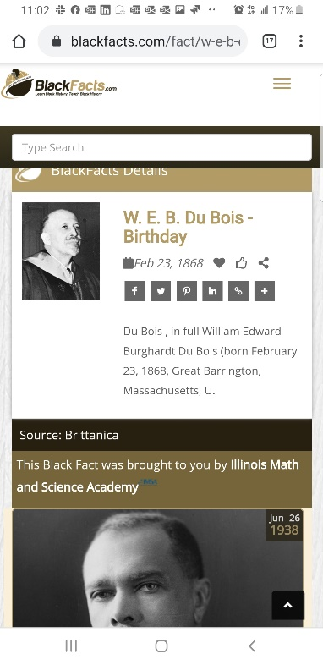
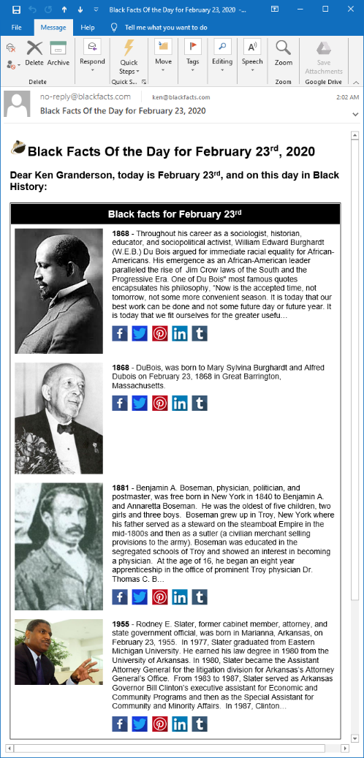
Publishing the Stories to Any Device
Blackfacts Today:
Internet’s First (1997) Searchable Black History Website
Blackfacts.com (Mobile / Tablet / Desktop)
#1 Google / Bing / Yahoo Search Result
E-Mail (Black Fact Of The Day™)
Third-Party Websites (Black Facts Widgets)
102K Facebook Following
86K Instagram Following
10K Twitter Following
Blackfacts Tomorrow:
‘Black Facts Minute™’ on Network TV
K-12 and College History Project Sites
Corporate Diversity Sites
Marketplace Affiliate Sites
Professional / Fraternal History Sites
Third-Party Video Ad Widgets
Store Displays
…etc
7
Notes:
PC: The screen captures are blurry at 200% zoom, which suggests they will be blurry if this pitchdeck were projected to a screen. Can the resolution be improved?
KG: Sure, also might want to have them fade in / out, initial concept was just showing that we already are showing the same content in multiple formats / devices

Slide 8
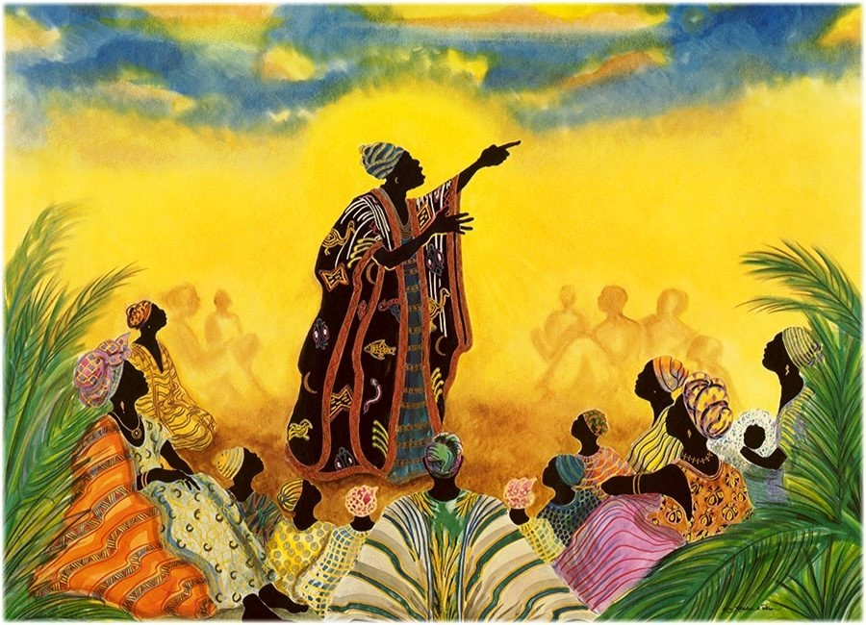
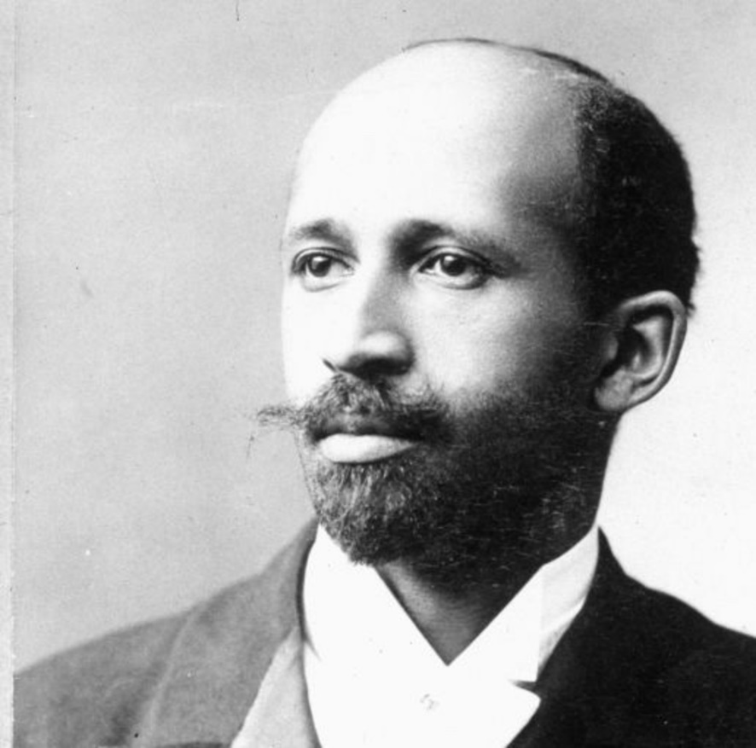



Saving the Stories Forever for Future Generations
Blackfacts.com is the realization of the lifelong dream of international scholar W.E.B. DuBois that he called the ‘Encyclopedia Africana.’
But even DuBois could not have realized that while libraries can burn, and griots die, digitized history is FOREVER, and now can be written by anyone, not just the victors of cultural battles.
8
Notes:
PC: It was stated that our e-mail, web and social media reach should be given high visibility. Could "#1 Search Result, 200k Social Media Following and 500k e-mail distribution be on a separate page with other high value marketing points (e.g. 20+ years of development)?
KG: Makes sense to me

Slide 9

Commercialization and Growth Plan
3 Year Strategic Objectives
To grow our existing platform from being a ‘Popular’ Black History reference website with a #1 Google/Bing/Yahoo Search position, 1.6MM average monthly visitors and 200K Social Media Following to THE #1 online source for Black History and Black Cultural Impact, Contributions and News and Resources. Thus becoming, the de facto BLACK WIKIPEDIA.
Then leveraging our Technology Platform to digitally empower businesses, organizations, schools and communities of color!
3 Year Tactical Objectives
Year 1: 2021 Portfolio (Grow It!)
  Expand Content, Features and Products
  Grow Membership (Free and Premium)
Year 2: Brand (Establish It!)
  Engage: Affiliates, Partners & Sponsors
  Black News Syndicate & Diversity Content Distribution
Year 3: Scale (Leverage It!)
  Open Sales Funnel, Leverage Social Media and Automation
  Monitor Audience Engagement
  Wash / Rinse / Repeat
30 Million Unique Visitors/Month
1 Million Premium Members
Content and Demographic Tracking
Outreach and Membership Services
Technology Solutions for the Black Community
New Products and Revenue Streams
Targeted solutions for Schools and Students
1 Million Black History Facts
150,000 Black Vendors
Notes:
PC: Looks great, but I still think BlackFacts has greater potential than an interactive encyclopedia. Again, can we find a word other than Stories that is grander in scope?

Slide 10



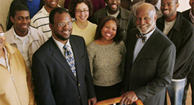


TARGET DEMOGRAPHICS
Who’s interested in Black Facts?
Consumers – Millennials and Beyond
Academia – Students, Teachers & Schools
Businesses / Professional Organizations
Sponsors & Advertisers
https://blackfacts.com
10

Slide 11




















BlackFacts.com Core Business Model
BlackFacts.com
BlackFacts
Content Bots
Content is organized via our proprietary Timbuktu™ Content Management System and external Artificial Intelligence APIs
Digital Griots
Mobile Web
Revenue Streams
Premium Membership
Premium Virtual Sites
Fact Widgets
School Sites
Blackfacts Legacy Sites
Corporate Sponsorship
Banner Advertising
Marketplace Affiliate Sales
Consumers
Any Site Visitor
Content Creators
Content Consumers
Polls & Quizzes
Associations
Associations and Schools
Historians
Push Notification
Consumers get BlackFacts content on any platform by visiting Blackfacts or Affiliate websites, or receiving notifications via Email/Text/Social Media.
BlackFacts content is syndicated via BlackFacts Widgets hosted on affiliate sites and entire custom BlackFacts-driven partner sites.
Content is submitted by BlackFacts Users, Griots and our proprietary web crawlers, from online pages, social media sharing, uploaded documents and (in Year 2) media.
Sponsors / Advertisers / Vendors
While access is free to all, Premium Memberships, the Wakanda Marketplace and Banner Advertising generate BlackFacts’ Revenue

Slide 12

Black
Influencers
Social Media
MARKETING
Strategy
Personal Network
Introduce!
Students/
Schools
DATA
LEVERAGING OUR BASE
Contacts in our Network with Influence
Inform!
Engage!
Leverage our Social Media Reach
Black Celebrities and Influencers
Schools/Students & History Activists
Past Black History Month Advertisers
Urban/Ethnic Advertisers
Activists
12

Slide 13


BlackFacts Core Platform & Services
Key revenue streams and service offerings to be rolled out on BlackFacts.com
Advertising Offerings
Leveraging the BlackFacts.com Website, Membership Emails and Social Media platforms, as well as our growing network of partners (and space on their websites) to offer Ad Space to our Advertisers
Wakanda Marketplace
BlackFacts will offer a marketplace where vendors can showcase and sell their products/services to our members and visitors. Included in the marketplace will be a FREE directory of businesses with links to their websites (with product sales in Year 2)
Sponsorships, Schools & Partners
BlackFacts offers special advertising packages, showcase Pages, promotional links to Facts and News Stories and much more to Sponsors, Educators and Partners
Subscription Services
BlackFacts will offer different tiers of subscriber services for members where they can have preferred content (Products, Services, News, Facts, Blogs) delivered to their email inbox and on their profile page on the website.
Diversity/Demographics Content
BlackFacts Smart Widgets™ offer our Historical, Diversity and Demographic content/data in a simple code snippet that can easily be customized and plugged into any website or online platform.
Notes:
In addition to updating (at least) tense for things already in play, need to add items that directly generate Revenue

Slide 14

GROWTH PROJECTIONS
2021 - Focusing on Membership Growth!
Membership
Sponsors/ Partners / Advertisers
$$
Marketplace/ Products
Growth Strategy:
Converting Free Members to Premium Offerings.

Slide 15







BlackFacts.com – The Ask!: Angel
Expand core team of developers and DBA resources to speed up buildout of key features and support expanded membership and ads/sponsor requirements
Ken G. Sr Developer – FT ($150k)
$500K
(Seed Investment)
Technology
Services
($336k)
Outreach
&
Sales
($72k)
Content Growth
($24k)
Operations & Marketing
($68k)
Full Stack Developer – FT ($100k)
Dale D. Management – PT ($50k)
Increased budget for business developments resources and Sales teams to reach out to Urban Schools and Sponsors
DBA – PT ($36k)
Graphics Designer – PT ($24k)
2 x Sales/Bus. Dev – PT ($12k x 2)
Social Media/ Marketing – PT ($24k)
Continue to grow our Site Content with News, Diversity Jobs, Black Business Directory. expand partnership opportunities and invite GRIOTS and content creators
Content Mgr/Historian – PT ($24k)
Operations/Marketing cost ($68k)
Operational costs for hosting infrastructure and Marketing costs in awareness campaigns on social media with added press releases and targeted news stories

Slide 16


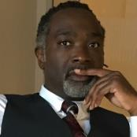
BlackFacts.com Management Team / Staff
Ken Granderson - Founder / Chief Technology Officer
MIT alumnus and Tech Visionary, Creating Ethnic Technology since 1995, Creator of BlackFacts.com, Roxbury.com, Official Website of the Government of St. Lucia (https://kengranderson.com)
Dale Dowdie - Chief Executive Officer
Enterprise-Level Technical Consultant / Entrepreneur
Building Online Business Applications and facilitating Tech Transformation, Data Centers Buildouts and DR/BCP Strategies since the 1980s for Clients including, Harvard University, NASA, Multi-national Banks, Liberty Mutual, Staples, TJX, EDS, IBM, McCormick, MassHousing and the City of New York
ken@blackfacts.com
857-222-2318
ddowdie@blackfacts.com
781-858-6852
Other Resources in Part-Time, Paid and Unpaid Consultant Roles:
Rick Van Rice (Business Development), Kevin Denny II (Front-End Development), Michelle Tutunjian (Business Analyst), Sandra Bone (Social Media), Beatriz Callejas (Social Media), Brandon Williams and Martin Pratt (Business Development), and Offshore Development Resources in India (Pilots and Product Support)

