Slide 1

Improving the Results from AI Technologies in Blackfacts
AI Analysis Challenges

Slide 2
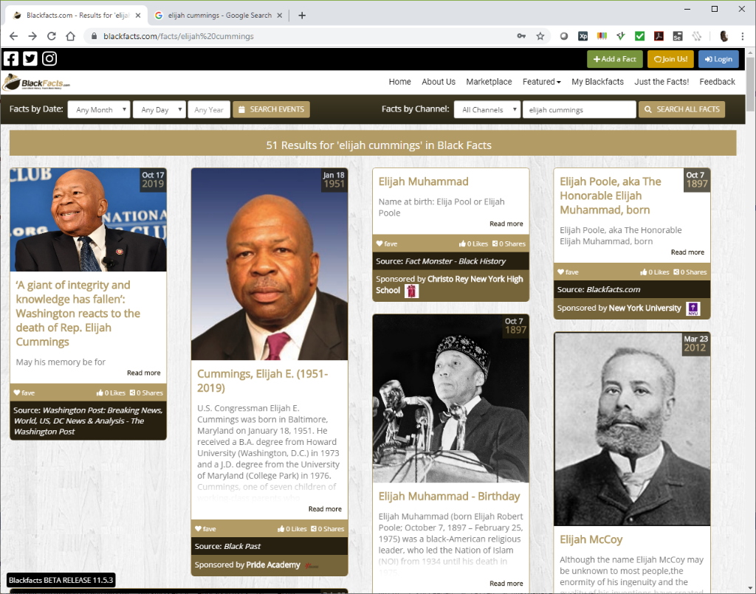
TL;DR Verison (Detailed Versions in Subsequent Slides)
Launched in 1997, Blackfacts.com is the Internet’s Black History Encyclopedia
We link Articles by running Entity Analysis from 2 AI systems (Aylien and Watson) to find common People / Places / Concepts / Keywords / etc
The Relevance numbers returned by the AI Engines are useless as they do not understand the context of the content, so Human Intervention is Required
As the AI engines generally return more ‘Noise’ than ‘Signal,’ manual selection of the ‘Good Stuff’ is labor-intensive
This reduces the potential for crowd-sourcing content, as very few will dothe work necessary to identify relevant linkages.
So we are looking for approaches used in the world of AI / Data Science / etc to enable more automation of the Entity Analysis results

Slide 3
Fact Linkage
A core feature of Blackfacts is the linkage between ‘Fact Cards’ based on various types of searches.
This linkage is based on common factors between facts, and is the foundation of Blackfacts’ efficacy as an educational tool, as it mirrors the human mind’s process of associating pieces of information with each other.
This linkage can be based on both human and machine knowledge, but Blackfacts’ future as The Black Wikipedia / Encyclopedia Africana relies on evolving the machine learning functionality to a level where it will be able to categorize and link millions of facts accurately with minimal human intervention required.

Slide 4




Fact Sources
Black Facts content can come from a variety of sources, including:
  Existing Historical Site Urls
  Online News Sites
  Member Uploaded Files
  Member Social Media Posts (future)
  Member Emails (future)
  Member Recorded Media (future)
Regardless of the source, the text of the content is extracted as the ‘lowest common denominator’ required by the AI systems currently in use (image recognition etc is in the future) and analyzed by the AI systems to identify people, places, organizations, concepts, etc that can be used to link the Facts.
Fact submitters can also add additional people, places, etc into Blackfacts to augment the frequent lack of the AI systems recognizing them, as well as the AI systems linkages being limited to the submitted text (i.e. the text not mentioning well-known organization affiliations).
BlackFacts.com
BlackFacts
Content Bots
Digital Griots
Consumers
Content Creators
Associations
Historians

Slide 5
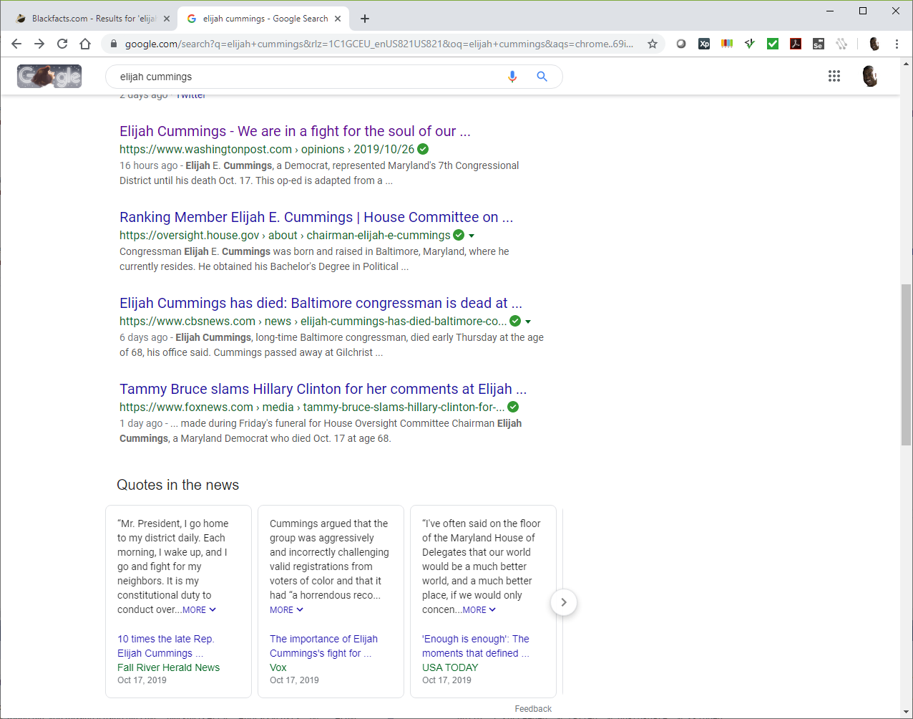
Add A Fact (Crowdsourcing Black History)
Currently, the most common Fact sources are online articles about historical or current people, events and organizations.
The image shows a Google search initiated outside of Blackfacts.com. Currently under development are in-site search tools as well as a browser extension that would enable submitting a Fact from any web page currently being viewed.

Slide 6
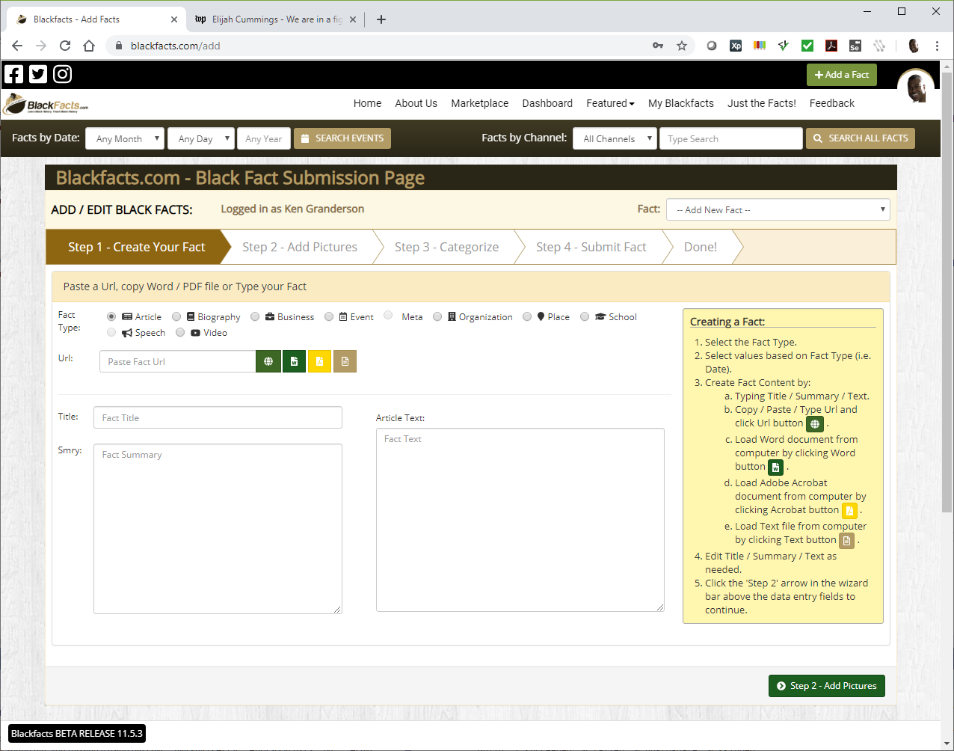
Add A Fact - Create
This is the Add A Fact page, accessed by clicking the
button in the top right of any Blackfacts page, and logging in if necessary.
The 4 buttons by the ‘Url’ field enable adding Facts by pasting in a Url or uploading a Word, PDF or Text file. This presentation will demonstrate the Url scenario.

Slide 7

Add A Fact - Create
This is the result of pasting the url https://www.washingtonpost.com/opinions/elijah-cummings-we-are-in-a-fight-for-the-soul-of-our-democracy/2019/10/26/cac744be-f4fd-11e9-a285-882a8e386a96_story.html into the ‘Url’ field, and clicking the green globe button.
This submits the url to Aylien.com, one of 2 external services Blackfacts uses for AI analysis, to extract the article content and (hopefully) identify the main article image.
In addition to Aylien’s article extraction, Blackfacts uses IBM Watson in addition to Aylien for Entity (place/place/organization) analysis, and has designed the AI service sub-system in an open manner such that we can easily add additional AI engines, like Azure Cognitive Services, AWS offerings, etc.
Other than the underlying application framework (.NET) and some freely available application widgets, the external AI systems are the ONLY third-party technologies used in Blackfacts. Everything else is our own intellectual property.

Slide 8
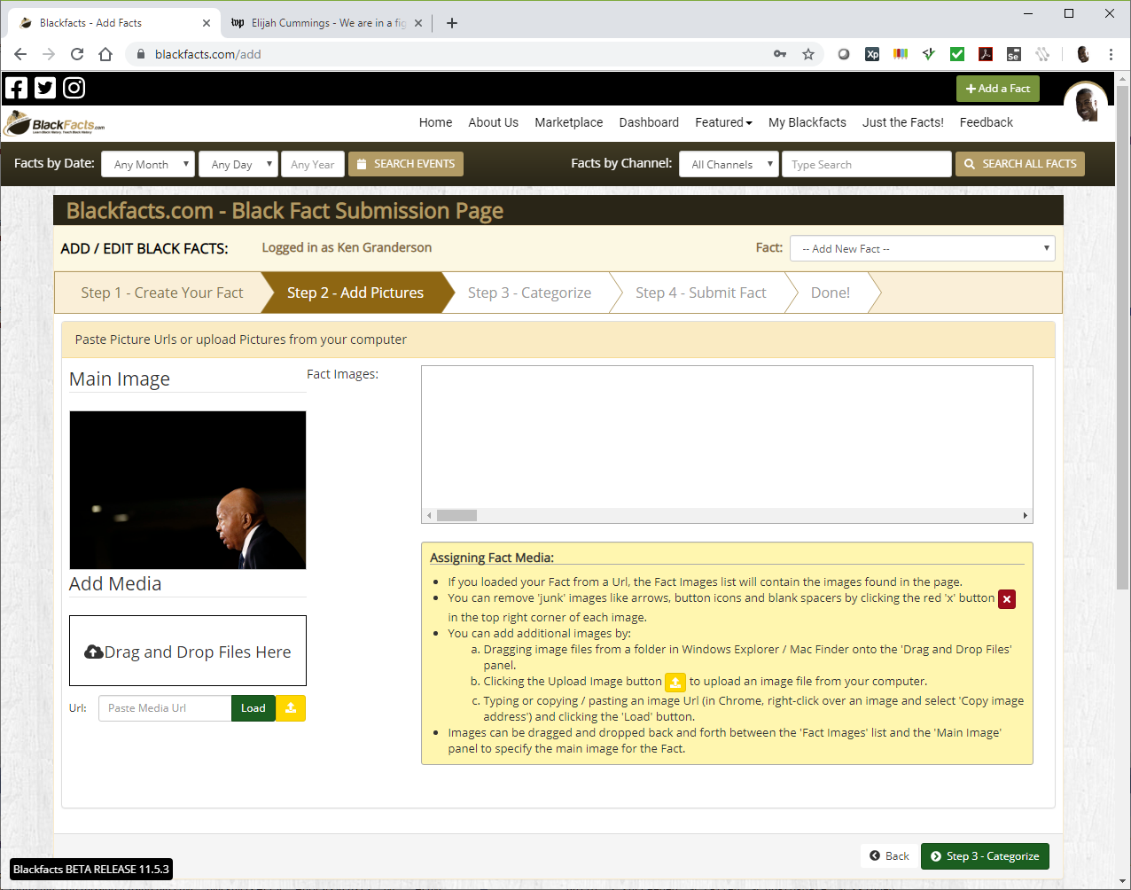
Add A Fact - Media
This is the ‘Add Pictures’ tab, showing the main article image successfully identified by Aylien.
Additional images can be added by copying / pasting their locations for a browser page into the ‘Url’ field, or dragging and dropping them from your computer.

Slide 9
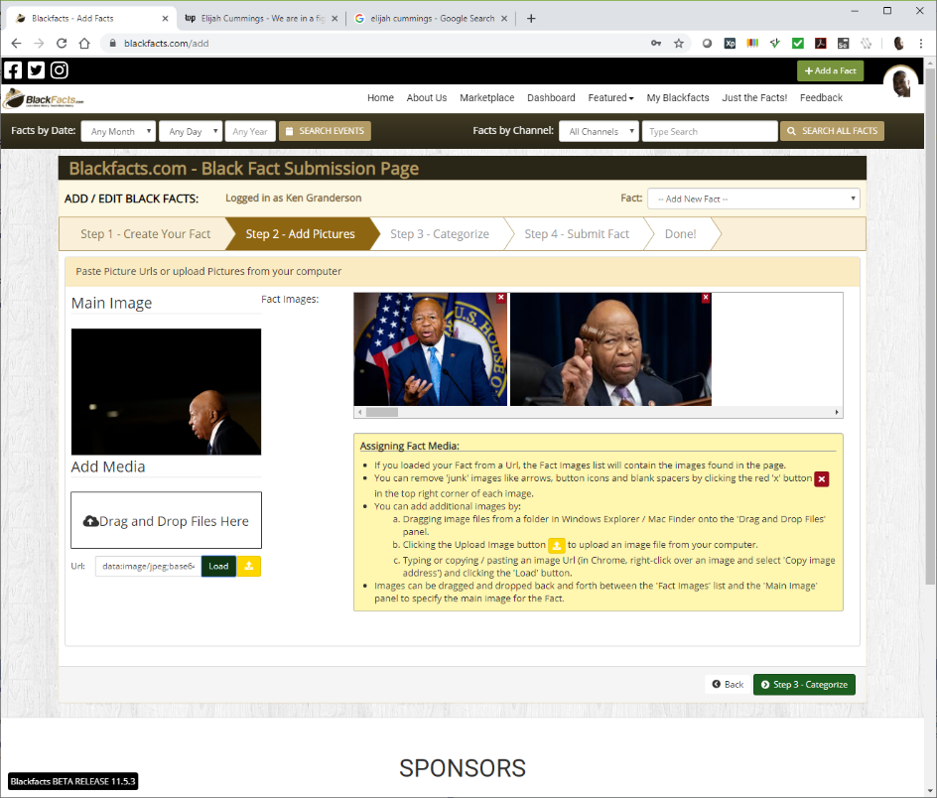
Add A Fact - Media
This is the result of doing a Google Image search for ‘Elijah cummings,’ right-clicking a couple of images and selecting ‘Copy Image Address’ and then pasting them into the ‘Url’ field.
Once in this screen, images can be made the Primary Fact Image (which shows up in the Fact Card view) by dragging it over to the left image box.

Slide 10
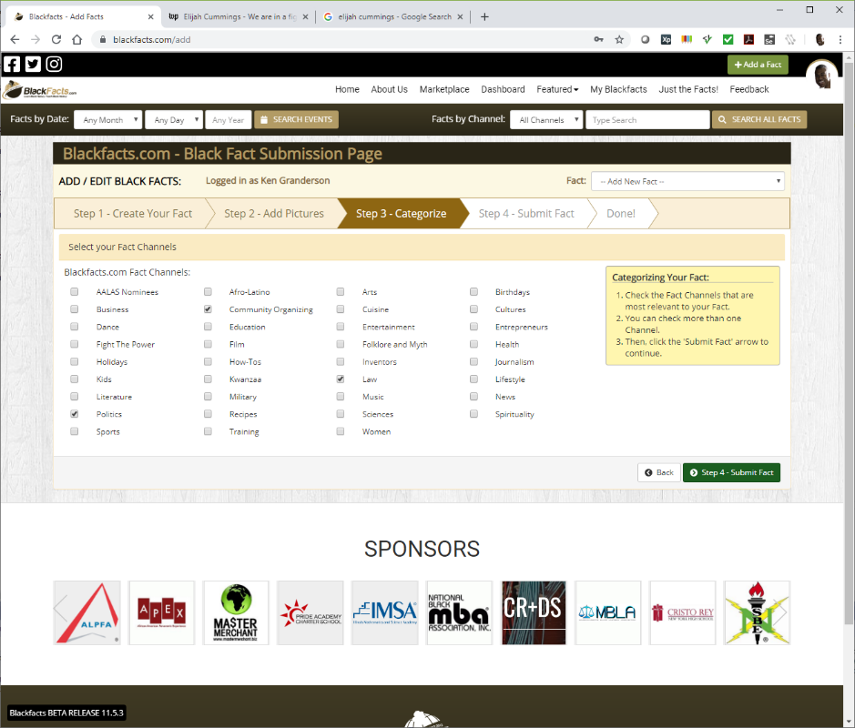
Add A Fact - Channels
Blackfacts Channels (also shown as Categories, oops,we will update for consistency) are human-organized groupings of Facts based on contextual similarity.
Channels are a primary grouping of Facts for search purposes, used to generate Channel Pages for Facts about Arts, Business, Politics, etc.
Several Channels (i.e. Afro-Latino) will not appear in the main Channels list until they contain enough content to fill up a Channel page. Including them in the Add A Fact page (and adding new Channels based on submissions) enables us to have new Channels reflect user interests.
Channels are distinct from Categories, which are automatically classified by the AI engines, and are over 430 in number.

Slide 11
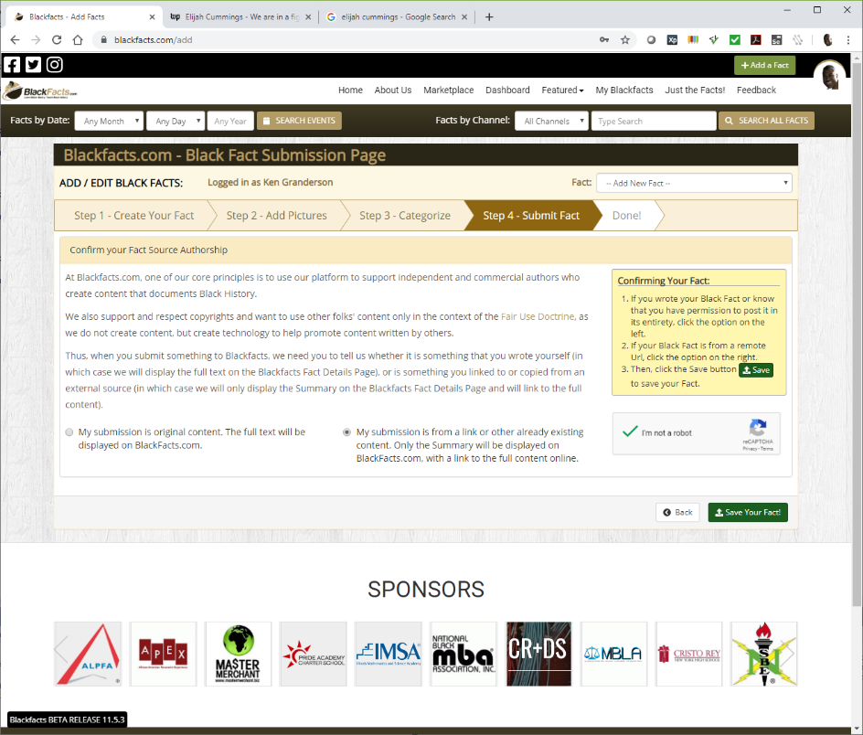
Add A Fact - Ownership
The last step (for non-Admins) of Adding a Fact is indicating whether the submitted Fact is your own content, or shared from another source.
Blackfacts uses this information to control the amount of content displayed directly on Blackfacts before linking to the original source, so that we can stay in compliance with the Fair Use Doctrine and ensure that we are promoting sites that create and publish Black History content rather than replacing them.

Slide 12

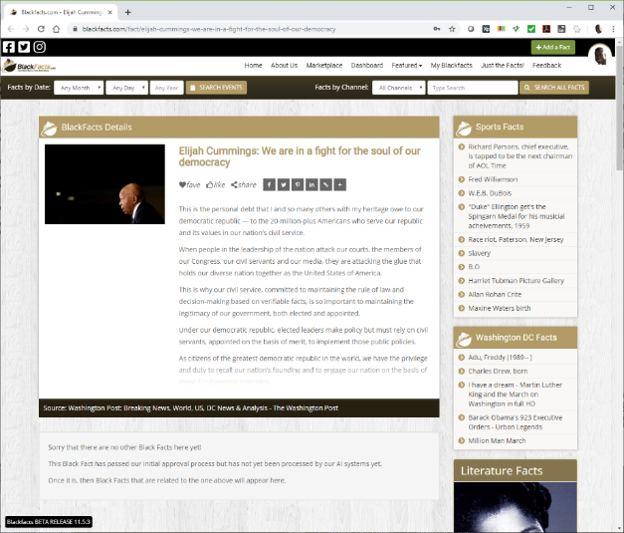
Add A Fact – Done!
As I am an Admin, my ‘Add A Fact’ submissions are automatically accepted, and my submission is immediately available on Blackfacts, although as shown under the Fact Details widget, this new Fcat has not yet been linked to any other Facts.
This is because I have not yet submitted the Fact to our Fact Analysis process, because we are currently not using trained AI models and so without human intervention, accepting all analysis results will generate an abundance of contextually irrelevant linkages, as well as the fact that the AI analysis costs money after a certain level of usage.
Back on the ‘Add A Fact’ page, I will click the ‘Analyze’ button to submit the new Fact for AI Analysis.

Slide 13
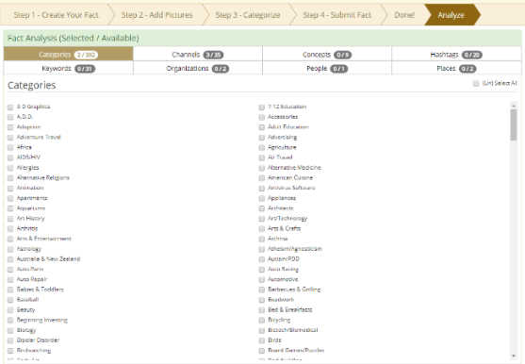
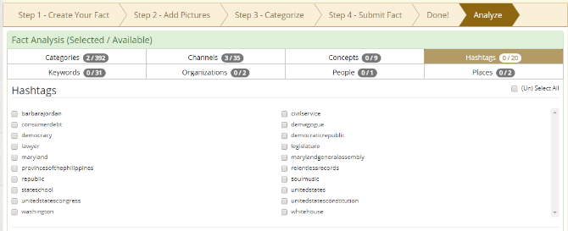
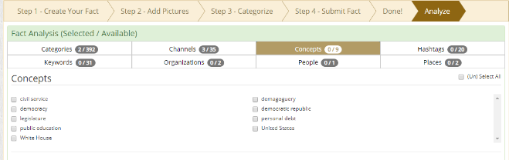
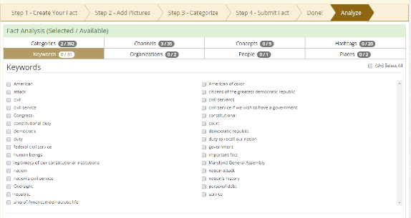
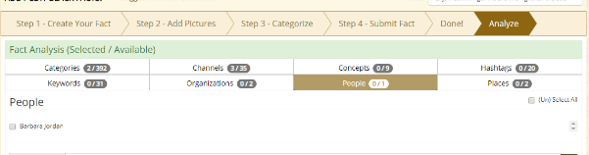
Add A Fact – AI Analysis
Blackfacts submits the entire Fact content to the ‘Natural Language Understanding’ services of Aylien and Watson, and returns their identification of the following:
  Categories (based on a standard IAB list)
  Concepts
  Hashtags
  Keywords
  Organizations
  People
  Places
As shown in the screen captures, the results can often be less than comprehensive or accurate ☹
To be fair, sparse results like this are also often the result of content where people are discussing things that mattered TO the subject, rather than the subject themselves.

Slide 14
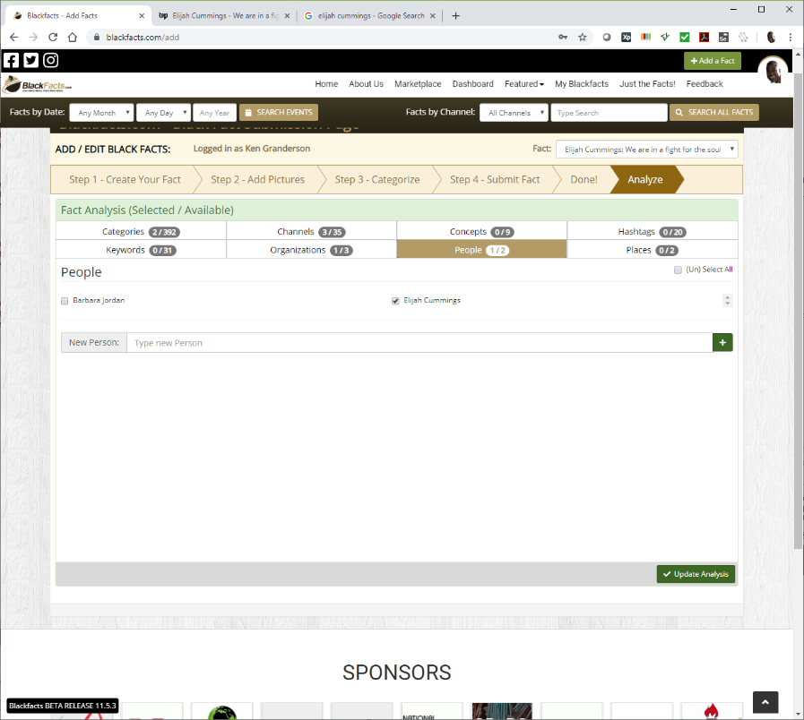
Add A Fact – AI Analysis
As this is not surprising and actually indicative of the need for Blackfacts, we have built the ability for human operators to link Facts to People / Organizations / etc not recognized by the AI engines.
These manual linkages are stored in the Blackfacts databases, as well as an adjunct database we maintain called Blackfacts.org, for a future project concept of archiving and organizing black-related content on a global level primarily for research, rather than general consumer use.

Slide 15
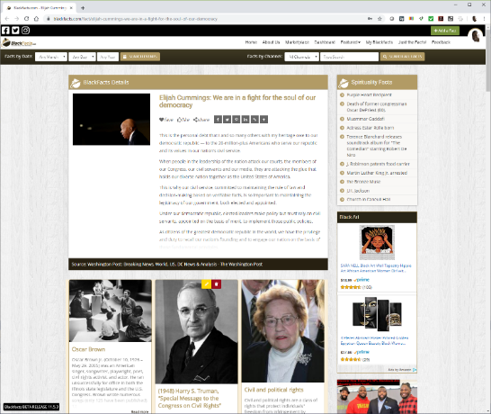
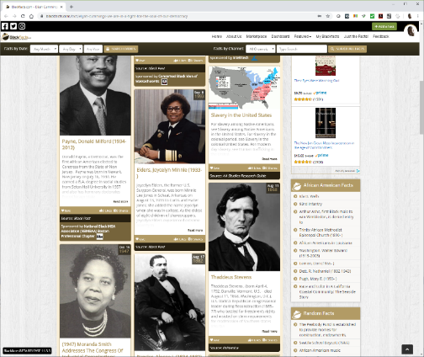
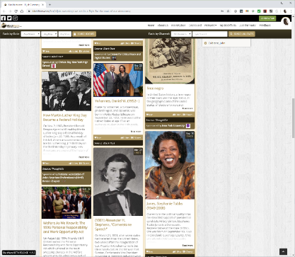
Add A Fact – Result
With the AI analysis data processed, reloading the page now shows other Black Facts that are related to the main Fact based on shared the AI analysis entities.
While the Blackfacts tech that reads external content, submits the content to the AI engines and then displays the content based on the analysis is doing its job, the inability of the AI engines ‘out of the box’ to provide richer and more contextually relevant linkages is preventing Blackfacts from delivering higher quality results.

Slide 16
Add A Fact – AI Analysis Challenges and Solutions
With our robust data models for both Fact analysis relationships and user activity, with better AI engine results, Blackfacts has the ability to generate more and more relevant Fact linkages as the basis for future features like:
  More Facts like this
  Show me more about subjects I like
  Show me more about subjects I don’t know about
  Others who found this interesting
  Facts I might be interested in
  etc
  We are confident that higher accuracy is achievable by using the learning data model capabilities of any of the AI engines. However, unlike the Natural Language Processing features that are offered at low volume for free, custom learning models have costs that will only be realistic to incur after Blackfacts has either achieved profitability through service offerings, or has secured significant external financing.

Slide 17



Ideas?
Hopefully this presentation illustrated our AI challenges.
While I am the sole architect and developer of the Blackfacts platform, I am NOT knowledgeable about AI or data science, so we are looking for ideas from those in those universes for how we might improve our AI engine results to improve accuracy, reduce manual work and thus increase the potential for scalability.
Feel free to contact me with thoughts and suggestions. Also feel free to share this with others who may be able to help. Thanks!
Ken Granderson - Founder / Chief Technology Officer
ken@blackfacts.com
857-222-2318

