Slide 1

CREATING The Future of Black History

Slide 2

Agenda
BHAG
Demo
  Google
  Web Site
    Today
    Marketplace
    News
  BFOTD
  Widgets
  Social Media
Pitch Deck
Next Steps

Slide 3



BlackFacts.com: Creating the Future of Black History by:
01
Collecting Stories Digitally
02
Organizing the Stories using AI
03
Publishing the Stories to Any Device
04
Saving the Stories Forever for Future Generations
3
Notes:
PC: Big Picture: Does the word "Stories" leave out any other major effort of the business? Or do Stories incorporate Black Schools, Black marketplace, etc...? Is there a better, grander, more-encompassing word to use than "Stories"?
KG: The term ‘stories’ came to mind because I have seen it used in many places recently in regard to historical ‘stories.’ The intended message is that we are managing the building blocks of what ultimately comprises what we call ‘history’ at a ‘molecular’ level, i.e. can organize them at will to create anything we need.
PC: Instead of Word, Twitter, etc... Icons, could we use words that the describe the types of things that one finds in BlackFacts like "Historical Events", "People", "Products for Sale", "Schools", "Oral History", etc...?
KG: The intended message was that no matter where the historical information comes from, we can incorporate it into BlackFacts.
PC:
- I like the visual icons for #1
- The icons for #2 are unfamiliar accept for our logo and the cloud
- There might be too many icons for #3 (e.g. redundancy of handheld devices)
- I am unfamiliar with the icon for #4 (looks like a Star Trek communicator?)
KG: All the graphics are conceptual – seeking to convey an idea, with the same or different graphics.
The AI graphic is using logos of AI engines - Watson/Aylien/Azure Cognitive Services to show info flowing through them
The Devices image is trying to communicate the idea of posting once, and it showing up anywhere
Yes, that IS an Original Trek Communicator – Along with the Federation and Klingon symbols, Blackfacts is right there! The message to convey is that Blackfacts is forever

Slide 4
Collecting Stories Digitally
Crawling the Web (Blackfacts Bots)
Social Media
Academics / Griots
Blackfacts Members
Blackfacts Legacy™
Blackfacts Griot™
Just get the Story to an electronic device, we’ll take it from there!
4
Notes:
PC: Could we add a page before this page that describes what "Types" of stories we collect? (see comment 2 for Page 2)
KG: Was trying to reduce the verbiage as much as possible and try and communicate major ideas, but maybe using concrete content types might be better.

Slide 5
Organizing the Stories using AI
Blackfacts Uses Current (and Future) AI Engines to Link Stories Based On:
People
Events
Places
Concepts
Keywords
Hashtags
Driving Features Like:
‘You May Also Like’
‘Also About Malcolm X’
‘The Black Church Throughout History’
‘Other Female Inventors’
‘Other Black LGBT Pioneers’
…etc
5
Notes:
PC: Again, I am unfamiliar with the blue spherical, the capital "A" (AI?) and the sun with eye icons
KG: Explained in previous notes, AI company logos

Slide 6
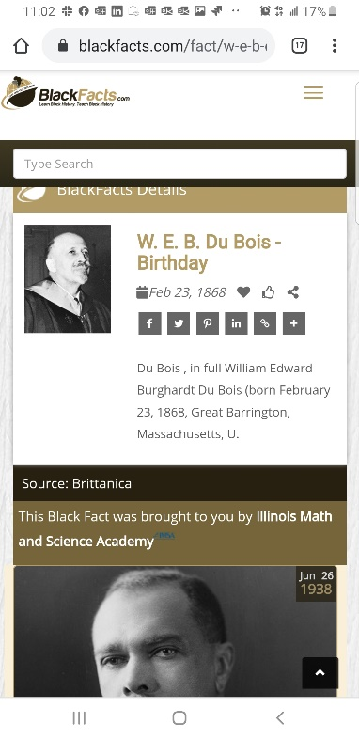
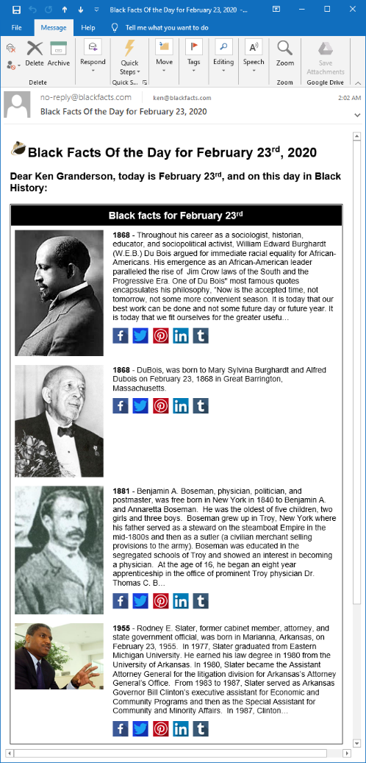
Publishing the Stories to Any Device
Blackfacts Today:
Internet’s First (1997) Searchable Black History Website
Blackfacts.com (Mobile / Tablet / Desktop)
#1 Google / Bing / Yahoo Search Result
E-Mail (Black Fact Of The Day™)
Third-Party Websites (Black Facts Widgets)
100K Facebook Following
76K Instagram Following
10K Twitter Following
Blackfacts Tomorrow:
‘Black Facts Minute™’ on Network TV
K-12 and College History Project Sites
Corporate Diversity Sites
Marketplace Affiliate Sites
Professional / Fraternal History Sites
Third-Party Video Ad Widgets
Store Displays
…etc
6
Notes:
PC: The screen captures are blurry at 200% zoom, which suggests they will be blurry if this pitchdeck were projected to a screen. Can the resolution be improved?
KG: Sure, also might want to have them fade in / out, initial concept was just showing that we already are showing the same content in multiple formats / devices

Slide 7
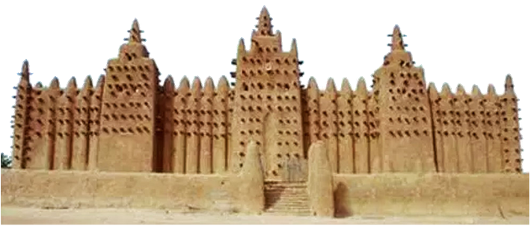
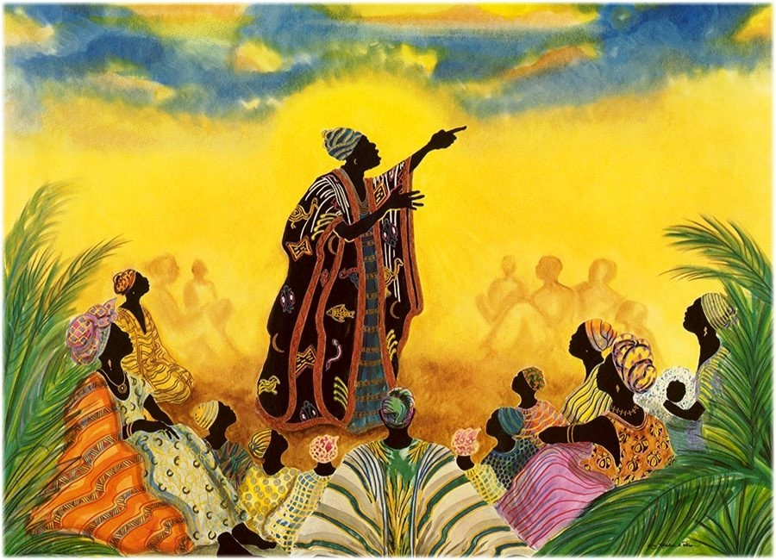
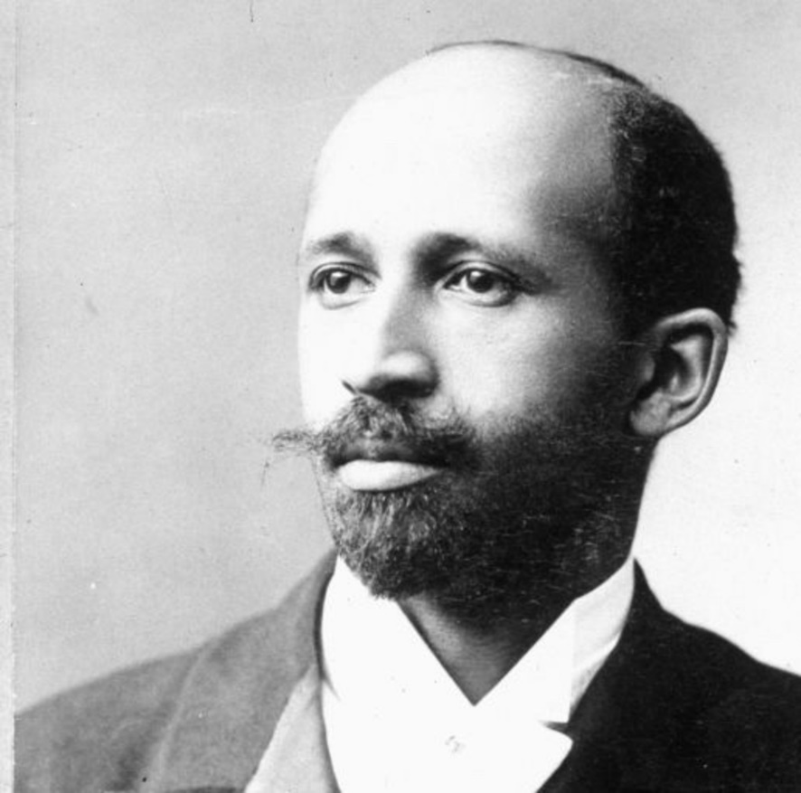



Saving Our Stories Forever for Future Generations
Blackfacts.com is the realization of the lifelong dream of international scholar W.E.B. DuBois that he called the ‘Encyclopedia Africana.’
But even DuBois could not have realized that while libraries can burn, and griots die, digitized history is FOREVER, and now can be written by anyone, not just the victors of cultural battles.
7
Notes:
PC: It was stated that our e-mail, web and social media reach should be given high visibility. Could "#1 Search Result, 200k Social Media Following and 500k e-mail distribution be on a separate page with other high value marketing points (e.g. 20+ years of development)?
KG: Makes sense to me

Slide 8
DEMO
8
Notes:
PC: The screen captures are blurry at 200% zoom, which suggests they will be blurry if this pitchdeck were projected to a screen. Can the resolution be improved?
KG: Sure, also might want to have them fade in / out, initial concept was just showing that we already are showing the same content in multiple formats / devices

Slide 9

Commercialization and Growth Plan
3 Year Strategic Objectives
To grow our existing platform from a black history reference website to THE #1 online source for Black History and Black Cultural Impact, Contributions and News and Resources. Thus becoming, the de facto BLACK WIKIPEDIA.
Then leveraging our Technology Platform as toolset to empower and integrate businesses, schools and communities of color!
3 Year Tactical Objectives
Year 1: Portfolio (Grow It!)
  Expand Content, Features and Products
  Grow Membership (Free and Premium)
Year 2: Brand (Establish It!)
  Engage: Affiliates, Partners & Sponsors
  Black News Syndicate & Diversity Content Distribution
Year 3: Scale (Leverage It!)
  Open Sales Funnel, Leverage Social Media and Automation
  Monitor Audience Engagement
  Wash / Rinse / Repeat
Content and Demographic Tracking
Outreach and Membership Services
Technology Solutions for the Black Community
New Products and Revenue Streams
Targeted solutions for Schools and Students
Notes:
PC: Looks great, but I still think BlackFacts has greater potential than an interactive encyclopedia. Again, can we find a word other than Stories that is grander in scope?

Slide 10



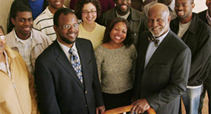


TARGET DEMOGRAPHICS
Who’s interested in Black Facts?
Consumers – Millennials and Beyond
Academia – Students, Teachers & Schools
Businesses / Professional Organizations
Sponsors & Advertisers
https://blackfacts.com
10

Slide 11




















BlackFacts.com Core Business Model
BlackFacts.com
BlackFacts
Content Bots
Revenue Streams
Premium Membership
Premium Virtual Sites
Fact Widgets
School Sites
Blackfacts Legacy Sites
Corporate Sponsorship
Banner Advertising
Marketplace Affiliate Sales
Digital Griots
Mobile Web
Consumers
Any Site Visitor
Content Creators
Content Consumers
Polls & Quizzes
Associations
Associations and Schools
Historians
Push Notification
Consumers get BlackFacts content on any platform by visiting the website or receiving push notifications via Email/Text/Social Media.
BlackFacts content is syndicated via BlackFacts Widgets hosted on affiliate sites and entire custom BlackFacts-driven partner sites.
Content is submitted by BlackFacts Users, Griots and our proprietary web crawlers, from online pages, social media sharing, uploaded documents and (in Year 2) media.
Sponsors / Advertisers / Vendors
While access is free to all, Premium Memberships, the Wakanda Marketplace and Banner Advertising generate BlackFacts’ Revenue

Slide 12

Black
Influencers
Social Media
MARKETING
Strategy
Personal Network
Introduce!
Students/
Schools
DATA
LEVERAGING OUR BASE
Contacts in our Network with influence
Inform!
Engage!
Leverage our Social Media Reach
Black Celebrities and Influencers
Schools/Students & History Activists
Past Black History Month Advertisers
Urban/Ethnic Advertisers
Activists
12

Slide 13


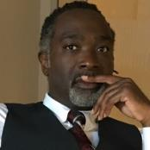
BlackFacts.com Management Team
Ken Granderson - Founder / Chief Technology Officer
MIT alumnus and Tech Visionary, Creating Ethnic Technology since 1995, Creator of BlackFacts.com, Roxbury.com, Official website of the Government of St. Lucia
Dale Dowdie - Chief Executive Officer
Enterprise-Level Technical Consultant / Entrepreneur
Building Online Business Applications and facilitating Tech Transformation, Data Centers Buildouts and DR/BCP Strategies since the 1980s for Clients including, Harvard University, NASA, Multi-national Banks, Liberty Mutual, Staples, TJX, EDS, IBM, McCormick, MassHousing and the City of New York
Other Resources in Part-Time, Paid and Unpaid Consultant Roles:
Peter Conroy and Rick Van Rice (Business Development), James Mwihia (QA and Tech Support), Michelle Tutunjian (Business Analyst), Sandra Bone (Social Media), Beatriz Callejas (Social Media), Melanie Semedo (Social Media) and Offshore Development Resources in India (Pilots and Product Support)
Notes:
PC: Does the inclusion of "Other Resources" help or hurt when asking for angel investment?
If it helps, reformat as a bullet like Ken's and Dale's with a generic "Group of People" Icon
If it hurts, remove this section.
KG: Out of my ‘lane’ to say, was looking to acknowledge / present a Team rather than the Ken and Dale Show

Slide 14

BlackFacts.com – The Ask!
Ken G. Sr Developer - FT
Dale D. Management - PT
$500k
(Angel Investment)
Technology
Services
Outreach
&
Marketing
Content Growth
Having a focused Team of Core Developers to build new features and support expanded site membership
Front-End Developer - FT
Designer Resource - PT
Business Dev Resource - PT
Marketing - PT
Social Media - PT
Increased budget for marketing of our solutions with a focus on Social Media and Educators/Schools
Content Mgr/Historian - PT
Continue to grow our Site Content with News, Diversity Jobs, Black Business Directory and more!
Angel Investment Returns:
200% in 3 Years
(Option for 1% Equity for each 100k Individual Investment)

Slide 15


FINANCIAL FORECAST
The Path to Profitability
 | Year - 1 (2021) | Year - 2 (2022) | Year - 3 (2023)
Member Subscriptions | $150,000 | $500,000 | $1,500,000
Sponsorship Revenue | $50,000 | $300,000 | $1,000,000
Product/Service Revenue | $50,000 | $400,000 | $1,500,000
Advertising Revenue | $50,000 | $500,000 | $1,000,000
Salaries/Wages/Marketing | ($200,000) | ($500,000) | ($1,000,000)
Gross Profit | $100,000 | $1,200,000 | $4,000,000
Investment Expense | ($0) | ($200,000) | ($800,000)
Operating Expenses | ($50,000) | ($150,000) | ($350,000)
Net Income | $50,000 | $850,000 | $2,850,000
30 Million Unique Visitors/Month
1 Million Premium Members
1 Million Black Facts
150,000 Black Vendors
https://blackfacts.com
15
Notes:
PC: Already discussed adding "Investment Income" line item.
KG: Agreed but did not add yet because it would require some reformatting of the table, which I would like to try and do just once, after some discussion / refinement of the numbers.

Slide 16

2021 REVENUE PROJECTIONS
Path to $250,000 in Revenue
Groups/Lifetime
($150 x 50) = $7.5k
5%
30%
15%
Wakanda Services = $15k
Advertisers = $15k
10%
Family ($50 x 300) = $15k
70%
Products = $35k
Educational Sponsors = $35k
35%
Gold ($25 x 1500) = $37.5k
25%
50%
Corporate Sponsors = $50k
60%
Silver ($15 x 6000) = $90k
Premium Membership
$150k
Products/
Services
$50k
Advertisers/
Sponsors
$100k
Notes:
PC: Should the "Path to $250k" be 'Path to' a higher figure? Even without investment income, the income items on Page 13 tally to $300k = $150k + $50k +50k +50k.
KG: Yes, and I think all of the numbers should be reviewed / refined to the point where anyone who might be sharing this would be fluent in what they meant.

Slide 17

Questions?
Ken Granderson - Founder / Chief Technology Officer
ken@blackfacts.com
857-222-2318
Dale Dowdie - Chief Executive Officer
ddowdie@blackfacts.com
781-858-6852

