Slide 1

Current and Future Usage of AI Technologies in Blackfacts
Fact AI Overview

Slide 2
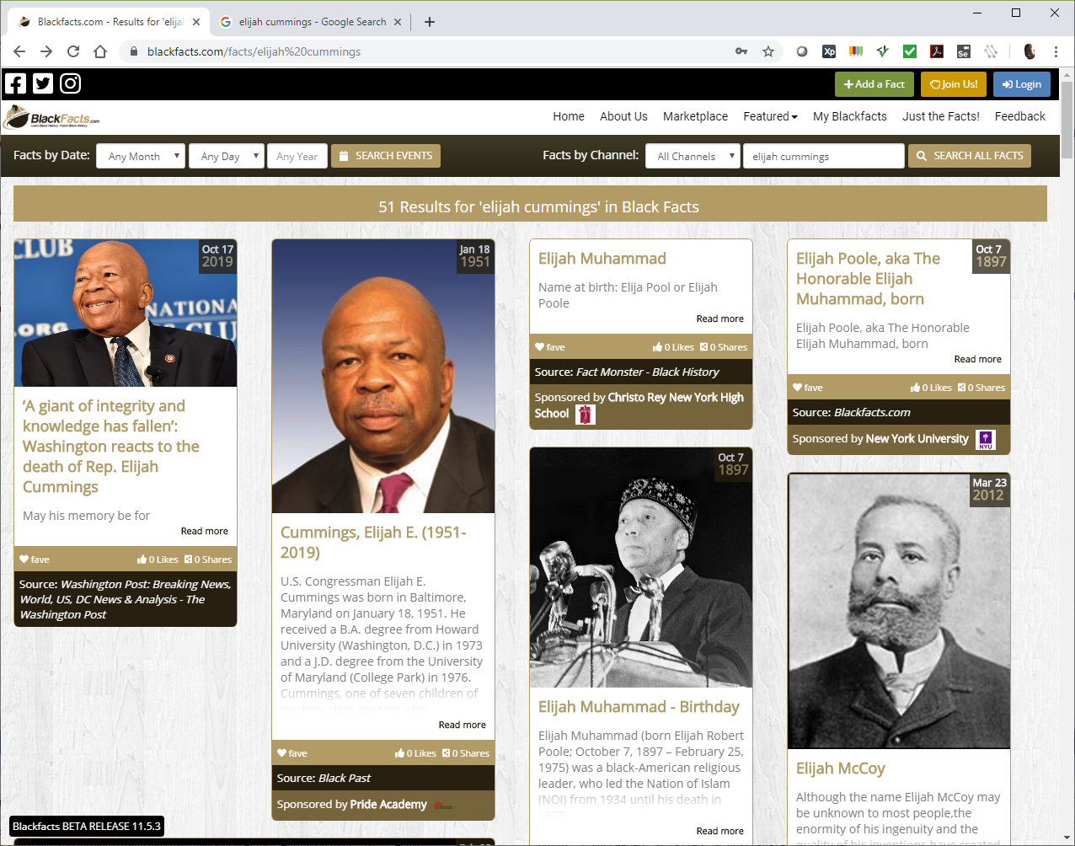
Fact Linkage
A core feature of Blackfacts is the linkage between ‘Fact Cards’ based on various types of searches.
This linkage is based on common factors between facts, and is the foundation of Blackfacts’ efficacy as an educational tool, as it mirrors the human mind’s process of associating pieces of information with each other.
This linkage can be based on both human and machine knowledge, but Blackfacts’ future as The Black Wikipedia relies on evolving the machine learning functionality to a level where it will be able to categorize and link millions of facts accurately with minimal human intervention required.

Slide 3




Fact Sources
Black Facts content can come from a variety of sources, including:
Existing Historical Site Urls
Online News Sites
Member Uploaded Files
Member Social Media Posts
Member Emails
Member Recorded Media
Regardless of the source, the text of the content is extracted as the ‘lowest common denominator’ required by the AI systems currently in use (image recognition etc is in the future) and analyzed by the AI systems to identify people, places, organizations, concepts, etc that can be used to link the Facts.
Fact submitters can also add additional people, places, etc into Blackfacts to augment the frequent lack of the AI systems recognizing them, as well as the AI systems linkages being limited to the submitted text (i.e. the text not mentioning well-known organization affiliations).
BlackFacts.com
BlackFacts
Content Bots
Digital Griots
Consumers
Content Creators
Associations
Historians

Slide 4
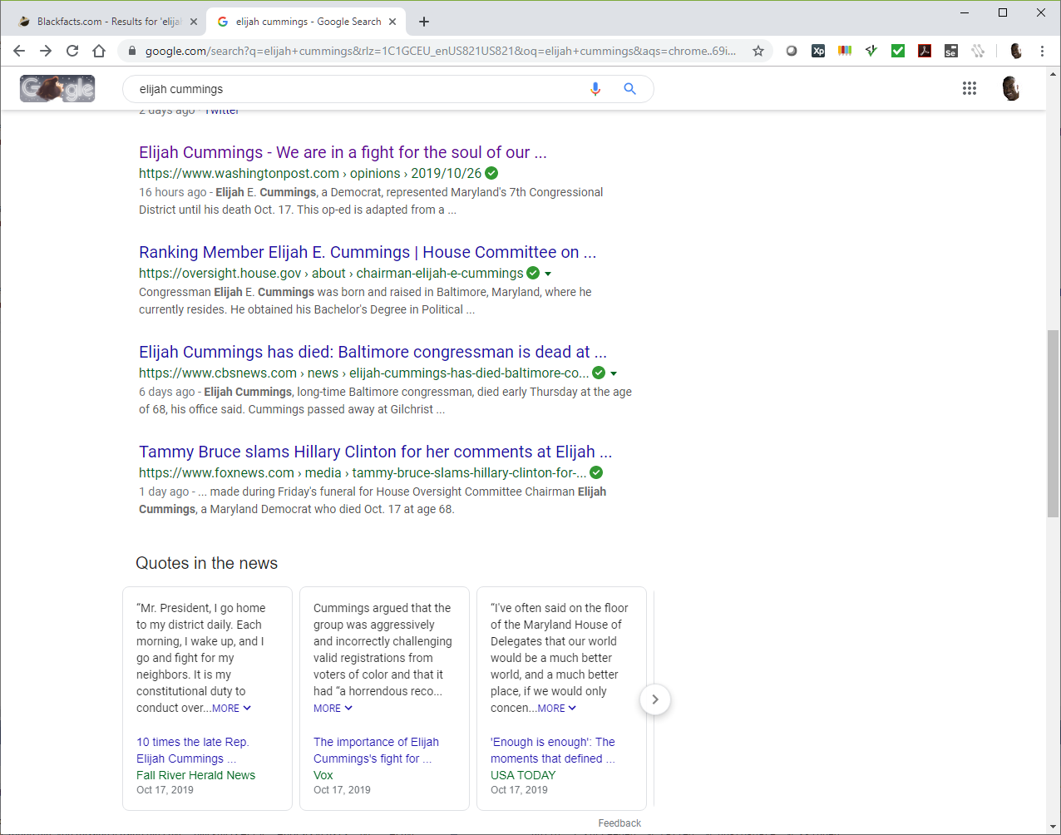
Add A Fact (Crowdsourcing Black History)
Currently, the most common Fact sources are online articles about historical or current people, events and organizations.
The image shows a Google search initiated outside of Blackfacts.com. Currently under development are in-site search tools as well as a browser extension that would enable submitting a Fact from any web page currently being viewed.

Slide 5
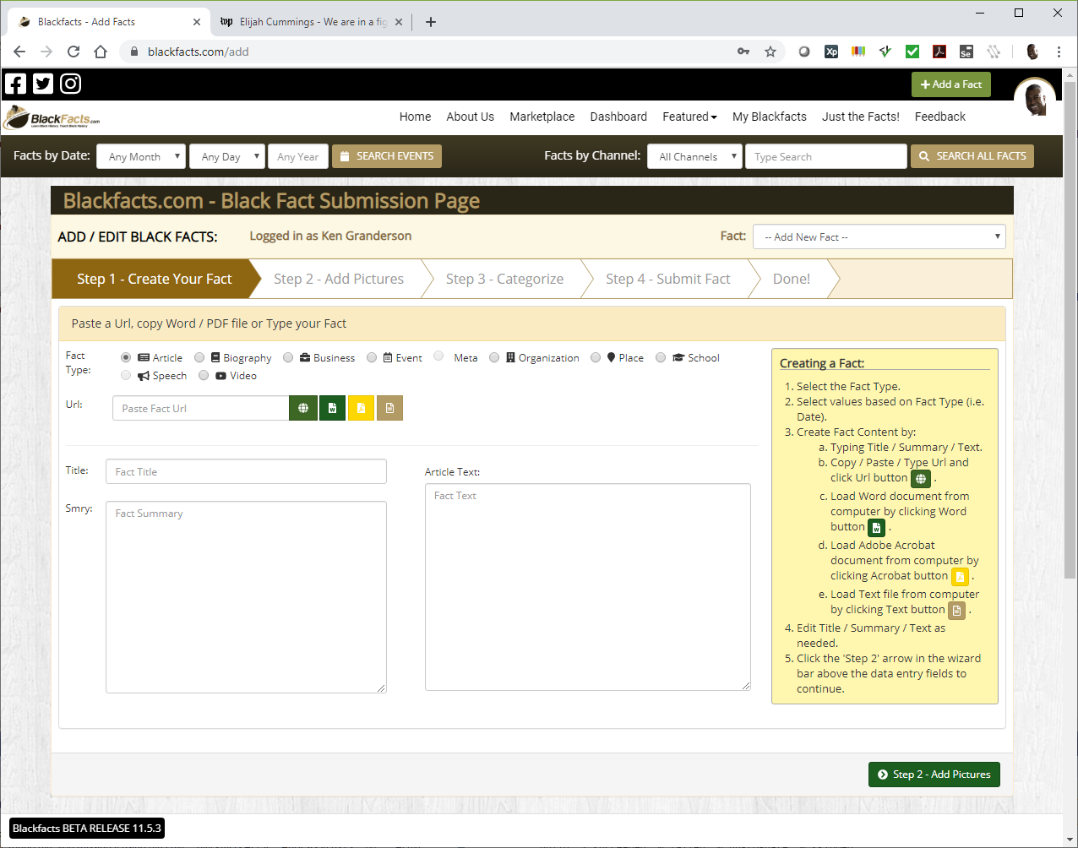
Add A Fact - Create
This is the Add A Fact page, accessed by clicking the
button in the top right of any Blackfacts page, and logging in if necessary.
The 4 buttons by the ‘Url’ field enable adding Facts by pasting in a Url or uploading a Word, PDF or Text file. This presentation will demonstrate the Url scenario.

Slide 6

Add A Fact - Create
This is the result of pasting the url https://www.washingtonpost.com/opinions/elijah-cummings-we-are-in-a-fight-for-the-soul-of-our-democracy/2019/10/26/cac744be-f4fd-11e9-a285-882a8e386a96_story.html into the ‘Url’ field, and clicking the green globe button.
This submits the url to Aylien.com, one of 2 external services Blackfacts uses for AI analysis, to extract the article content and (hopefully) identify the main article image.
In addition to Aylien’s article extraction, Blackfacts uses IBM Watson in addition to Aylien for Entity (place/place/organization) analysis, and has designed the AI service sub-system in an open manner such that we can easily add additional AI engines, like Azure Cognitive Services, AWS offerings, etc.
Other than the underlying application framework (.NET) and some freely available application widgets, the external AI systems are the ONLY third-party technologies used in Blackfacts. Everything else is our own intellectual property.

Slide 7
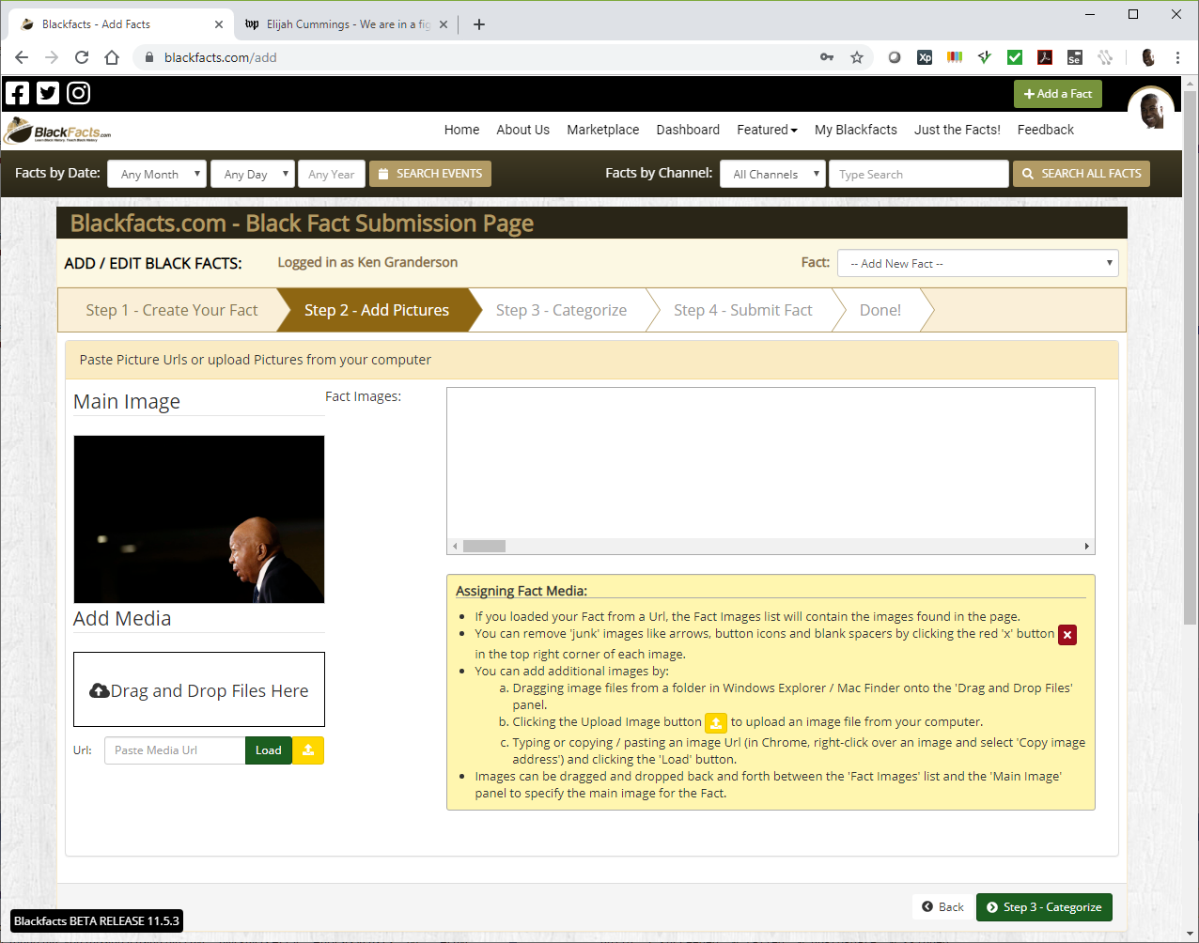
Add A Fact - Media
This is the ‘Add Pictures’ tab, showing the main article image successfully identified by Aylien.
Additional images can be added by copying / pasting their locations for a browser page into the ‘Url’ field, or dragging and dropping them from your computer.

Slide 8
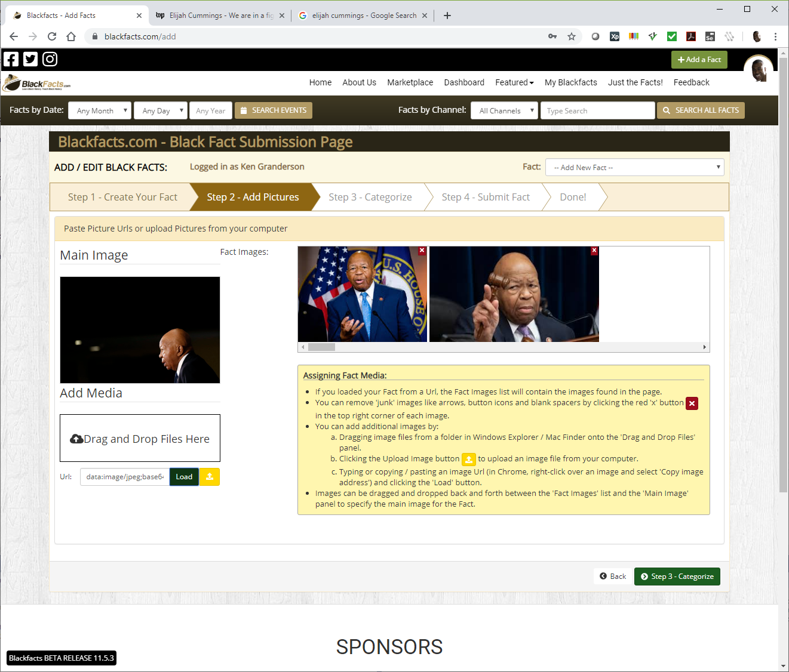
Add A Fact - Media
This is the result of doing a Google Image search for ‘Elijah cummings,’ right-clicking a couple of images and selecting ‘Copy Image Address’ and then pasting them into the ‘Url’ field.
Once in this screen, images can be made the Primary Fact Image (which shows up in the Fact Card view) by dragging it over to the left image box.

Slide 9
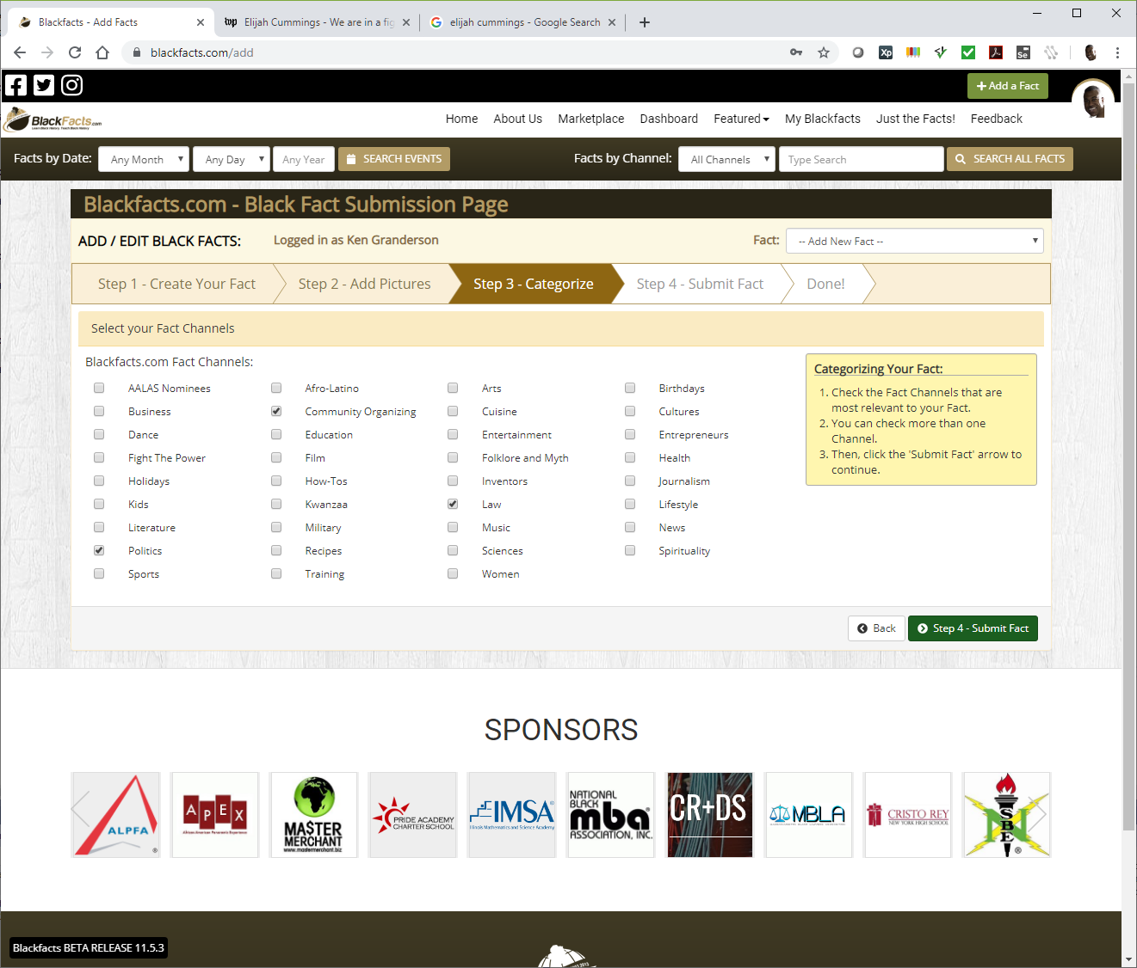
Add A Fact - Channels
Blackfacts Channels (also shown as Categories, oops,we will update for consistency) are human-organized groupings of Facts based on contextual similarity.
Channels are a primary grouping of Facts for search purposes, used to generate Channel Pages for Facts about Arts, Business, Politics, etc.
Several Channels (i.e. Afro-Latino) will not appear in the main Channels list until they contain enough content to fill up a Channel page. Including them in the Add A Fact page (and adding new Channels based on submissions) enables us to have new Channels reflect user interests.
Channels are distinct from Categories, which are automatically classified by the AI engines, and are over 430 in number.

Slide 10
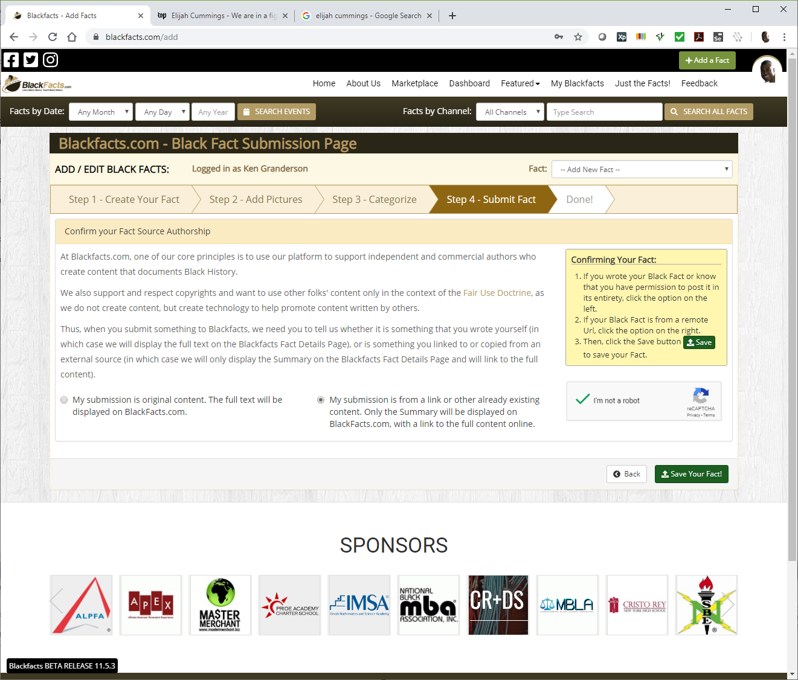
Add A Fact - Ownership
The last step (for non-Admins) of Adding a Fact is indicating whether the submitted Fact is your own content, or shared from another source.
Blackfacts uses this information to control the amount of content displayed directly on Blackfacts before linking to the original source, so that we can stay in compliance with the Fair Use Doctrine and ensure that we are promoting sites that create and publish Black History content rather than replacing them.

Slide 11
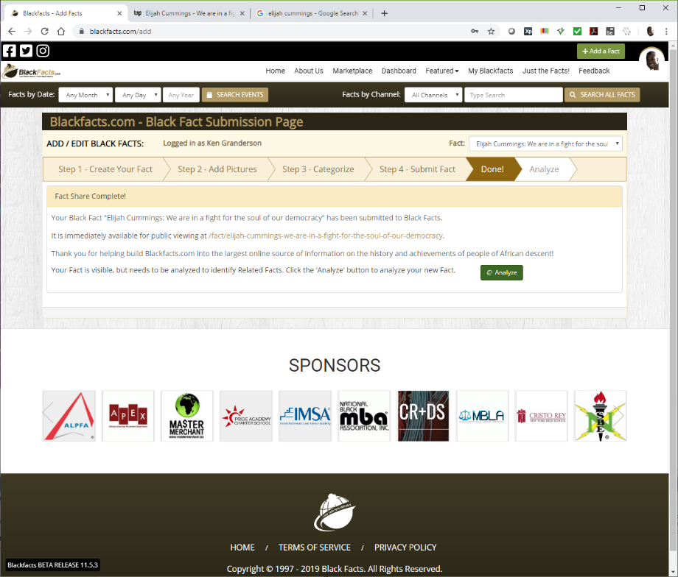
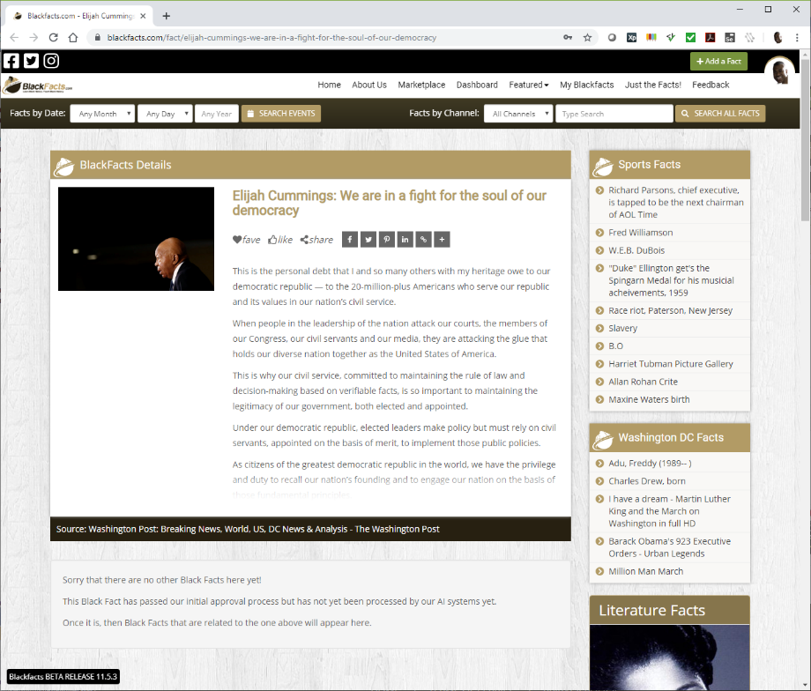
Add A Fact – Done!
As I am an Admin, my ‘Add A Fact’ submissions are automatically accepted, and my submission is immediately available on Blackfacts, although as shown under the Fact Details widget, this new Fcat has not yet been linked to any other Facts.
This is because I have not yet submitted the Fact to our Fact Analysis process, because we are currently not using trained AI models and so without human intervention, accepting all analysis results will generate an abundance of contextually irrelevant linkages, as well as the fact that the AI analysis costs money after a certain level of usage.
Back on the ‘Add A Fact’ page, I will click the ‘Analyze’ button to submit the new Fact for AI Analysis.

Slide 12
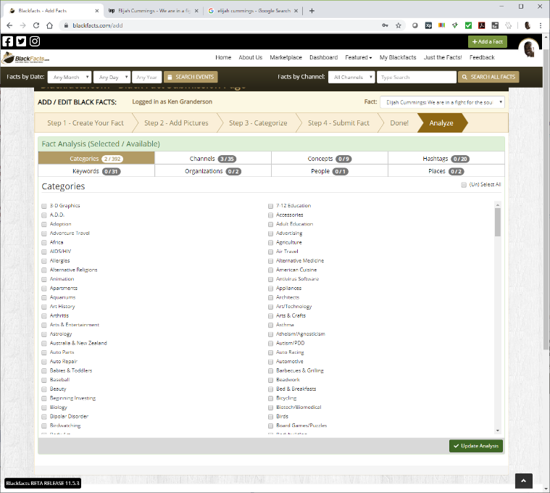
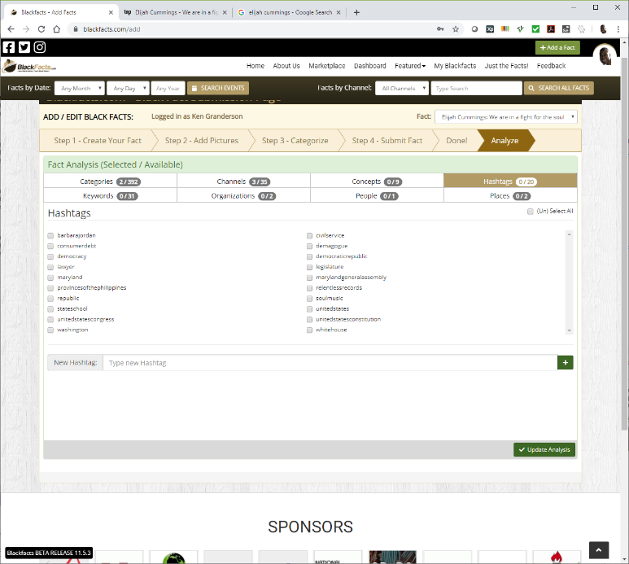
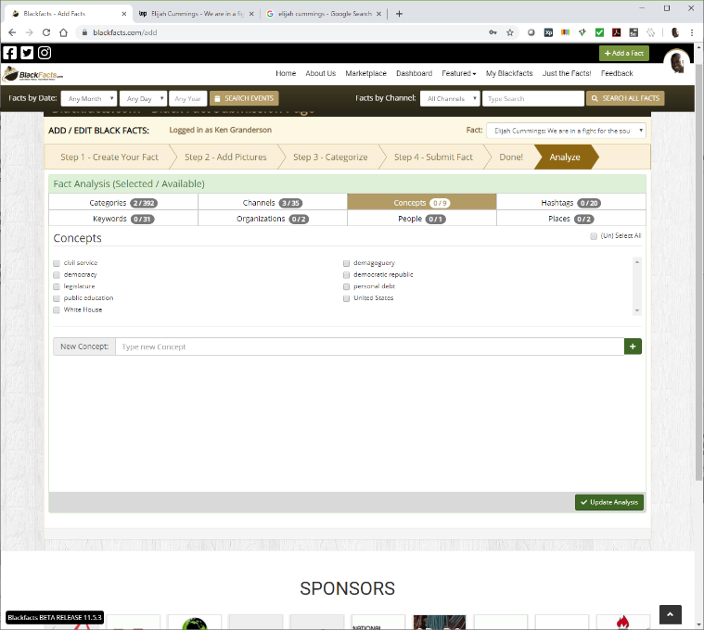

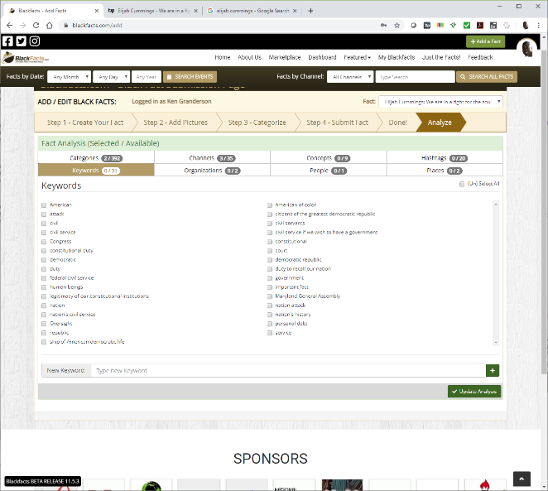
Add A Fact – AI Analysis
Blackfacts submits the entire Fact content to the ‘Natural Language Understanding’ services of Aylien and Watson, and returns their identification of the following:
Categories
Concepts
Hashtags
Keywords
Organizations
People
Places
As shown in the screen captures, the results can often be less than comprehensive or accurate ☹
To be fair, sparse results like this are also often the result of content where people are discussing things that mattered TO the subject, rather than the subject themselves.

Slide 13

Add A Fact – AI Analysis
As this is not surprising and actually indicative of the need for Blackfacts, we have built the ability for human operators to link Facts to People / Organizations / etc not recognized by the AI engines.
These manual linkages are stored in the Blackfacts databases, as well as an adjunct database we maintain called Blackfacts.org, for a future project concept of archiving and organizing black-related content on a global level primarily for research, rather than general consumer use.

Slide 14
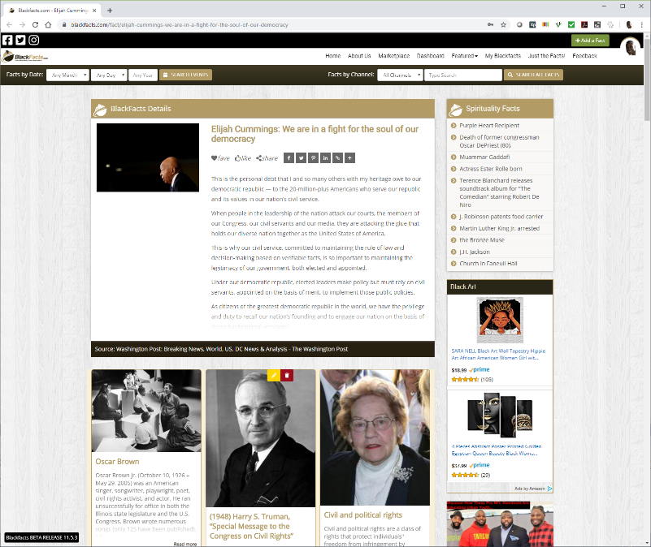
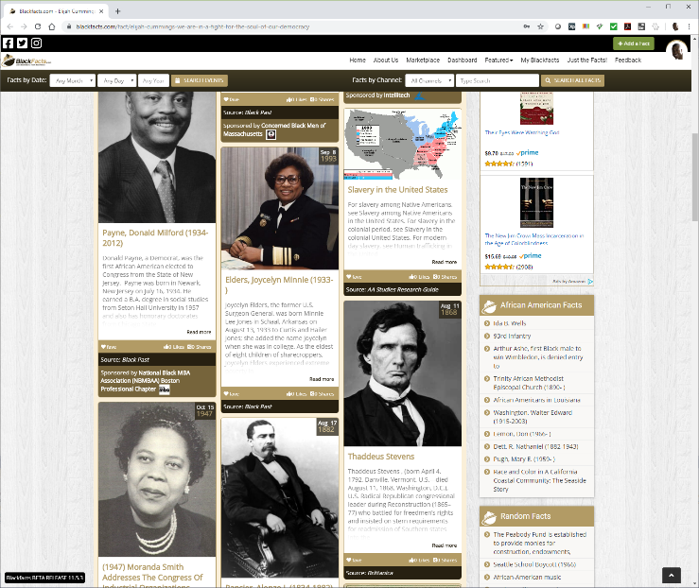
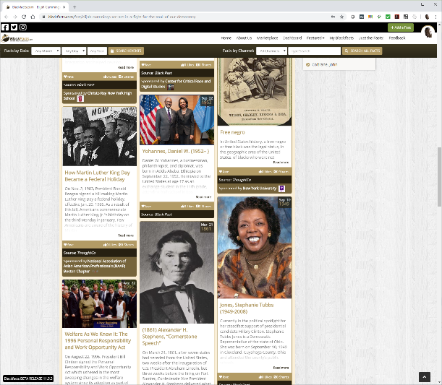
Add A Fact – Result
With the AI analysis data processed, reloading the page now shows other Black Facts that are related to the main Fact based on shared the AI analysis entities.
While the Blackfacts tech that reads external content, submits the content to the AI engines and then displays the content based on the analysis is doing its job, the inability of the AI engines ‘out of the box’ to provide richer and more contextually relevant linkages is preventing Blackfacts from delivering higher quality results.

Slide 15
Add A Fact – AI Analysis Challenges and Solutions
With our robust data models for both Fact analysis relationships and user activity, with better AI engine results, Blackfacts has the ability to generate more and more relevant Fact linkages as the basis for future features like:
More Facts like this
Show me more about subjects I like
Show me more about subjects I don’t know about
Others who found this interesting
Facts I might be interested in
etc
We are confident that higher accuracy is achievable by using the learning data model capabilities of any of the AI engines. However, unlike the Natural Language Processing features that are offered at low volume for free, custom learning models have costs that will only be realistic to incur after Blackfacts has either achieved profitability through service offerings, or has secured significant external financing.

Slide 16
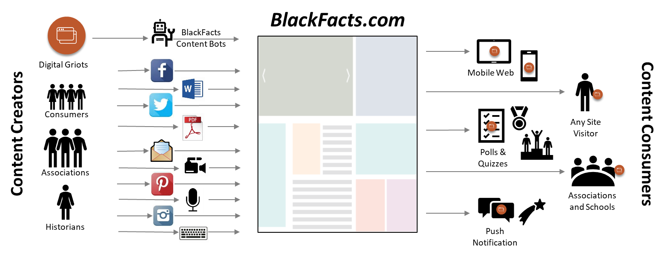
Blackfacts – Our Future is AI
Blackfacts ability to become ‘The Black Wikipedia’ and capture and preserve our stories, told by us, for all perpetuity, rests on three basic ideas:
1. Capture the Content – No matter where it is and what form it is in, get a textual representation of the information
2. Classify and Link the Content – Find common people, events, ideas, et cetera across separate content items, and create contextually appropriate linkages between them
3. Distribute the Content to People Wherever They Are – Make Blackfacts content available to the world whether they are mobile or desktop users, in school, on the train, at the gas station, in Dunkin Donuts, on their company intranet, looking at their cable TV Guide, wherever digital or printed content is found.
The Blackfacts Tech Team has the technical ability to achieve items #1 and #3 with our proprietary tech, third party tools, and #3 will require building relationships with external entities interested in our content, which is not expected to be a problem once we start marketing Blackfacts aggressively.
However, #2 requires significant investments of money and (initially) labor to arrive at the point where the AI systems will be able to operate with minimal human involvement and then become as scalable as other Blackfacts tech that has been developed without incurring significant labor costs.
Thus, we are looking to partner with academic or research institutions engaged in work that could benefit from our capabilities, who have the ability to write and win grants for research or product development in this space.

Slide 17
Following Slides
This concludes the Fact AI description.
The balance of the slides in this presentation are part of the Blackfacts Pitch Deck, included to answer some likely questions that may arise by viewers of this presentation, as well as to provide contact information if viewers of this presentation are interested in contacting us.

Slide 18


















BlackFacts.com Core Business Model
BlackFacts.com
BlackFacts
Content Bots
Revenue Streams
Premium Membership
Premium Virtual Sites
Fact Widgets
School/Diversity Sites
BlackFacts Legacy Sites
Corporate Sponsorship
Banner/Email/Social Advertising
Marketplace Affiliate Sales
Digital Griots
Mobile Web
Consumers
Any Site Visitor
Content Creators
Content Consumers
Polls & Quizzes
Associations
Associations and Schools
Historians
Push Notification
Consumers get BlackFacts content on any platform by visiting the website or receiving push notifications via Email/Text/Social Media.
BlackFacts content is syndicated via BlackFacts Widgets hosted on affiliate sites and entire custom BlackFacts-driven partner sites.
Content is submitted by BlackFacts Users, Griots and our proprietary web crawlers (news & relevant content), from online pages, social media sharing, uploaded documents and media.
Sponsors / Advertisers / Vendors
While access is free to all, Premium Memberships, the Wakanda Marketplace, Corporate/School Sponsorships and Advertising generate BlackFacts’ Revenue

Slide 19


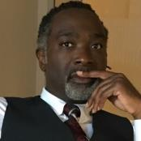
BlackFacts.com Management Team
Ken Granderson - Founder / Chief Technology Officer MIT alumnus and Tech Visionary, Creating Ethnic Technology since 1995, Creator of BlackFacts.com, Roxbury.com, Official website of the Government of St. Lucia
Dale Dowdie - Chief Executive Officer Enterprise-Level Technical Consultant / Entrepreneur Building Online Business Applications and facilitating Tech Transformation, Data Centers Buildouts and DR/BCP Strategies since the 1980s for Clients including, Harvard University, NASA, Multi-national Banks, Liberty Mutual, Staples, TJX, EDS, IBM, McCormick, MassHousing and the City of New York
Other Resources in Part-Time, Paid and Unpaid Consultant Roles:
Rick Van Rice (Business Development), James Mwihia (QA and Tech Support), Michelle Tutunjian (Operations Manager), Sandra Bone (Social Media), Beatriz Callejas (Social Media), Melanie Semedo (Social Media) and Offshore Development Resources in India (Pilots and Product Support)

Slide 20



Blackfacts.com: 3 Year Plan*
In order to meet our goals, we recognize the needs to make several improvements to our current site, particularly for Administration and Support of features for Members, Partners and Sponsors. We must also expand our reach by looking to new sources of content and implementing our strategic marketing plan. These features are being built/tested now for rollout in 2020.
02
2020: New Features
2021: Revenue Builders
2022: Growth and Profitability
Future: Black Wikipedia
Black News Syndicate
Business & HBCU Directory
Widgets 2.0 (Custom Layouts)
Educational Showcase Sites
Diversity Showcase Sites
Enhanced Content Relevance
Marketplace Vendor Catalog
Marketplace Self-Service Signup
Widgets 3.0 (Ads)
Affiliate Self Service Signup
Wakanda Initiative Launch
Build Strategic Partnerships
Full Wakanda Business feature set
Full Wakanda Organization feature set
Full Marketplace vendor tool set
Full Premium Membership feature set
Launch Strategic Partnerships
20

Slide 21
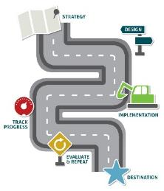

BlackFacts.com – What’s Next?
What are the key tasks to get BlackFacts.com ready for the Feb 2020 kickoff
AREAS OF FOCUS
DESCRIPTION
STATUS
ACTION
Increased Membership Functionality
With our new membership model now available we must fine-tune and improve on the underlying functionality needed to support those members
In Process
Update Administrative Tools
In Process
New Website Design, Branding and Technology will be a BIG part of our rollout and preparation for 2020
Kick-off Marketing Campaign
In Process
Our Marketing campaign is a series of Email Campaigns using our email lists and social media outreach
Begin Programs that drive revenue (ads, products, etc.)
We have already had requests for Advertisement and Products Sales/Affiliate programs. We need to Pilot these offerings to enable them on the site
Not Started
Kick Off – Feb 2020 Event
No Started
Black History Month 2020 is the Event that signals the start of the next evolution for BlackFacts.com
Notes:
In addition to updating (at least) tense for things already in play, need to add items that directly generate Revenue

Slide 22

Questions?
Ken Granderson - Founder / Chief Technology Officer ken@blackfacts.com 857-222-2318
Dale Dowdie - Chief Executive Officer ddowdie@blackfacts.com 781-858-6852
Notes:
KG: Added MIT reference, NYC reference

