Slide 1

Presents Black Tech Trivia Quiz

Slide 2
Black Tech Trivia Question 1 of 5:
Q: In what year did Kamal Al-Mansour create a Black-oriented software product called ‘CPTime’ under the business name AfroLink Software?

Slide 3
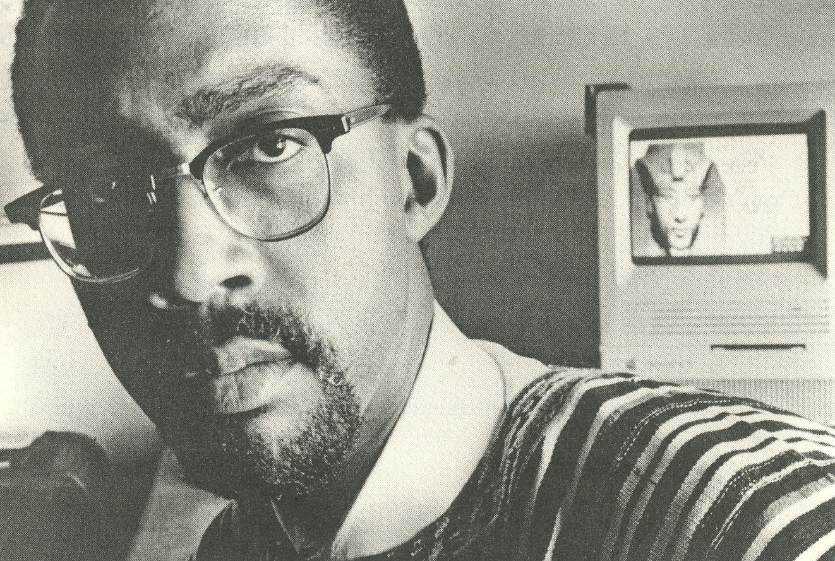
Black Tech Trivia Question 1 of 5:
Q: In what year did Kamal Al-Mansour create a Black-oriented software product called ‘CPTime’ under the business name AfroLink Software?
A: Kamal Al Mansour founded CPTimeOnline and developed AfroLink Software in 1988 after realizing that there was no Black representation in Software.
Learn More: https://links.blackfacts.com/trivia-q1

Slide 4
Black Tech Trivia Question 2 of 5:
Q: What is the name of the Black Technologist who created the programming language ‘Lingo’ for the #1 desktop computer animation product of the 1990s, Macromedia Director?

Slide 5

Black Tech Trivia Question 2 of 5:
Q: What is the name of the Black Technologist who created the programming language ‘Lingo’ for the #1 desktop computer animation product of the 1990s, Macromedia Director?
A: John Henry Thompson.
Learn More: https://links.blackfacts.com/trivia-q2

Slide 6
Black Tech Trivia Question 3 of 5:
Q: What was the first company to register dot-com domain names, and who founded it?

Slide 7
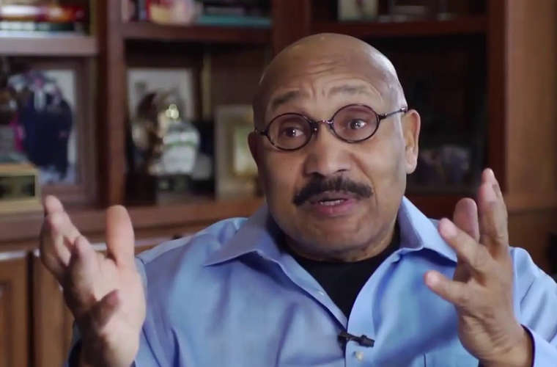
Black Tech Trivia Question 3 of 5:
Q: What was the first company to register dot-com domain names, and who founded it?
A: Emmit McHenry started Network Solutions, the first company to register dot-com domain names.
Learn More: https://links.blackfacts.com/trivia-q3

Slide 8
Black Tech Trivia Question 4 of 5:
Q: What was the first major commercial software product featuring the history of people of African descent, released 2 years after BlackFacts.com was launched?

Slide 9
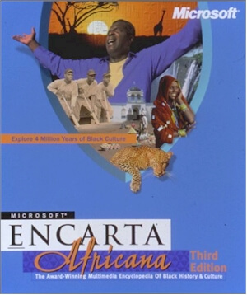
Black Tech Trivia Question 4 of 5:
Q: What was the first major commercial software product featuring the history of people of African descent, released 2 years after BlackFacts.com was launched?
A: Encarta Africana, the 1999 CD-ROM Encyclopedia from Microsoft, in collaboration with Dr. Henry Louis Gates Jr., and Dr. Kwame Anthony Appiah.
Learn More: https://links.blackfacts.com/trivia-q4

Slide 10
Black Tech Trivia Question 5 of 5:
Q: In 2007, what major software company gifted its flagship developer tools suite to every National Society of Black Engineers (NSBE) school chapter in the USA?

Slide 11
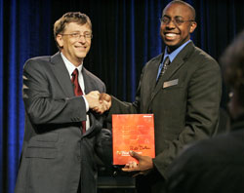
Black Tech Trivia Question 5 of 5:
Q: In 2007, what major software company gifted its flagship developer tools suite to every National Society of Black Engineers (NSBE) school chapter in the USA?
A: Microsoft. In this picture, Microsoft Chairman Bill Gates presents a copy of Microsoft Visual Studio 2005 Professional Edition software to National Society of Black Engineers (NSBE) National Chairperson and CEO Darryl Dickerson as part of a national software donation Microsoft made to all NSBE educational chapters nationwide.
Learn More: https://links.blackfacts.com/trivia-q5

Slide 12
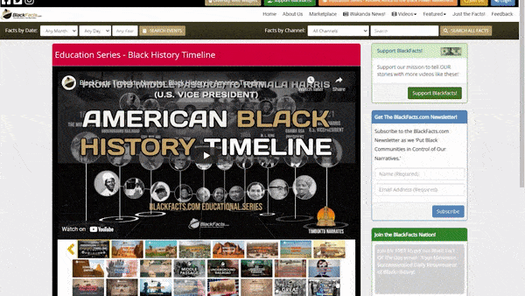

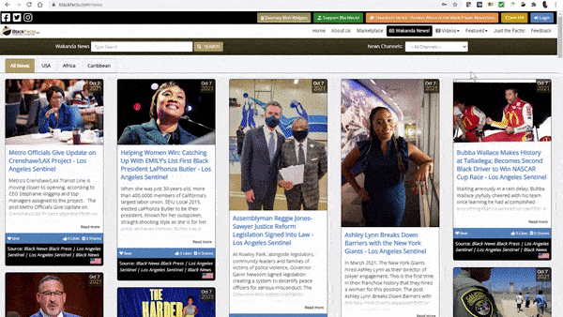
Black Tech Trivia Quiz Bonus Links:
Timeline of When Black Americans Begin Using the Internet
https://blackfacts.com/fact/a-history-timeline-when-african-americans-begin-using-the-internet
Daily Black History
https://blackfacts.com
Diverse Historical & Cultural Videos
https://blackfacts.com/videos
National & International Diversity Focused News
https://blackfacts.com/news
Share this Quiz with friends at:
https://links.blackfacts.com/trivia

