Slide 1

The Internet’s First Black History Encyclopedia, Launched in 1997
100% Black Conceived, Created, Controlled and Owned
Putting Black Communities In Control of Our Narratives
We create technologIES THAT
uplift the race

Slide 2

Putting Black Communities In Control of Our Narratives
1
Blackfacts Is Creating Tools for
Journalists
Educators
Media Companies
Activists
Historians
Thought Leaders
Individuals
Web Site Owners
Civic Leaders
Faith Leaders
Business Leaders
3
To Any Electronic Devices / Feeds, including
Web Browsers
Mobile Devices
Tablets
Email
Jumbotrons
RSS Feeds
Other Digital Displays
4
On Intellectual Property and Technology Infrastructure that
We Created
We Own
We Manage
We Control
We Protect
2
To Publish Online Content to be
Categorized
Cross-Indexed
Syndicated
So that Never Again Will Others be able to Ignore, Overlook or Destroy the Record of our Achievements, Successes and Triumphs
2

Slide 3



Our Unique Foundation / Qualifications
Technical Wizardry
Unmatched Vision
Track Record
3

Slide 4
Our Unique Foundation / Qualifications
Technical Wizardry
Blackfacts is a Black Tech Company founded by Black Tech Wizards, with a combined half-century of professional tech industry experience running their own tech consultancies, as well as writing code for technology leaders including NASA, Phoenix Technologies, IBM and Hewlett-Packard.
One Blackfacts Founder has managed technology projects for billion-dollar organizations, and the other is an MIT alumnus who, as the #1 DJ in the Black College market in the Northeast US in the 80s, literally ‘partied through MIT.’
So we do Tech better than most in the industry.
4

Slide 5
Our Unique Foundation / Qualifications
Unmatched Vision
In addition to launching Blackfacts in 1997 as the Internet’s First Black History Encyclopedia, the Blackfacts Leadership Team created precursors to Facebook, EventBrite, Yelp and Yahoo Groups for the Black community several years before those well-known sites, put Boston’s communities of color online in the 90s, and built a Newspaper Site Management system that put Boston’s Black Newspaper online in 2001.
We have always been WAY ahead of the curve, and still are today.
5

Slide 6
Our Unique Foundation / Qualifications
Track Record
While in 2020, many are just starting to talk about Diversity in Technology, since 1995, the Blackfacts Leadership Team has been ‘Living Tech Diversity’ by creating tech products and online services that ‘Bring Communities of Color into the Information Age’ and have created and delivered solutions to small and large businesses, as well as to communities at local to international levels.
In 1997, Blackfacts was conceived as a ‘Community Technology Awareness Project’ intended to help the Black community see itself as a participant in the then-new brave new world of the Internet.
In 2018, the Blackfacts Team decided to evolve it into a social venture that would leverage our technical expertise and commitment to community to create a unique platform to put Us in control of telling and disseminating Our stories via the Internet.
6

Slide 7



BlackFacts Today: ‘Creating the Future of Black History’ by:
1
Collecting Our Black History Stories and News Digitally via Our Proprietary Platform
2
Organizing Our Stories using Artificial Intelligence
3
Publishing Our Stories to Any Site or Device
4
Saving Our Stories Forever for Future Generations
on a Platform We Own and Control
7

Slide 8
Collecting Stories Digitally
Crawling the Web (BlackFacts Bots)
Social Media
Academics / Griots
BlackFacts Members
BlackFacts Legacy™
BlackFacts Griot™
Just get the Story to an electronic device, we’ll take it from there!
8

Slide 9

Organizing the Stories using AI
BlackFacts Uses our proprietary AI-aware Engine (code-named Timbuktu™) to Link Stories Based On:
People
Events
Places
Concepts
Keywords
Hashtags
Driving Features Like:
‘You May Also Like’
‘Also About Malcolm X’
‘The Black Church Throughout History’
‘Other Female Inventors’
‘Other Black LGBT Pioneers’
…etc.
Timbuktu™
9

Slide 10
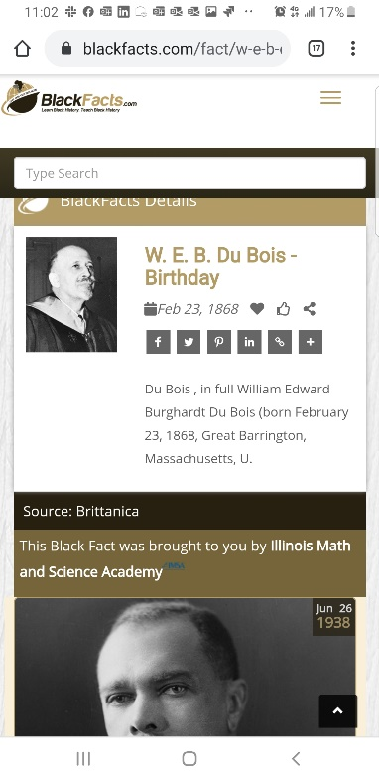
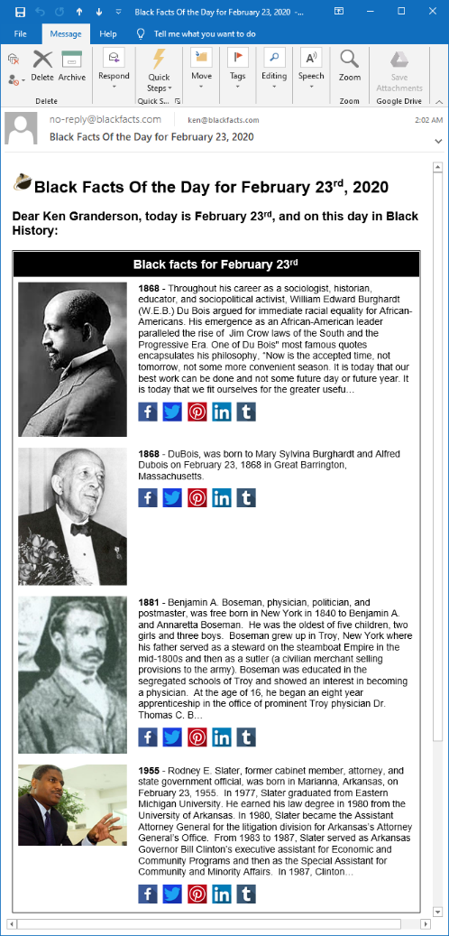
Publishing the Stories to Any Device
Blackfacts Today:
Internet’s First (1997) Searchable Black History Website
Blackfacts.com (Mobile / Tablet / Desktop)
#1 Google / Bing / Yahoo Search Result
E-Mail (Black Fact Of The Day™)
Daily Black News from 160+ Global Sources
Third-Party Websites (Black Facts Widgets)
105K Facebook Followers
85K Instagram Followers
11K Twitter Followers
Blackfacts Tomorrow:
‘Black Facts Minute™’ on Network TV
K-12 and College History Project Sites
Corporate Diversity Sites
Marketplace Affiliate Sites
Professional / Fraternal History Sites
Third-Party Video Ad Widgets
Store Displays
…etc
10

Slide 11
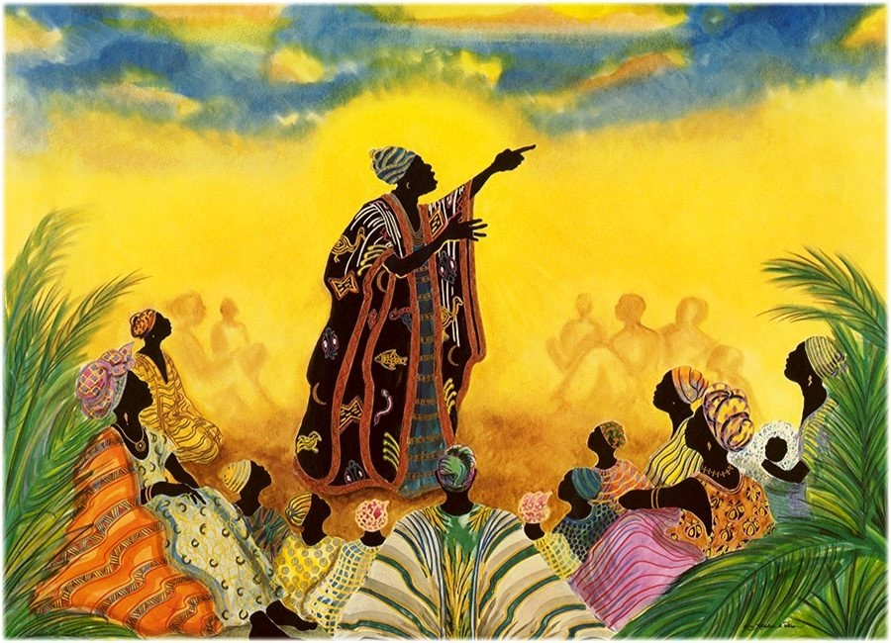
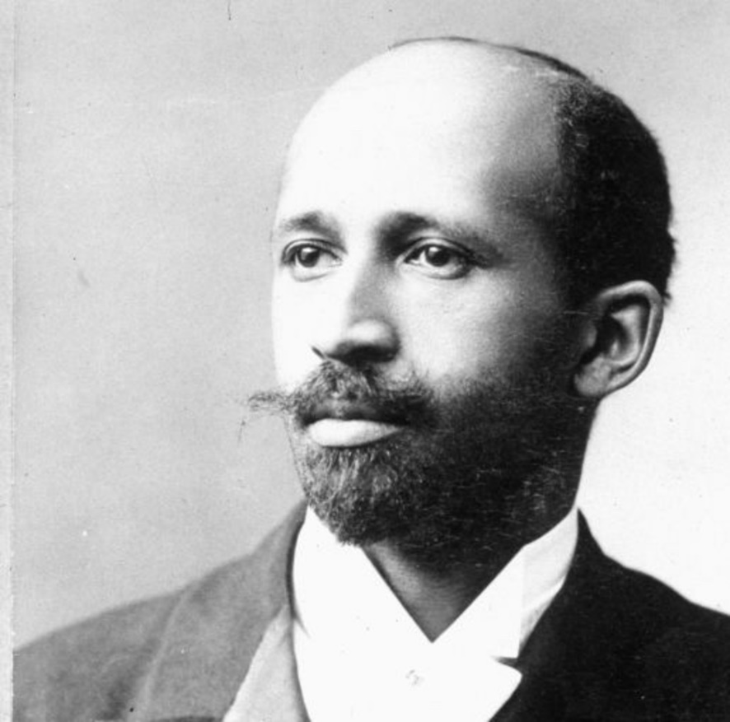



Saving the Stories Forever for Future Generations
Blackfacts.com is the realization of the lifelong dream of international scholar W.E.B. DuBois that he called the ‘Encyclopedia Africana.’
But even DuBois could not have realized that while libraries can burn, and griots die, digitized history is FOREVER, and now can be written by anyone, not just the victors of cultural battles.
11

Slide 12



Questions? Ask Us!
Ken Granderson - Founder / Chief Technology Officer MIT alumnus and Tech Visionary, Creating Ethnic Technology since 1995, Creator of BlackFacts.com, Roxbury.com, Official Website of the Government of St. Lucia (https://kengranderson.com)
Dale Dowdie - Chief Executive Officer Enterprise-Level Technical Consultant / Entrepreneur Building Online Business Applications and facilitating Tech Transformation, Data Centers Buildouts and DR/BCP Strategies since the 1980s for Clients including, Harvard University, NASA, Multi-national Banks, Liberty Mutual, Staples, TJX, EDS, IBM, McCormick, MassHousing and the City of New York
ken@blackfacts.com 857-222-2318
ddowdie@blackfacts.com 781-858-6852

