Slide 1

About BlackFacts.com
Introducing
A quick introduction to the concept, main features and future of Blackfacts.com
Notes:
Engage vs Inspire?
A platform to educate, inform and engage about the wealth of significant HISTORICAL and cultural contributions of people of color to society
Need to reformat to be consistent with rest of presentation

Slide 2


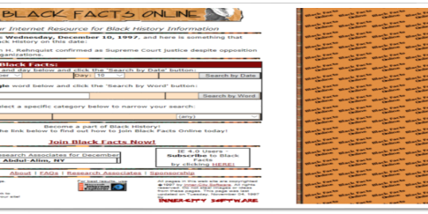
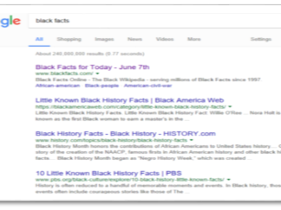
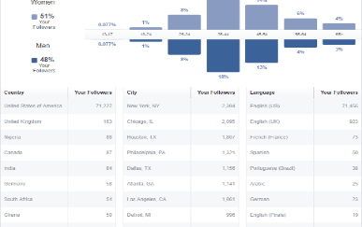

BlackFacts.com: 23 Years of Evolution
1997 (In the Beginning)
Started as a Text-Based Black History Community Project
2000-2017
Recognition that we have “Something”!
With Totally Organic Growth & Zero Budget
TODAY
AI – linked Text/Graphic/Video Historical Facts indexed 7 ways
01
03
02
#1 in Search Engines
Demographic Data
Amazon
Alexa Skill
Today By the Numbers:
50,000 Facts → 100k by end of 2020
200k Social Media Followers & 300M Reach
500,000 user Email list and growing
2
Notes:
KG: Removed ‘3’ from ‘#1 in 3 Search Engines’

Slide 3





















BlackFacts.com: How It Works
BlackFacts.com
Blackfacts
Content Bots
Revenue Streams
Premium Membership
Premium Virtual Sites
Fact Widgets
School Sites
Blackfacts Legacy Sites
Corporate Sponsorship
Banner Advertising
Marketplace Affiliate Sales
Digital Griots
Mobile Web
Consumers
Any Site Visitor
Content Creators
Content Consumers
Polls & Quizzes
Associations
Associations and Schools
Historians
Push Notification
Content is sourced from Blackfacts Users, Griots and curated Historical and News Sites.
Content comes from online pages, social media sharing, uploaded documents and (eventually) media.
Blackfacts content can be consumed via any platform by visiting the website, participating in Quizzes and Games or receiving push notifications via Email/Text/Social Media.
Blackfacts affiliate features include Blackfacts Widgets hosted on existing affiliate sites and entire custom Blackfacts affiliate sites.
Sponsors / Advertisers / Vendors
While access to Blackfacts is free to all, Premium Memberships, the Wakanda Marketplace and Banner Advertising generate Blackfacts’ Revenue

Slide 4


Blackfacts.com: The Big Picture
Technology Benefits for Everyone
All Platforms. Consumer / Community / Commercial. Globally Available.
Blackfacts.com
Wakanda Technology Initiative
Blackfacts.com is just the initial offering in what will be an entire platform of technology services created to help ‘uplift the race’ by connecting individuals and communities of color with today’s advanced software capabilities.
The platform is called the Wakanda Technology Initiative™ and is based on a ‘Black Paper’ by Blackfacts’ founder Ken Granderson titled Lessons From Wakanda: Embrace Technology To Protect Your Culture.
The Wakanda Technology Initiative™ aims to finally connect communities and organizations of color with today’s powerful software capabilities towards the goal of enabling us to be more competitive in every aspect of our lives and fields of endeavor.
Diverse Demographics
Universal Platform
Consumers
Assns
Historians
Businesses & Start-Ups
Professional
Associations
Entrepreneurs
& Students
Content Services
Engage / Inspire / Educate
Individuals / Educators
Promote Organization Diversity
Create / Expand Awareness
Create / Expand Affiliations
Organization / Business Services
World-Class Online Presence
Automation of Key Operations
Automation of Marketing / Outreach
Automation of Fund-Raising / Commerce

Slide 5


The Wakanda Technology Initiative™
Technology Services Offering for Minority Entrepreneurs, Businesses and Students
Low Cost. Easy to Use. Business/Startup-in-a-Box! Ecosystem
Core Content Management Services (CMS)
Other Features
Structured Website
Branded Page(s)
(CSS)
Carousel Widgets
Templates
Cloud Services Integration
Select your
Widgets
Existing website
Embedded
Components
HTML Widgets
Video Widgets
Calendars
Social Media Integration
Embed in
Your
Site
Businesses & Start-Ups
Data
Tables
Admin
Tools
List Widgets
Gallery Widgets
Feedback
Survey Widgets
eCommerce (Shopping Cart)
Integrated Community
Target Demographics
No Website
No Problem
Event Widgets
Professional
Associations
Shared Services
Discounts on Products/Services
Reports/
Activity Logs
Ads
Manager
Mail/ Chat Services
Jobs/ Internship Postings
Affiliate Programs
Entrepreneurs
& Students
Freemium Subscription
Shared Reward Programs
Integrated sales of products/services
Get complete
Website
Data
Model
Security
Shared Content Widgets
News Feed
Diversity Showcase
Target Demographic: Entities with sub-par or non-existent technology presences - offer a low-cost solution that brings them to a higher quality of functionality
Pricing Structure (NOT YET FINAL):
FREE for the Introductory Offering
$19.99/month for BASIC package
$49.99/month for STANDARD package
$79.99/month for PREMIUM package
Other services a la Carte billing
Outcomes: Organizations with credible online presences, digital marketing campaigns, e-commerce for membership and ticket sales, etc.
Businesses with online ordering, specials, marketing, loyalty clubs, accounting, human resources, inventory management, etc.

Slide 6


Blackfacts.com: 3 Year Plan*
In order to meet our financial and social interaction goals, we recognize the needs to make several improvements to our current site, particularly for Administration and Support of features for Members, Partners and Sponsors. We must also expand our reach by looking to new sources of content and implementing our strategic marketing plan
02
2020: New Features
2021: Revenue Builders
2022: Growth and Profitability
Black News
Crowdsourced Content
Widgets 2.0 (Custom Layouts)
Educational Site
Diversity Showcase Site
Marketplace Vendor Catalog
Marketplace Self-Service Signup
Widgets 3.0 (Ads)
Affiliate Self Service Signup
Wakanda Initiative Launch
Build Strategic Partnerships
Full Wakanda Business feature set
Full Wakanda Organization feature set
Full Marketplace vendor tool set
Full Premium Membership feature set
Launch Strategic Partnerships
* This 3 Year Schedule is based on organic growth, i.e. without securing external financing. External financing will accelerate the schedule by up to one year.
6

Slide 7



BlackFacts.com Management Team
Ken Granderson - Founder / Chief Technology Officer MIT alumnus and Tech Visionary, Creating Ethnic Technologies since 1995, Creator of BlackFacts.com, Roxbury.com, Official Web Site of the Government of St. Lucia
Dale Dowdie - Chief Executive Officer Enterprise-Level Technical Consultant / Entrepreneur, Building Online Business Applications and facilitating Tech Transformation since 1980s for Clients including: NASA, Bank of Boston, US Trust Bank, Citizens Bank, Liberty Mutual, Staples, TJX, Phillips, IBM, McCormick, MassHousing, City of New York
Other Resources in Part-Time, Paid and Unpaid Consultant Roles:
Rick Van Rice (Business Development), James Mwihia (QA and Tech Support), Michelle Tutunjian (Business Analyst), Sandra Bone (Social Media), Beatriz Callejas (Social Media), Melanie Semedo (Social Media) and Offshore Development Resources in India (Pilots and Product Support)
Notes:
KG: Added MIT reference, NYC reference

Slide 8

Questions?
Ken Granderson - Founder / Chief Technology Officer ken@blackfacts.com 857-222-2318
Dale Dowdie - Chief Executive Officer ddowdie@blackfacts.com 781-858-6852
Notes:
KG: Added MIT reference, NYC reference

