Slide 1



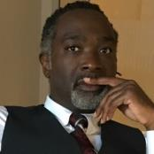
26 Years of Diversity Technology Solutions (Built on the Microsoft Stack)
Ken Granderson
Co-Founder / CTO
Dale Dowdie
Co-Founder / CEO

Slide 2

Introductions / Objectives
Agenda
25 Years of Diversity Technology Solutions in 10 Minutes
BlackFacts’ Vision for Using Technology to Support Black Communities and Businesses
Q & A
Notes:
Our Agenda for this talk is simple:
First, I am going to try and describe our 25 years of Diversity Technology Solutions in 10 Minutes, and let you know how Microsoft has been a silent partner in our success every step of the way.
Then, my longtime friend and collaborator and BlackFacts CEO Dale Dowdie will share some of what we are building now,
And hopefully we will have a few minutes to take any questions that you may have.

Slide 3
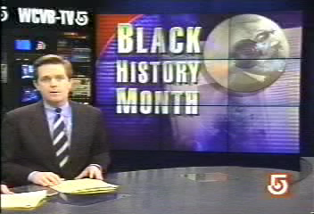
African-Americans in Boston: More Than 350 Years
1995
Historical Images / Presentations available at https://kengranderson.com - Videos on YouTube, available at https://links.blackfacts.com/inner-city-software
Notes:
Let me share a 2 minute story about something that happened in 1995, at the dawn of the Information Age

Slide 4
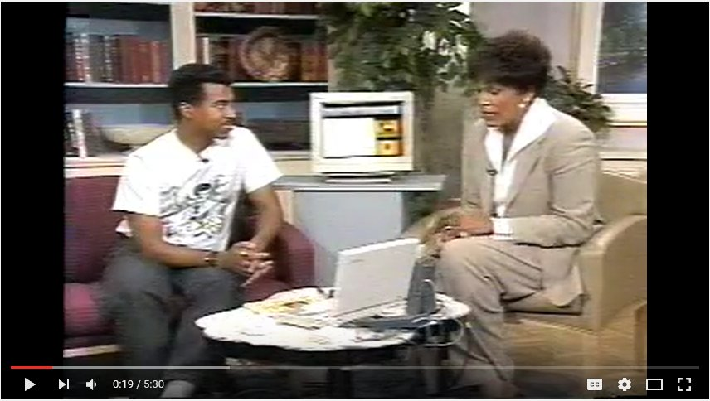
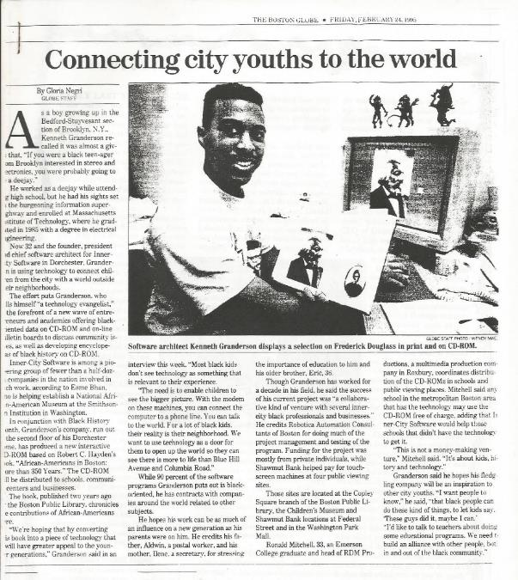
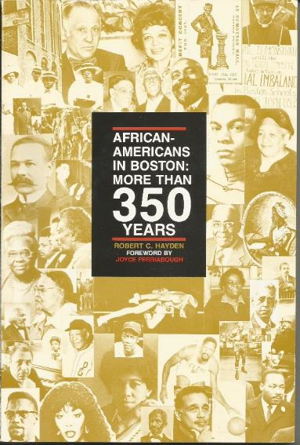
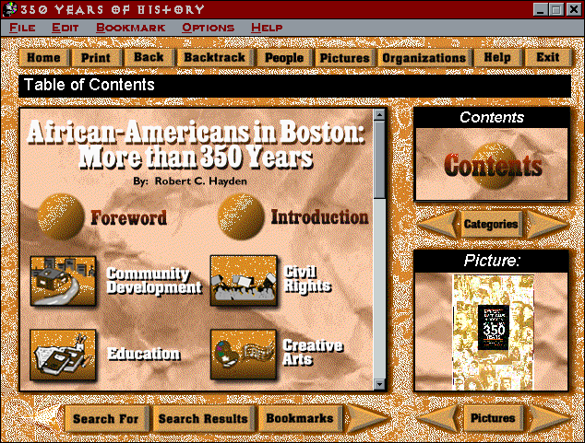
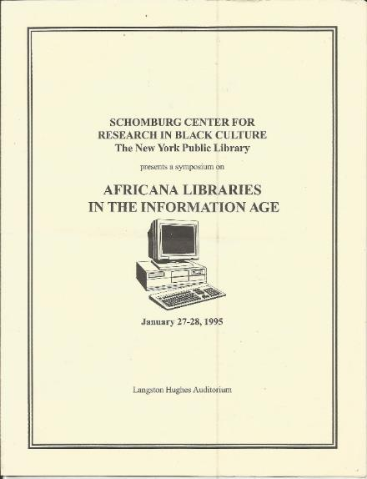
African-Americans in Boston: More Than 350 Years
1995
Historical Images / Presentations available at https://kengranderson.com - Videos on YouTube, available at https://links.blackfacts.com/inner-city-software
Notes:
350 Years was displayed at the Boston Public Library and Children’s Museums on touch screen kiosks
It was in the news and local television, and presented at the Schomburg Center for Research in Black Culture in Harlem
However, due to politics and the none of the schools in Boston’s black communities having CD-ROM capable computers, it never got into the school system.

Slide 5
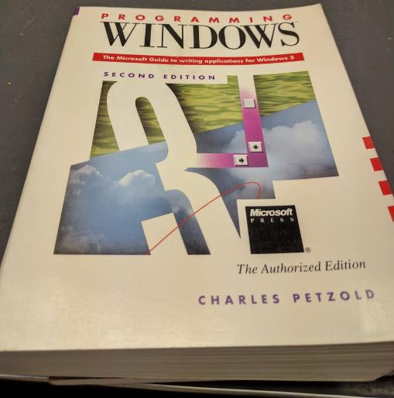
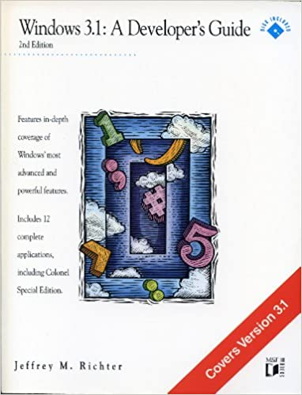
Starting Out
1989
Notes:
The story actually starts several years earlier, when I was working as a software tester at a company called Phoenix Technologies, and decided to get into programming.
I purchased two books – Programming Windows 3.0 and Windows 3 – A Developer’s Guide, and taught myself to code in C and C++.
A warning – We are about to cover a lot of activity in a very short period of time.
So I am going to just mention projects briefly. If you are interested, everything I am about to show and describe is available online in more detail.
A Side Note – I recently connected to Developer’s Guide author Jeffrey Richter on LinkedIn and thanked him for helping me get started.

Slide 6
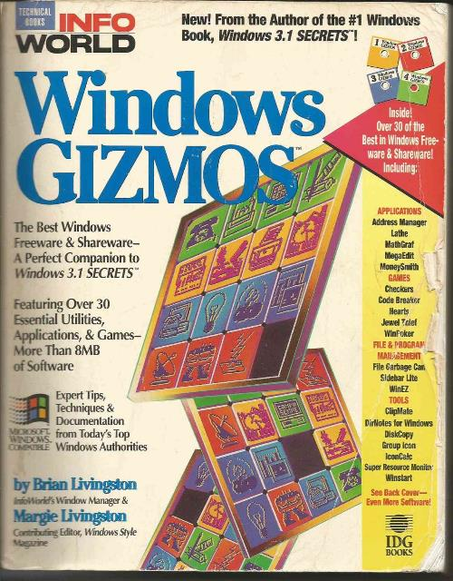
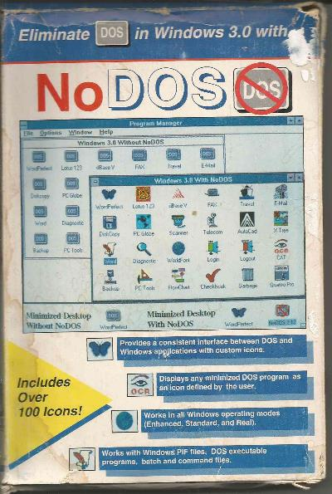
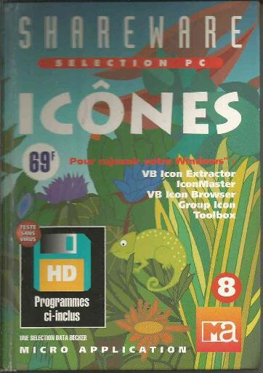
Teaching Myself to Code
1992
Historical Images / Presentations available at https://kengranderson.com - Videos on YouTube, available at https://links.blackfacts.com/inner-city-software
Notes:
I started putting out programs on the dial-up bulletin board systems that preceded the Internet, in what then was called ‘Shareware’ - try it and if you like it, buy it.
I got on the map with a desktop customization utility called ‘NoDOS’ that made Windows easier to use, and when that feature was included in Windows 3.1, I did ‘GrpIcon,’ which ended up in several books in the US and at least one in France.
GrpIcon was included in the book ‘Windows Gizmos,’ a book sold across the country, and resulted in 2000 registered users at $20 each.
As my salary then was $43,000, I quit my job at Phoenix and started doing software full-time under my company name ‘Inner-City Software,’ which was a euphemism for ‘Black Software Company.’

Slide 7
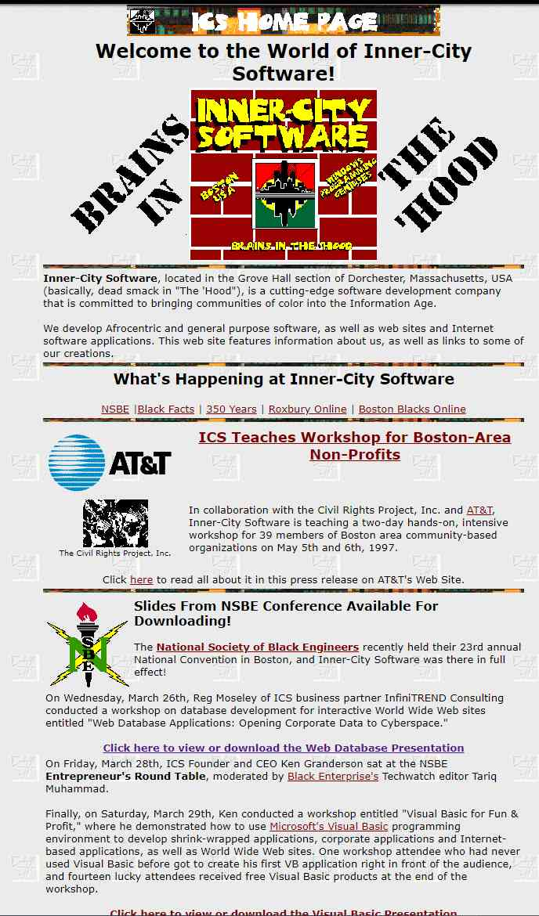

Inner-City Software
1992
Historical Images / Presentations available at https://kengranderson.com - Videos on YouTube, available at https://links.blackfacts.com/inner-city-software
Notes:
I realized that this Brave New World of technology had no ‘Old Boy Network’ to get in my way, nor did it require access to capital to pay for licenses, buildings and staff in order to get products out there, so I established Inner-City Software with the goal of broadcasting both inside and outside the Black community that the Computer Age represented the closest thing ever to a level playing field.

Slide 8
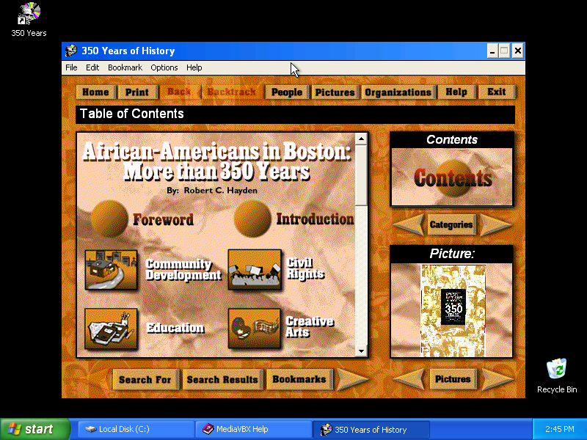
The Tech Behind 350 Years of History
1995
Historical Images / Presentations available at https://kengranderson.com - Videos on YouTube, available at https://links.blackfacts.com/inner-city-software
Notes:
The 350 Years of History program was powered by Microsoft MediaView, a subset of the Encarta libraries that Microsoft made available for free to developers.
The API was C-based, so to simplify things for VB developers, I created a Visual Basic VBX control, which I then sold to other developers for $200 via the bulletin board systems.
One of our customers was LiveLink systems in Jerusalem, who used the VBX control for a CD-ROM version of the Encyclopedia Judaica.

Slide 9
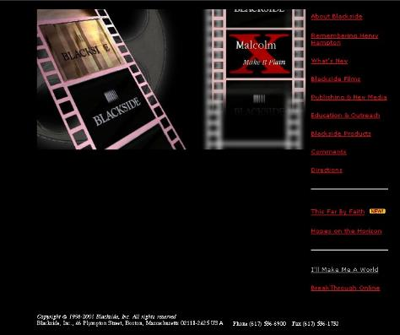
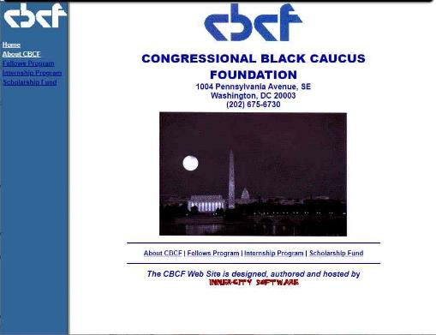
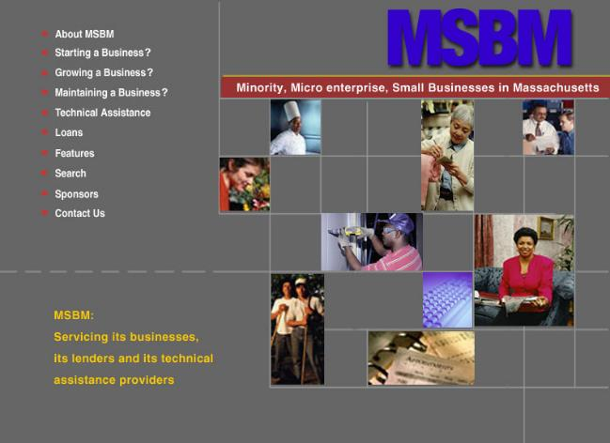
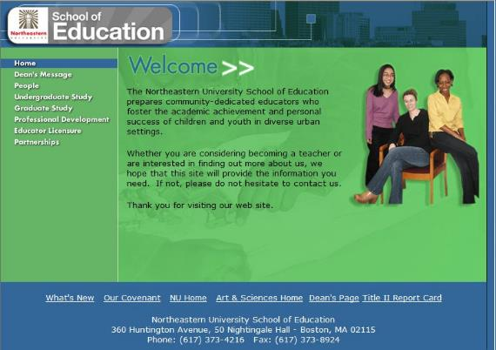
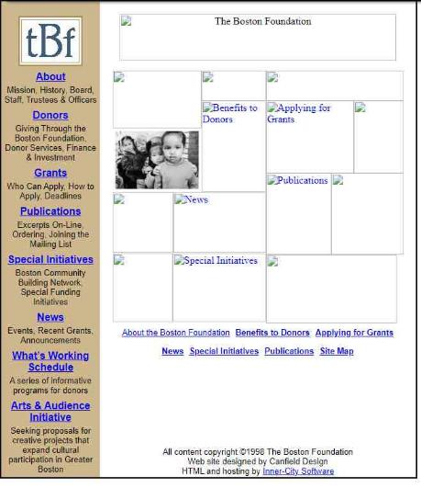
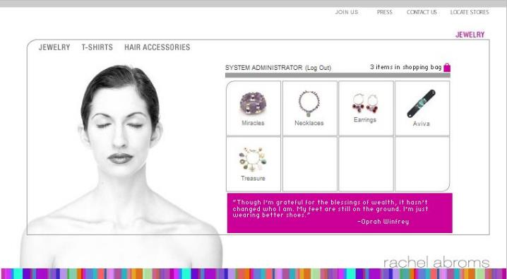
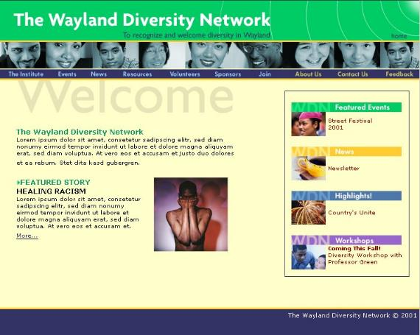
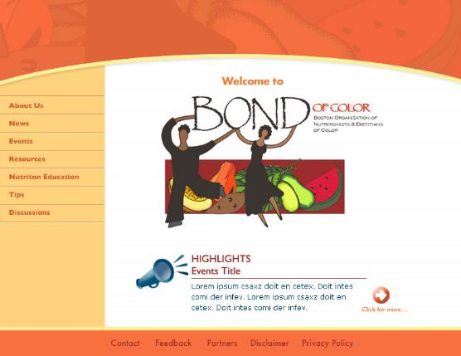
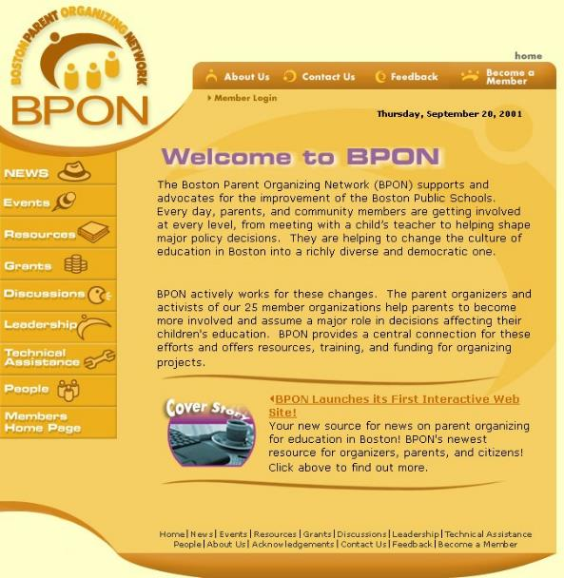
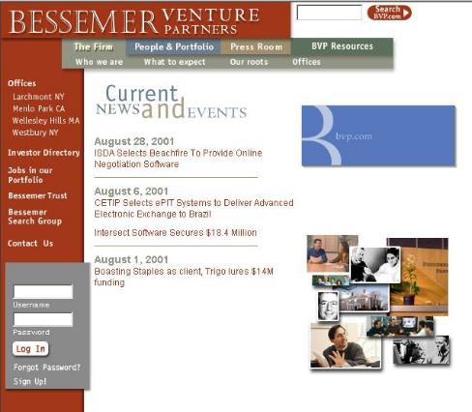
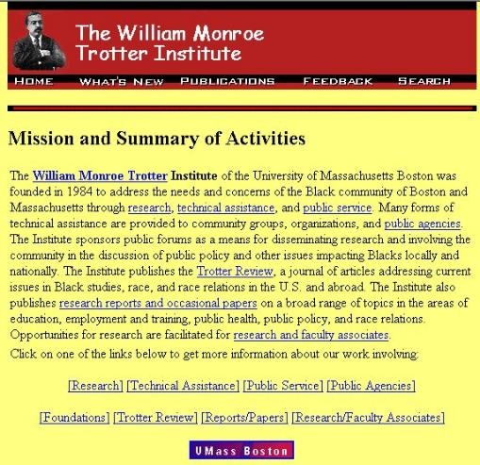
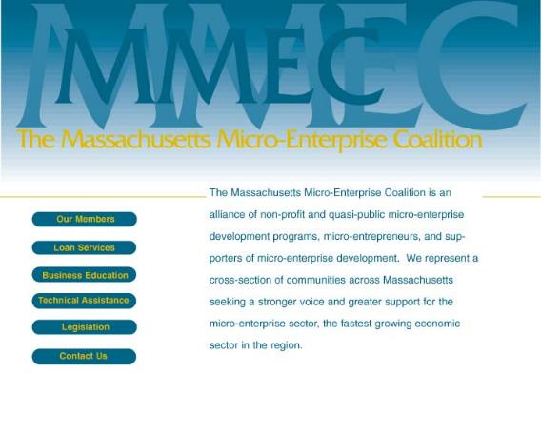
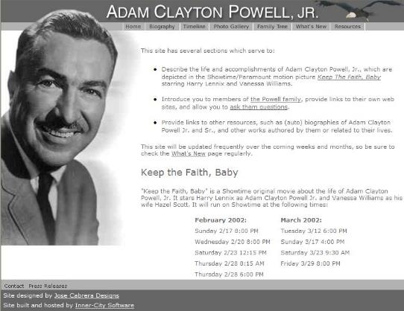
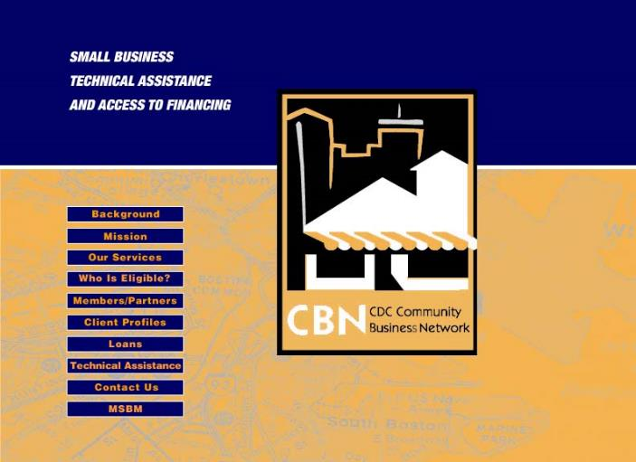
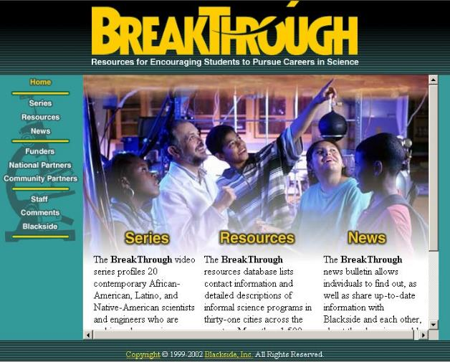
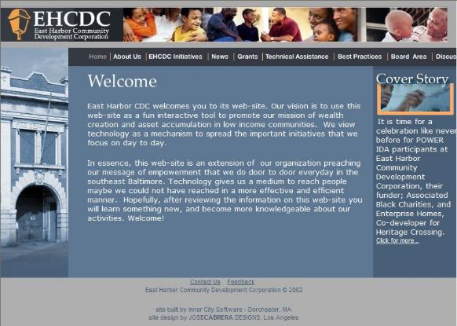

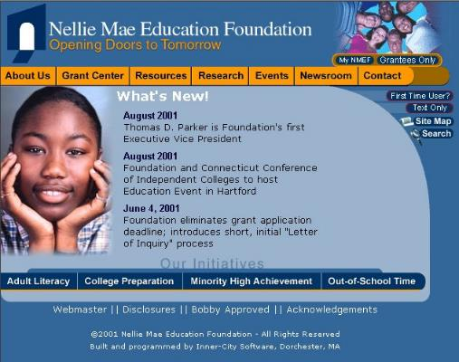
Inner-City Software Clients
Historical Images / Presentations available at https://kengranderson.com - Videos on YouTube, available at https://links.blackfacts.com/inner-city-software
Notes:
Inner-City Software became The Tech company in Boston’s communities of color, and we put dozens of local organizations and businesses online, from Black businesses like the New England Black Pages and the Black newspaper the Bay State Banner, to ally organizations like the Boston Foundation and Nellie Mae Education Foundation.
We also did the web sites for Black organizations in other areas like the Congressional Black Caucus Foundation in DC.
In the quasi-public and private sector, we did web sites and other tech work for a bunch of community economic development organizations and the VC firm Bessemer Venture Partners, but unfortunately were never able to secure external financing from any of them.

Slide 10
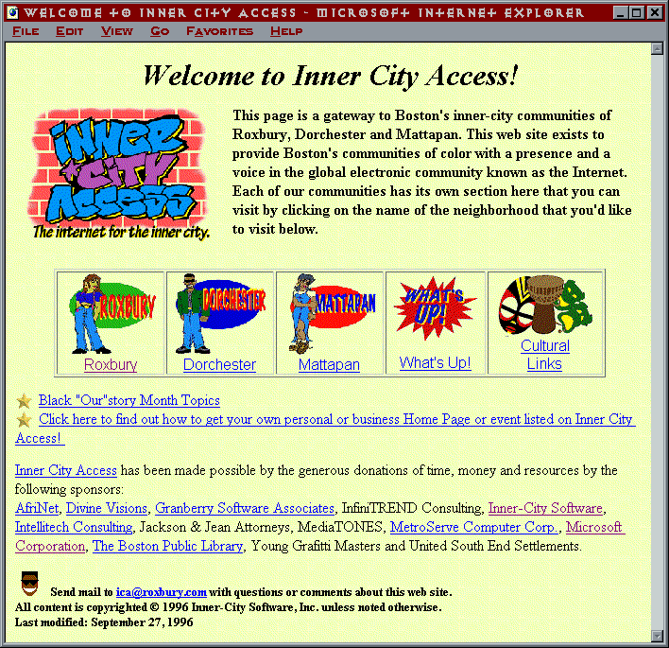
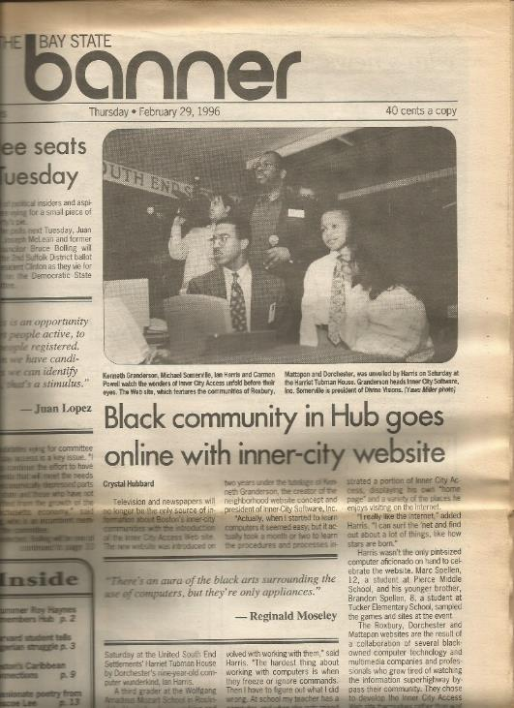

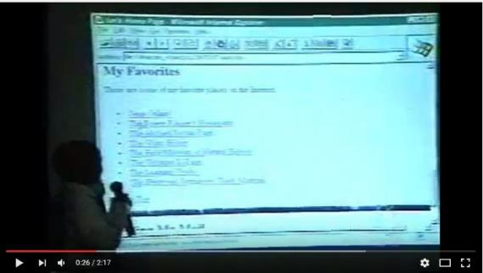
Inner City Access
1996
Historical Images / Presentations available at https://kengranderson.com - Videos on YouTube, available at https://links.blackfacts.com/inner-city-software
Notes:
In 1996, I saw that the Internet was going to be another game changer - not just for techies, but for everyone.
So I gathered up all the Black tech folks I knew to help me put together web sites for Boston’s Communities of Color, under the name ‘Inner City Access’
We gathered the information, we recruited some young folks to create some graphics, we built the HTML pages, hosted it with local Black networking company, and launched Inner City Access for Black History Month 1996.
This was the first Diversity Technology Project that Dale Dowdie, my now partner in BlackFacts, worked on together.

Slide 11
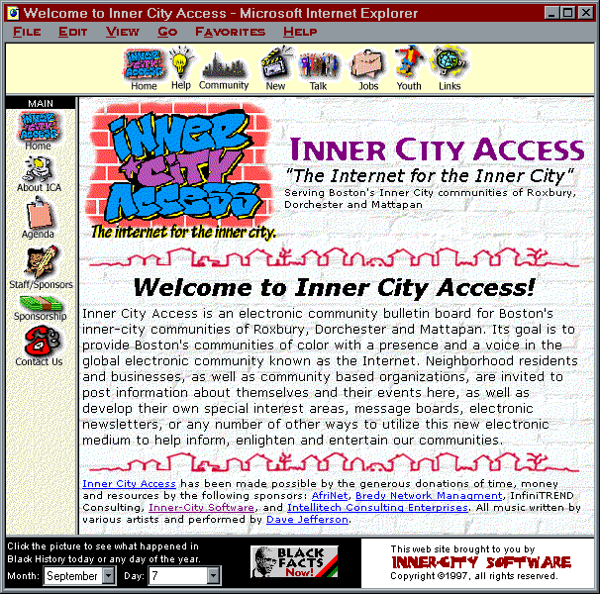
Inner City Access – Enabled by Microsoft
1996
Historical Images / Presentations available at https://kengranderson.com - Videos on YouTube, available at https://links.blackfacts.com/inner-city-software
Notes:
To do the HTML for the Inner City Access project, I wanted to use this awesome HTML Editor by Vermeer Technologies called FrontPage
FrontPage was so good that Microsoft went and bought the company before I got the $500 list price together to purchase FrontPage.
Which was a good thing, because while Vermeer was selling FrontPage for $500, when the local Microsoft folks learned what I was using it for, they let me get it for half price.

Slide 12
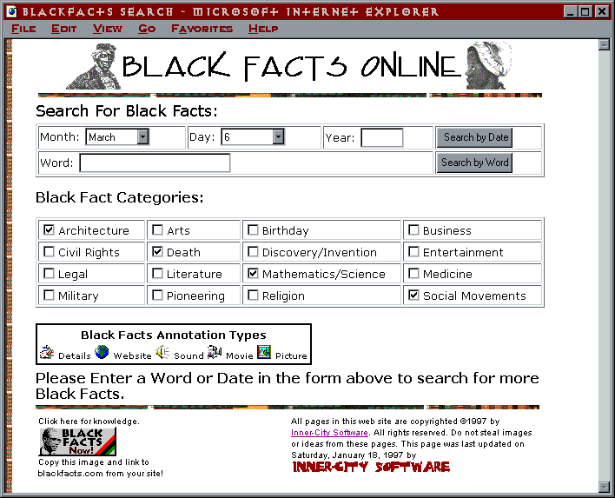

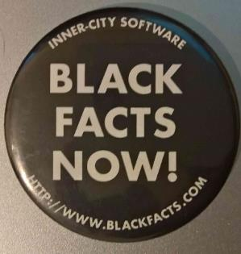
Blackfacts.com
1997
Historical Images / Presentations available at https://kengranderson.com - Videos on YouTube, available at https://links.blackfacts.com/inner-city-software
Notes:
After Microsoft bought FrontPage, I was helping so many people in the MS Developer FrontPage forums that they made me an MVP, and I have always guessed that I am probably Microsoft’s first Black MVP.
Being an MVP gave me access to all of Microsoft’s tools, including SQL Server. So I taught myself how to do database programming, and launched Black Facts Online for Black History Month 1997, with the goal of helping the Black online community see that they were fully included in this new Internet thing.

Slide 13

NSBE Annual Conference VB Presentation
1997
Presentation available as YouTube video at https://links.blackfacts.com/nsbe-1997 or as ppt from ken@blackfacts.com
Notes:
In 1997 I had the opportunity to do a presentation for the Annual Conference of the National Society of Black Engineers, where I demonstrated creating a simple Windows application in Visual Basic 4.
The folks at the local Microsoft office gave me three copies of VB Professional and Enterprise to give away as door prizes, which were some pretty nice door prizes!

Slide 14
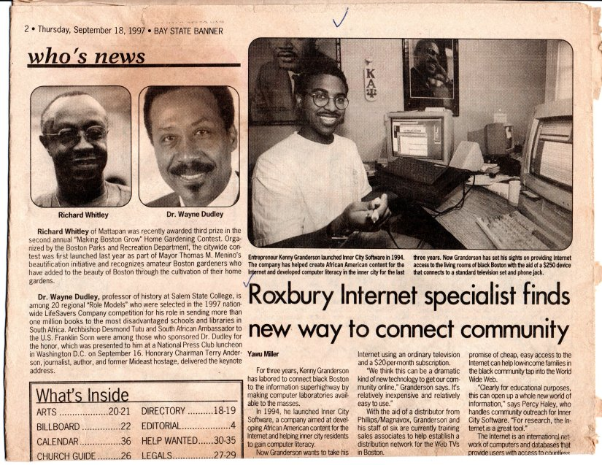
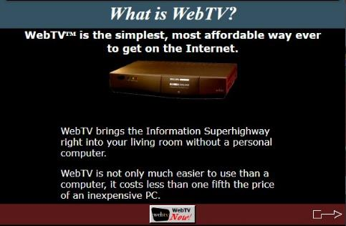
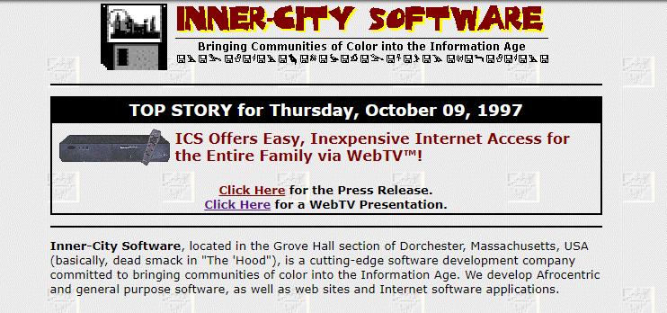
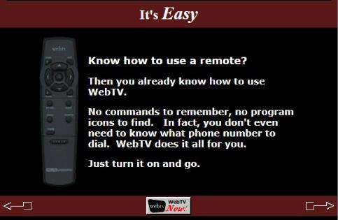

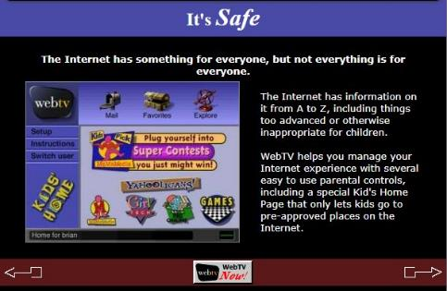
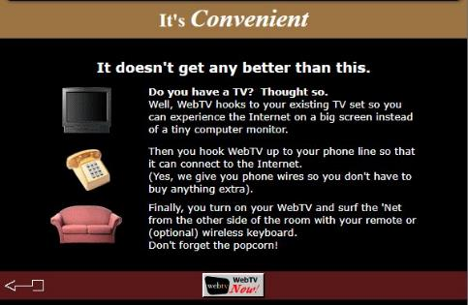
WebTV - Putting Folks Online for $139
1998
Our WebTV HTML Presentation is available on the Wayback Machine at https://links.blackfacts.com/webtv
Notes:
Later that year, a low-cost Internet access set-top box called WebTV put people online by connecting to their phone and TV set.
We promoted it in the Boston area as an easy and inexpensive way for folks to get online without having to afford a computer.
And it became even more affordable when guess who bought the company? Microsoft!

Slide 15
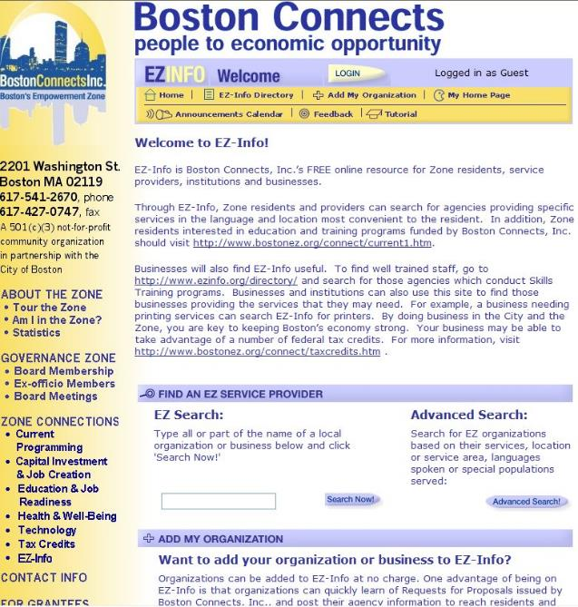
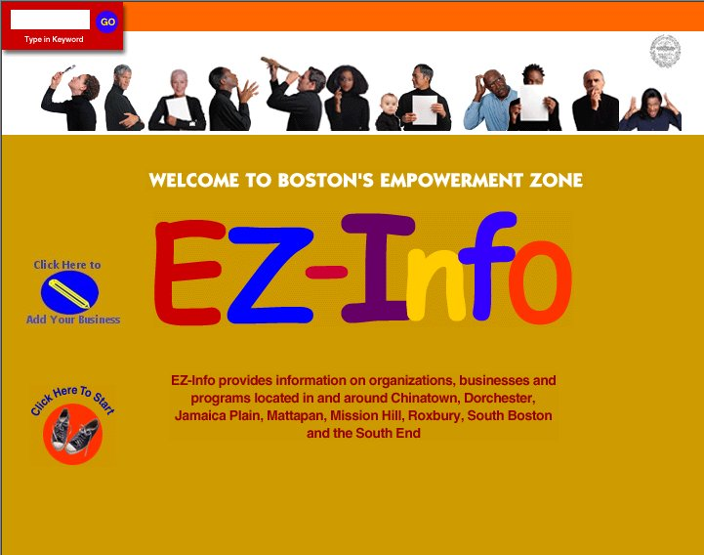
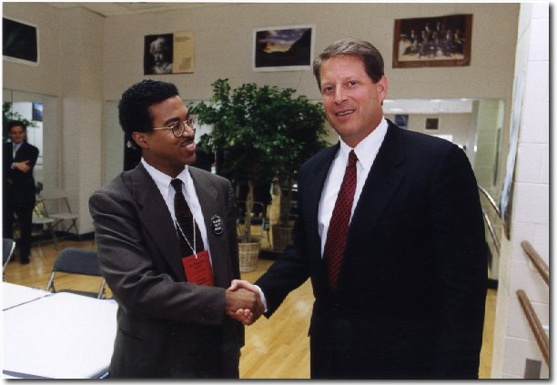
Boston’s Empowerment Zone
1999
Historical Images / Presentations available at https://kengranderson.com - Videos on YouTube, available at https://links.blackfacts.com/inner-city-software
Notes:
Around 1997 – 1999, I worked with Boston’s Empowerment Zone and built a Business Directory of all of the Empowerment Zone businesses.
The Empowerment Zones were a pet project of Vice President Al Gore, and I got to present it to him.

Slide 16
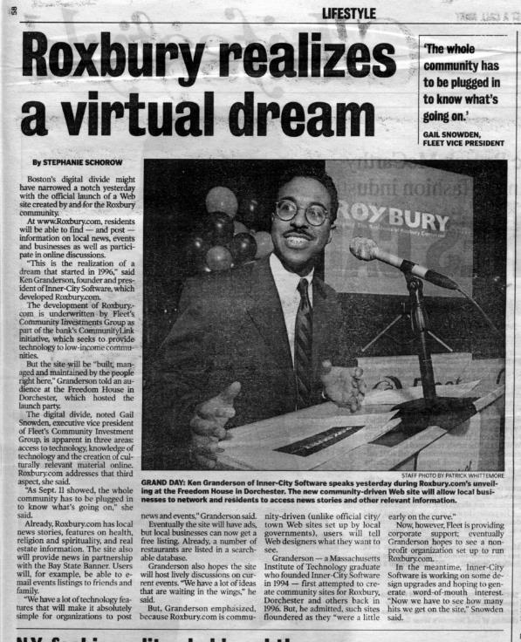
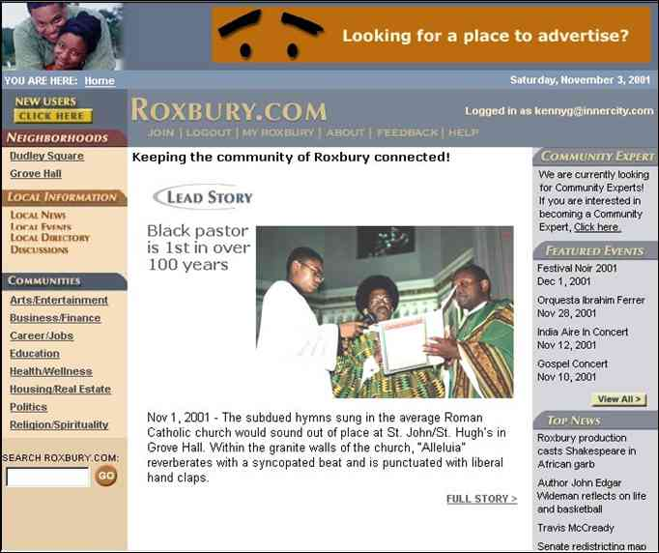
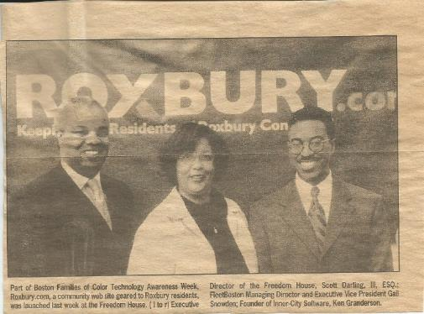
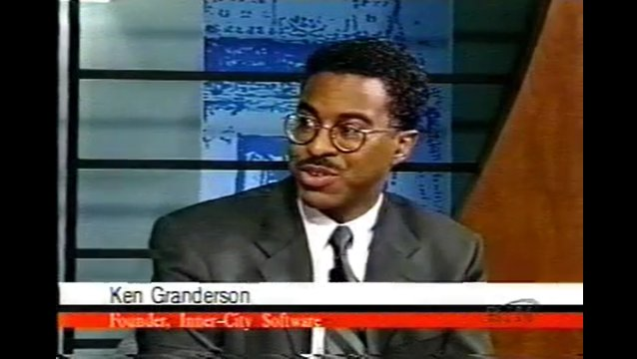

Roxbury.com
2002
Historical Images / Presentations available at https://kengranderson.com - Videos on YouTube, available at https://links.blackfacts.com/inner-city-software
Notes:
By 2000, I had a small staff, and taught them to do database web programming so that we could put our neighborhood online at Roxbury.com with local news, events, business listings, subject matter expert articles and community discussions.
Roxbury.com was the perfect solution for local Black banking executive Gail Snowden’s CommunityLink technology education and access project in Roxbury, as it gave graduates someplace relevant to go once they learned about computers and got a free family computer at graduation.
I negotiated a one-year sponsorship for Roxbury.com with Fleet Bank (now Bank Of America) for $150,000, which covered most of my payroll.
For local news, I built a custom newspaper publishing site for the Bay State Banner for free, in exchange for letting me pull news they posted into Roxbury.com

Slide 17

Roxbury.com
2002
Historical Images / Presentations available at https://kengranderson.com - Videos on YouTube, available at https://links.blackfacts.com/inner-city-software
Notes:
So here are some actual screen shots from Roxbury.com.

Slide 18








Roxbury.com
2002
Notes:
The Roxbury.com Home Page
Local News
Local Events
Event Details posted by a local organization from one of our weekly training sessions (this was 4 years before EventBrite)
Local Business Listings - 2 years before Yelp
Business Details
Community Experts - today would be called a Blog
Online Community Discussions – 2 years before Facebook, driven by my 6000 member strong email listserv Boston Blacks Online that I had been running since 1996

Slide 19




Roxbury.com
2002
Notes:
So this is what Boston’s Black community of Roxbury looked like online in 2002, powered by Windows NT, Internet Information Server 3.0 and SQL Server 2000.

Slide 20

Government of Saint Lucia Web Site
2013
Notes:
After Inner-City Software, I stepped back from doing my own projects for a while and worked with a smoking cessation web community, built a social network site, custom SMS text messaging platform and online recommendation engine for a longtime friend and associate who has created and purchased a few tech companies.
I also worked with Dale on several projects including a web-based scheduling and shop management system for barber shops and beauty salons, a web-based project management system for a major insurance company.
Around 2013, my former developer now in the UK, who is a native of Saint Lucia, was consulting for their government.
She (yes, I said SHE, who was one of my 3 developers in the 90s) connected me to the government, and I architected, built and stood up the official web site for the Government of Saint Lucia, which is running unchanged today.

Slide 21
Blackfacts Reboot
2017
New Look
New Platform
New Features
New Goals
Notes:
During this time, Black Facts was running on auto-pilot. Towards the end of every year, Dale and I would start thinking about next Black History Month and what would we do with it, and in 2017, we decided to reboot Blackfacts with a new look, a new platform providing new functionality, and new goals far more audacious than simply making sure that Black folks saw themselves reflected on the Internet.

Slide 22

What is BlackFacts.com?
BlackFacts.com: Putting Black Communities In Control of Our Stories
1
BlackFacts.com Creates Digital Tools for
Journalists
Educators
Activists
Historians
Civic Leaders
Faith Leaders
Business Leaders
2
To Publish Online Content that We
Categorize
Cross-Index
Syndicate
3
To Any Electronic Devices / Feeds, including
Web Browsers
Mobile Devices
Tablets
Email
RSS Feeds
Other Digital Displays
4
On Intellectual Property and Technology Infrastructure that
We Created
We Own
We Manage
We Control
We Protect
So that Never Again Will Others be able to Ignore, Overlook or Destroy the Record of our Achievements, Successes and Triumphs

Slide 23

Collecting Stories Digitally
Crawling the Web (BlackFacts Bots)
Social Media
Academics / Griots
BlackFacts Members
BlackFacts Legacy™
BlackFacts Griot™
Just get the Story to an electronic device, we’ll take it from there!

Slide 24

Organizing the Stories using AI
BlackFacts Uses our proprietary AI-aware Engine (code-named Timbuktu™) to Link Stories Based On:
People
Events
Places
Concepts
Keywords
Hashtags
Driving Features Like:
‘You May Also Like’
‘Also About Malcolm X’
‘The Black Church Throughout History’
‘Other Female Inventors’
‘Other Black LGBT Pioneers’
…etc.
Timbuktu™

Slide 25





Delivering Diversity Technology Everywhere
Our Widget solutions enable us to be THE source for Diversity Content (on the Web, via Email, Social Media & Podcast):
Widgets deliver Diversity Content to your Website.
Black History:
Daily Black History Facts updated automatically (https://blackfacts.com/widgets)
BlackFacts Minute™:
Unique Daily Black History Videos relevant to the specific date (https://blackfacts.com/blackfacts-minute)
Black News:
New Feeds (general or custom) of News from our “Wakanda” News Frameworks – Ticker, Lists, Scrolling Marquee, etc (widget page coming soon!)
Diversity Widget:
Delivering DEI focused Videos or News and Partner Content directly from our library. Topic Specific: Women, LGBT, Implicit Bias, Latino, Asian etc. (https://blackfacts.com/widgets/videos)
BlackFacts Podcast:
Enables our Followers to LISTEN to our stories Anywhere (https://blackfacts-daily-black-history.simplecast.com/episodes)

Slide 26




















BlackFacts.com Core Business Model
BlackFacts.com
BlackFacts
Content Bots
Content is organized via our proprietary Timbuktu™ Content Management System and external Artificial Intelligence APIs
Digital Griots
Mobile Web
Revenue Streams
Premium Membership
Premium Virtual Sites
Fact Widgets
School Sites
BlackFacts Legacy Sites
Corporate Sponsorship
Banner Advertising
Marketplace Affiliate Sales
Consumers
Any Site Visitor
Content Creators
Content Consumers
Polls & Quizzes
Associations
Associations and Schools
Historians
Push Notification
Consumers get BlackFacts content on any platform by visiting BlackFacts or Affiliate websites or receiving notifications via Email/Text/Social Media.
BlackFacts content is syndicated via BlackFacts Widgets hosted on affiliate sites and entire custom BlackFacts-driven partner sites.
Content is submitted by BlackFacts Users, Griots and our proprietary web crawlers, from online pages, social media sharing, uploaded documents and (in Year 2) media.
Sponsors / Advertisers / Vendors
While access is free to all, Premium Memberships, the Wakanda Marketplace and Banner Advertising generate BlackFacts’ Revenue

Slide 27

Wakanda Website
Administrative Tools Framework
Wakanda Business Incubator
(Startup In a Box)
Wakanda Site Admin Tools
Front-End Website Landing Page Options / Features (BASIC SITE)
Global Site Mgr
Global User Mgr
Page Builder Tool
Post Management
Carousel Plug-in
Single Page Site
Multi Page Site
HTML Plug-in
Video Plug-in
Wakanda A.I. (Machine learning via IBM Watson and Aylien)
List Plug-in
Included Website Components
Gallery Plug-in
Natural Language Process
Article Extractor / Content Aggregation
Content Indexing and Cross Referencing
Smart Search and Intelligent Agents/Bots
Survey Plug-in
Carousel
Plug-In
About Us / General Info
Blog Posts
Contact / Feedback Forms
Gallery Plug-in
Calendar Plug-in
Ads
Plug-In
Photos/Video Galleries & Lists
Event Calendar
News Feeds
Feedback Plug-in
Core Content Management Services (CMS)
Other Features
Included Back Office Components
Other Features
Structured Website
Branded Page(s)
(CSS)
Users/ Groups
Templates
Cloud Services Integration
Blog Posts
Time Tracker
Wiki
Polls
Cloud Services Integration
Multi Page Site
Features
Forms
Social Media Integration
Event Calendar
Announce-ments
File Manager
Projects & Tasks
Social Media Integration
Data
Tables
Admin
Tools
Built in Plug-Ins
eCommerce (Shopping Cart)
Users /Groups and Member Profile Management
eCommerce (Shopping Cart)
Front-End Web Landing Page(s)
Wakanda Shared Services
Discounts on Products/Services
Wakanda Shared Services
Discounts on Products/Services
Reports/
Activity Logs
Ads
Manager
Mail/ Chat Services
Jobs/ Internship Postings
Affiliate Programs
Reports/
Activity Logs
Ads
Manager
Mail/ Chat Services
Jobs/ Internship Postings
Affiliate Programs
Single Page Site
Shared Reward Programs
Integrated sales of products/services
Shared Reward Programs
Integrated sales of products/services
Data
Model
Security
Shared Content Widgets
News Feed
Data
Model
Security
Shared Content Widgets
News Feed
Diversity Showcase
Diversity Showcase
Business Automation Tools (Incubator)
Property Listing Widget
Property Manager
Tenant Manager
Product Manager
Appointment Scheduler
Service Request Manager

Slide 28

Questions? Ask Us!
Ken Granderson - Founder / Chief Technology Officer MIT alumnus and Tech Visionary, Creating Ethnic Technology since 1995, Creator of BlackFacts.com, Roxbury.com, Official Website of the Government of St. Lucia (https://kengranderson.com)
Dale Dowdie - Chief Executive Officer Enterprise-Level Technical Consultant / Entrepreneur Building Online Business Applications and facilitating Tech Transformation, Data Centers Buildouts and DR/BCP Strategies since the 1980s for Clients including, Harvard University, NASA, Multi-national Banks, Liberty Mutual, Staples, TJX, EDS, IBM, McCormick, MassHousing and the City of New York
ken@blackfacts.com 857-222-2318
ddowdie@blackfacts.com 781-858-6852

